Slide 1
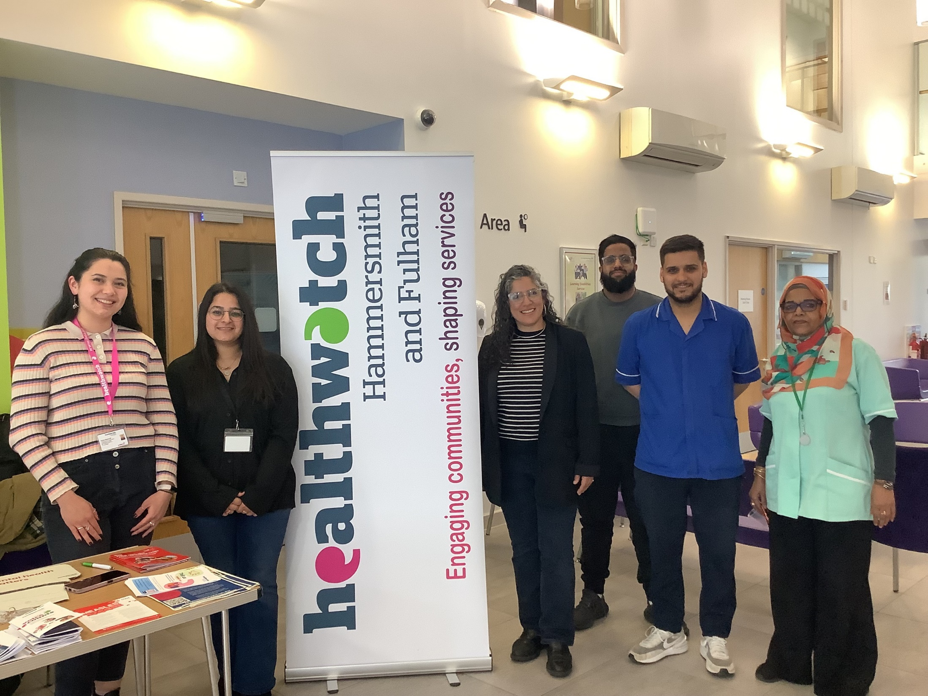


Healthwatch H&F -
Work Updates & Impact
Notes:
Thank you for inviting us + dedicating agenda to us!
Our aim for this session is to discuss with the partnership our ideas for the project work we would like to work on for this new year.
We already have ideas and would like to pitch them to you but we want to ensure that they ideally align our work with the Partnership’s priority delivery areas – including INT’s/Access, Mental Health and Tackling Inequalities, so when it comes to making recommendations based on resident and local service user feedback/insights, we can make our engagement as meaningful for residents and health services as possible. So we are on the same page, and ensure co-design/co-production space, to prioritise more patient involvement and hopefully lead to more service improvements.
Will quickly introduce/re-introduce ourselves, so everyone is on the same page here and knows what we do and what we're about
Recommendations from recent projects – discussion with Sue re. updates on our work
Project ideas
Discussion

Slide 2


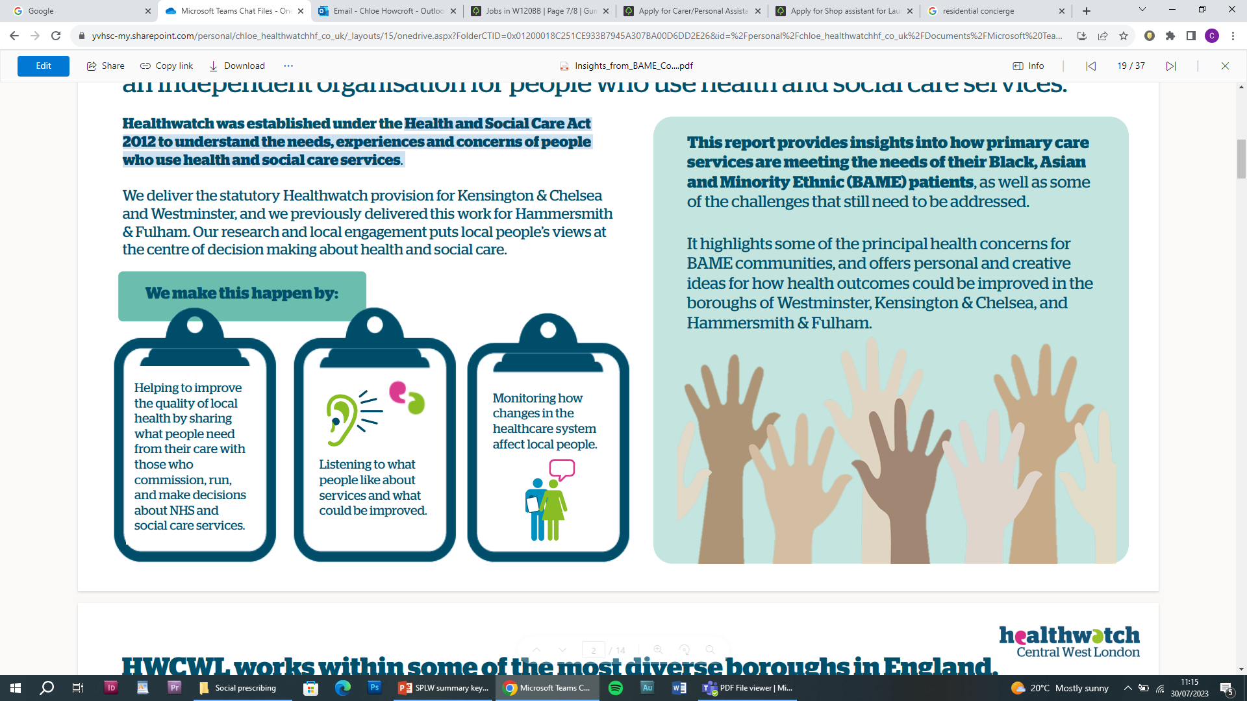

We are Healthwatch Hammersmith and Fulham
Healthwatch is a statutory service established by the Health and Social Care Act 2012 to understand the needs, experiences and concerns of people who use local health and social care services.
We are funded by the Local Authority (Council).
We are the independent voice for people who use NHS and publicly funded health and care services in Hammersmith and Fulham. Our research and local engagement puts local people at the heart of care and decision making about health and social care, to ensure that services are fit-for-purpose now and in future.
We make this happen by:
HFHCP Operational Delivery Group
Notes:
There are plenty of public/patient engagement mechanisms and feedback loops already. So, in this saturated public/patient engagement sea, what sets us apart... ^
We listen to, collect and represent the views of local people who share their views and opinions with us about the health and care services they use in order to meet their needs and ensure that they are involved in the design and improvement of these services and to improve health outcomes.​
We are your consumer champion for local health and social care services - The role of Healthwatch includes representing and championing the health and social care needs and experiences of adults and children in the borough, acting as an independent local voice ensuring that services meet the needs and remain high-quality and fit-for-purpose​
​
There is a local Healthwatch in every area of England – 153​
​
Part of national healthwatch network – to help improve health and social care policy and practice at a national level​
Different from local VCSE organisations who by and large don’t have statutory functions – but work closely with them​.
​
Healthwatch H&F- The Background​
​
The Local Authority has commissioned Your Voice in Health & Social Care (YVHSC) to deliver Healthwatch Hammersmith & Fulham. ​
​
YVHSC took over the provision of Healthwatch Hammersmith & Fulham on 1 April 2020. No longer part of the tri-borough.​
​
Your Voice in Health and Social Care (YVHSC) is a company limited by guarantee and a registered charitable organisation that gives people a voice to improve and shape services so they can get the best out of Health and Social Care provisions. ​
​
YVHSC currently deliver 6 Healthwatch contracts across London, including Hounslow and Ealing in NWL.​

Slide 3
How do we do this?
Patient Experience Programme, quarterly report – 1200 views per quarter
4‘Enter & View’ visits
2 deep dive research studies per year
Information and signposting service
Other engagement and outreach activities
Collaboratively!
“Healthwatch provides an invaluable service in collecting patient views and we share these with our patients – both the good and the bad. Their reports help us to shape our services to ensure we are doing our best to meet patient expectations. Healthwatch colleagues regularly come to the surgery to speak to our patients, who really seem to like having an opportunity to talk to them in an informal and safe environment. Sometimes patients might feel more relaxed about sharing their feelings with the Healthwatch team than with us. All in all, it’s a great way for the practice to get a temperature check on what patients are thinking – and a good opportunity for us to then adapt so that we keep on trying to improve.”
- Magnus Nelson (Ashville Practice Manager)
HFHCP Operational Delivery Group
Notes:
Collaboratively – i.e. part of ODG here, on the Health and Well-being Board and many other steering groups - get to that in a few minutes
Info & signposting – e.g. complaints
Outreach – still not a lot of people know who we are/what we do…

Slide 4

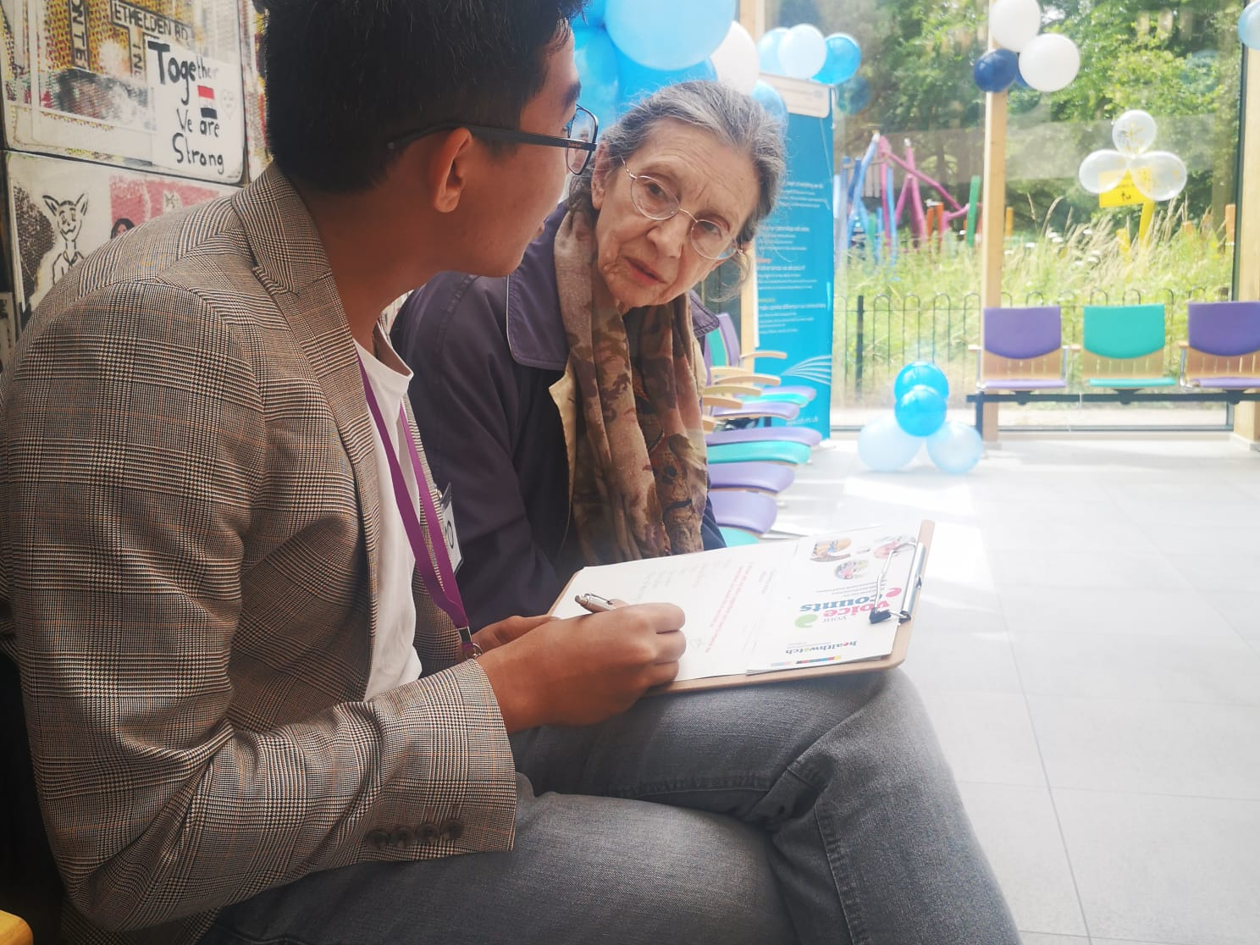
Our Impact- In a nutshell

Slide 5
How many recommendations have been implemented?
E&V
Chelsea & Westminster – 6 recommendations made, all were picked up by trust and have been implemented
Back on Track - The Hammersmith & Fulham Improving Access to Psychological Therapies (IAPT) service – 4 recommendations made- all fully implemented
Changes in GP Practices in North Hammersmith & Fulham Primary Care Network Post COVID- 7 recommendations – all fully implemented
Experiences of people living in Care Homes- 31 recommendations made, out of which 14 fully recommended, 5 Partially recommended, and 2 in progress.
Community Pharmacy – 10 recommendations made, 4 fully implemented, 3 partially implemented and 2 in-progress

Slide 6
How many recommendations have been implemented?
Deep Dive projects
Carers project (2021/22) - 6 recommendations, increasing awareness of available support and signposting them through our engagement
Young People's Mental Health During the COVID-19 Pandemic (2021/22)- 15 recommendations; Mental health support awareness especially for young people, parental support, increased support in school.
London Service Ambulance Service engagement (2021/22)- 6 recommendations; Waiting times, enhancing coordination between health and social care.
Mental health Inpatient Project – 81 recommendations (Since getting commissioned in 2022)
PATCHS (2022/23) – 4 recommendations; Digital access to promote patient engagements – improving patient education, freeing up phone line

Slide 7
How many recommendations have been implemented?
Deep Dive projects
Social prescribing in H&F (2022/23)- 9 recommendations; Improving referrals processes, multi-sector collaboration, and patient education.
NWL Vaccine project (2023/24) - 4 recommendations; Vaccine attitudes and uptakes- enhancing education, community outreach to address hesitancy
Cost of living and Health Project (2023/24)- 20 recommendations; Expanding outreach for public health, oral hygiene, affordable physical activities, improved mental health support and therapy access
Maternity experiences of ethnic minorities (2023/24)- 10 recommendations; Advocacy for better communication, post-natal support, and financial aid, improving maternity care inclusivity

Slide 8
Overall outreach
Through our engagement events and outreach initiatives, we have reached a significant number of residents, ensuring their voices shape local health services. Our work has also supported numerous volunteers in their efforts to improve community health.
Total People Reached: Healthwatch H&F workers and volunteers attended more than 527 meetings and engagements since fiscal year 2021 across the borough, resulting in more than 13,500 interactions with residents and providers.
Volunteers Supported: Since the 2021 fiscal year, we have had 167 volunteers who gave us 5201 hours of their time to help us complete our engagement work. This equals a total of 743 workdays. contributing to health and social care improvements.

Slide 9
Patient Experience,
Enter & View and Project Recommendations 2024/25

Slide 10
GP service recommendations
Recommendations | Potential Outcome | Potential Impact
Expand Online Booking Options – Improve appointment scheduling and provide clear guidance on NHS apps. | Patients can book appointments more easily without long call wait times. | Reduced frustration, improved access to GP services, and fewer missed appointments.
Reduce Waiting Times for Urgent Appointments – Optimise scheduling and expand telehealth services. | More patients receive timely medical attention. | Better health outcomes, reduced emergency visits, and increased patient satisfaction.
Implement a Call-Back System for Phone Appointments – Allow patients to request a call-back instead of waiting on hold. | Patients no longer need to endure long phone queues. | Improved patient experience, reduced stress, and better appointment accessibility.
Provide Clear GP Appointment Confirmations – Ensure appointment details include time, location, format, and the healthcare professional’s name. | Patients are well-prepared and informed about their appointments. | Fewer missed appointments and increased patient engagement.
HWHF Health & Wellbeing Board

Slide 11
GP service recommendations
Recommendations | Potential Outcome | Potential Impact
Improve Telephone Response Times – Reduce call waiting times by increasing reception staff or using automated systems. | Faster response times and improved communication. | Easier access to GP services and reduced frustration.
Provide Real-Time Updates on Waiting Times – Display estimated waiting times in GP surgeries. | Patients have realistic expectations about delays. | Reduced frustration and improved patient experience in waiting rooms.
Hospital service recommendations
Recommendations | Potential Outcome | Potential Impact
Improve Coordination Between GPs and Hospitals – Improve communication to ensure smoother referrals and follow-ups. | Fewer referral delays and reduced administrative errors. | Faster access to specialist care, improved patient trust, and better treatment outcomes.
Provide Clear Timelines for Test Results – Improve access through NHS apps, text notifications, or online patient portals. | Patients are informed about when to expect their results, reducing uncertainty. | Reduced patient anxiety, fewer unnecessary follow-ups, and improved efficiency.
HWHF Health & Wellbeing Board

Slide 12
Hospital service recommendations
Recommendations | Potential Outcome | Potential Impact
Reduce Waiting Times in Outpatient Clinics and A&E – Optimize triage, increase staff availability, and improve queue management. | Shorter wait times and better communication about delays. | Improved patient satisfaction and reduced pressure on emergency services.
Improve Hospital Waiting Areas – Provide comfortable seating, clear signage, and refreshments. | Patients feel more at ease while waiting. | Better patient experience, reduced discomfort, and increased satisfaction.
Increase Availability of Interpreters – Ensure translation services for non-English speakers, especially in A&E. | Patients can communicate effectively with healthcare providers. | Improved health outcomes, reduced miscommunication, and better inclusivity.
Improve Hospital Signage and Navigation – Add clearer, multilingual wayfinding signs. | Patients and visitors can find their way more easily. | Reduced stress, fewer missed appointments, and a smoother hospital experience.
HWHF Health & Wellbeing Board

Slide 13
Dental service recommendations
Recommendations | Potential Outcome | Potential Impact
Increase NHS Dental Appointments – Expand availability and ensure patients know how to access NHS dental services. | Patients can find and book NHS dental appointments more easily. | Reduced waiting times, better oral health outcomes, and improved accessibility.
Clarify NHS vs. Private Treatment Options – Provide transparent explanations of available treatments and associated costs. | Patients fully understand their treatment choices | Reduced financial stress and increased patient trust
Ensure Transparent Communication on Dental Costs – Require receptionists and dentists to explain treatment costs before procedures. | Patients are aware of all costs before treatment. | Fewer billing disputes and improved patient satisfaction.
Pharmacy service recommendations
Recommendations | Potential Outcome | Potential Impact
Improve Medication Availability – Strengthen supply chain management to ensure essential medicines are in stock. | Patients experience fewer delays in obtaining prescriptions. | Better medication adherence, reduced frustration, and improved health outcomes.
HWHF Health & Wellbeing Board

Slide 14
Pharmacy service recommendations
Recommendations | Potential Outcome | Potential Impact
Enhance Coordination Between GPs and Pharmacies – Improve prescription processing by integrating digital systems. | Prescriptions are handled more efficiently and accurately. | Reduced patient frustration and fewer prescription delays.
Train Pharmacy Staff for Better Medication Guidance – Ensure clear instructions on medication use, side effects, and interactions. | Patients understand how to take their medications safely. | Improved medication adherence and reduced risk of complications.
Improve Handling of Urgent Prescriptions – Designate staff to process emergency medication requests promptly. | Urgent prescriptions are processed more quickly. | Reduced health risks for patients needing immediate medication and increased trust in pharmacy services.
HWHF Health & Wellbeing Board

Slide 15
Enter and View Programme
Mandated by the Health and Social Care Act 2012, Enter and View visits enable trained Healthwatch staff and volunteers (Authorised Representatives) to visit and observe health and care services.
Focus of our 2024/2025 E&V: Outpatient services in hospitals used by Hammersmith and Fulham residents
Healthwatch Hammersmith & Fulham conducted Enter & View visits to Charing Cross Hospital, Hammersmith Hospital, and Chelsea and Westminster Hospital to evaluate the outpatient department experience for patients and staff.
The visits focused on key areas such as appointment letters, accessibility, signage, waiting times, patient-staff interactions, and overall facilities. The visits were prompted by previous patient experiences gathered through our Patient Experience Programme.
As part of our visits, we collected feedback from 52 patients and 20 staff members across the three hospitals.
Each hospital received a set of recommendations based on our findings, with responses requested to outline planned actions. For Charing Cross Hospital and Hammersmith Hospital, we are currently awaiting formal responses, which we expect to receive within the next few weeks.
HWHF Health & Wellbeing Board

Slide 16
Outpatient hospital services E&V Recommendations
Theme | Chelsea & Westminster Hospital | Hammersmith Hospital | Charing Cross Hospital | Implemented?
 |  |  |  | Chelsea & Westminster Hospital | Charing cross; Hammersmith Hospital
Signage and Navigation Issues | We recommend improving signage across all outpatient departments, ensuring consistency with appointment letters. | We recommend improving directional signage, particularly in corridors leading to outpatient clinics. | We recommend improving signage throughout the hospital, particularly for lift access to the outpatient department. | The hospital has developed a new signage plan with improved wayfinding, scheduled for implementation by late 2024. | TBC- Awaiting formal response
Appointment Communication challenges | We recommend standardising appointment letters to match hospital signage and including maps for better clarity. | We recommend reviewing the administration process for sending appointment letters, ensuring they arrive on time and include clear instructions | We recommend including visual maps and standardised terminology in all appointment communications. | The hospital is working with an internal team to align appointment communications with hospital wayfinding.
 | We recommend improving communication about appointment rescheduling and cancellations by providing timely SMS/email notifications. | - | Provide additional seating during busy times. | The hospital has expanded pre-appointment reminder calls and is reviewing administrative processes to reduce scheduling errors.
Waiting Time Transparency | - | - | We recommend implementing a queuing system with digital and audio updates to inform patients of delays.
HFHCP Operational Delivery Group

Slide 17
Outpatient hospital services E&V Recommendations
Theme | Chelsea & Westminster Hospital | Hammersmith Hospital | Charing Cross Hospital | Implemented?
 |  |  |  | Chelsea & Westminster Hospital | Charing cross; Hammersmith Hospital
Complaints procedure awareness | - | We recommend ensuring that complaints policies are displayed clearly in reception areas and that staff are trained to direct patients to the process. |  |  | TBC- Awaiting formal response
Accessibility and Disabled Patient support | We recommend expanding language support services, including translated documents and interpreter availability across outpatient departments. | We recommend increasing the number of disabled parking spaces and improving wayfinding for existing spaces. | We recommend displaying clear information on free parking for Blue Badge holders at the main entrance | Information sheets on available translation services are now displayed in all outpatient departments.
 |  | . | We recommend increasing awareness of WiFi access, accessibility features, and other patient services through visible signage.
Staff Wellbeing and Support | We recommend increasing staff wellbeing support, including mental health resources, debriefing sessions, and team check-ins | We recommend implementing regular wellbeing check-ins and ensuring staff have access to mental health support services. | We recommend implementing a staff wellbeing programme to provide additional support and reduce stress. | Outpatient teams now hold monthly meetings to address staff concerns and provide support.
HFHCP Operational Delivery Group

Slide 18
Project: Suicide prevention work
Recommendations | Predicted Outcome | Predicted Impact
Recommendation 1: Expand Peer-Led Support Groups: Establish community-based mental health groups where individuals can share experiences in a supportive environment. | Increased access to mental health support. | Reduced stigma and greater willingness to seek help.
Recommendation 2: Raise Awareness Through Campaigns: Use real-life recovery stories to challenge misconceptions and encourage early mental health intervention. | Increased public understanding and reduced stigma. | More people seeking support before reaching a crisis point.
Recommendation 3: Family Education Workshops: Provide training for family members to recognise early warning signs and support loved ones with mental health conditions. | Families become more effective in supporting mental health recovery. | Stronger social safety nets and fewer crisis situations.
Recommendation 4: 24/7 Mental Health Helplines: Expand crisis helplines to include text-based and chat support for those who struggle with verbal communication. | More immediate crisis intervention options | Reduced suicide risk and improved accessibility for individuals in distress.
HWHF Health & Wellbeing Board

Slide 19
Project: Suicide prevention work
Recommendations | Predicted Outcome | Predicted Impact
Recommendation 5: Fast-Track Mental Health Referrals: Ensure individuals showing crisis warning signs receive immediate assessments rather than waiting weeks for appointments. | Quicker access to mental health care. | Reduced risk of crisis escalation and suicide prevention.
Recommendation 6: Increase Drop-In Mental Health Services: Set up support hubs in community centres, faith-based institutions, and public spaces where people can seek help without formal referrals. | Easier access to early intervention and counselling. | Reduced strain on emergency services and improved mental health support in underserved communities. .
HWHF Health & Wellbeing Board

Slide 20
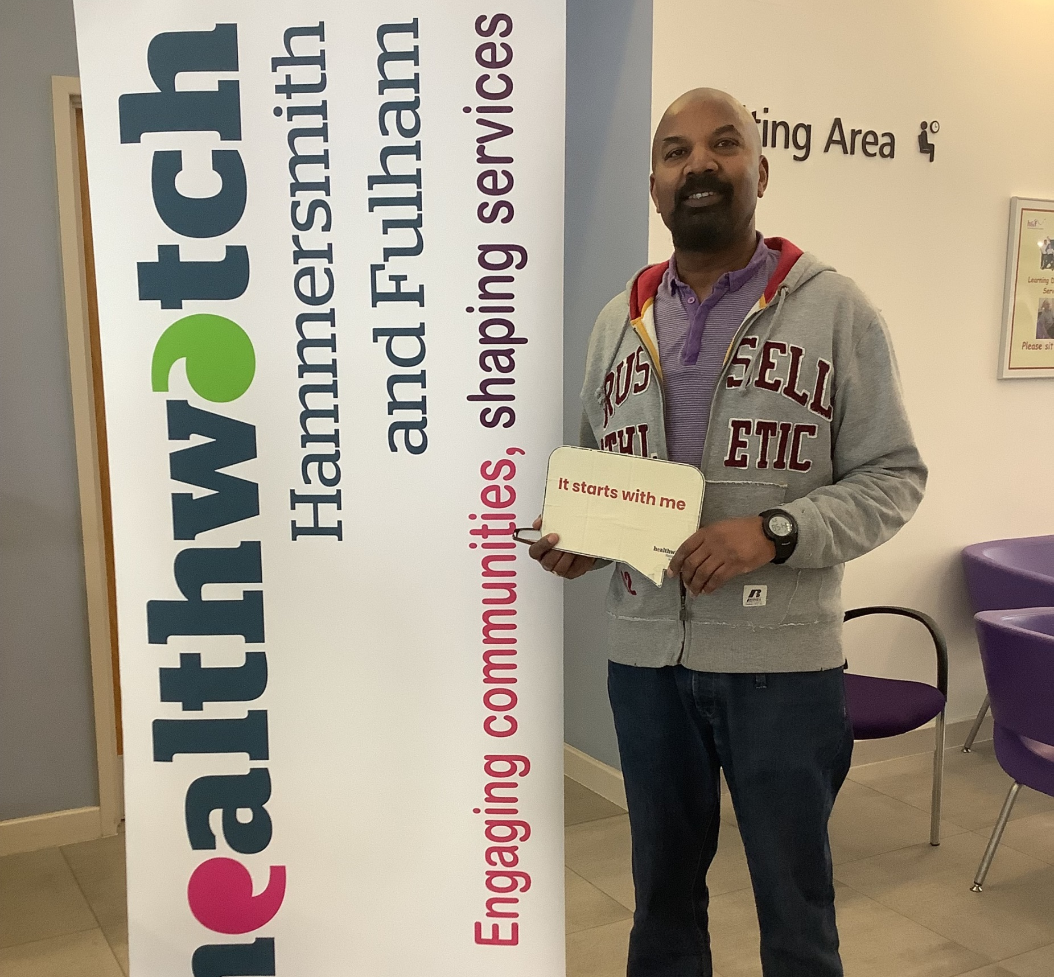
Engagement 2024/25
Notes:
We want to ideally align our work with the Partnership’s priority delivery areas – including INT’s/Access, Mental Health and Tackling Inequalities.
to improve our working relationship with system partners and stakeholders so we are all on the same page, when it comes to putting forth and implementing recommendations
And ultimately to improve how we can move work from collecting resident and local service user feedback/insights and move this into the co-design/co-production space, to prioritise more patient involvement and hopefully lead to some service improvements.
Idea > rationale – questions and discussion after

Slide 21
Mental health and Suicide Prevention engagement
Since 2022, we have engaged with inpatients at Lakeside and Hammersmith & Fulham Mental Health Units under the West London Mental Health Trust. Now in its third year, this project supports those facing suicidal thoughts, with over 125 inpatients reached since June 2024.
Since September 2024, we have hosted community events promoting mental health awareness, including suicide prevention initiatives. Collaborating with charities like MIND, The Listening Place, and Papyrus, we provided vital training and introduced mindfulness coaching for additional support.
Outcomes
Advocated for structured ward orientation, treatment plans, and community-building activities to improve patient experience.
Recommended improvements in safety, facilities, activities, meal diversity, and discharge planning.
Proposed peer-led support groups, family education workshops, crisis intervention services, and increased drop-in mental health support.
Trained Healthwatch teams in suicide awareness, enabling engagement with 100+ individuals to gather feedback and provide support.
Promoted mental health awareness and open conversations on suicide prevention, guiding individuals to appropriate services.
HWHF Health & Wellbeing Board
Notes:
Autism highlighted as an area of interest from recent engagement work

Slide 22
Mental health and Suicide Prevention engagement
Impact:
Shaped NWL suicide prevention strategies and influenced patient care improvements.
Strengthened mental health support networks and crisis intervention efforts.
Ensured those in need accessed vital resources and professional help.
HWHF Health & Wellbeing Board
Notes:
Autism highlighted as an area of interest from recent engagement work

Slide 23
Maternity Health Inequalities engagement
In 2023/24, we partnered with Healthwatch Brent to explore maternity care experiences in Northwest London, focusing on ethnic minorities, especially Black women. Through in-person engagements in Hammersmith & Fulham, we contributed to a borough-wide survey.
Findings were shared with key groups, including the H&F Inequalities Operations Subgroup and the Health Disparities Forum. We also advise Imperial’s Black Maternal Health Co-production project, sharing insights to shape its work.
Outcomes
Regular feedback from minority groups informs maternity service improvements.
Strengthened the case for maternity peer-support groups to provide emotional support and guidance.
Helped develop self-advocacy models and best practices for engaging ethnic minorities in maternity care.
Impact
Improved maternity care for ethnic minorities through continuous feedback.
Established peer-support groups, boosting community involvement in co-production efforts.
HWHF Health & Wellbeing Board
Notes:
Autism highlighted as an area of interest from recent engagement work

Slide 24
Vaccination hesitancy engagement 2021-2025
Healthwatch H&F has arranged numerous vaccination engagements since 2021. We actively participated in several NWL Immunisation & Vaccination Board meetings, offering insights into our vaccination engagements with residents. Specifically, we emphasized priorities regarding engagement with communities lacking trust or experiencing vaccine hesitancy.
In 2022-23, we conducted social media campaigns on monkeypox and polio. Our goal was to raise awareness about vaccinations for these conditions, empowering residents to make informed decisions about their health needs. Moreover, residents were encouraged to share their vaccination experiences, which were subsequently relayed to relevant stakeholders at NWL vaccination board meetings. We organised a vaccine community event aimed at educating parents about the polio vaccine for children. This initiative was followed by another social media campaign informing residents about vaccines available for school children. We provided guidance on accessing these vaccines and directed residents to relevant information sources, enabling them to make well-informed decisions.
In 2023-24, we continued our discussions regarding low vaccination rates among individuals from Black, Asian, and Minority Ethnic (BAME) communities. Additionally, we initiated a research project on vaccine hesitancy to comprehend the perspectives of local residents towards vaccination, along with identifying potential barriers and facilitators influencing uptake. Our focus was specifically directed towards children and young people aged 11-25 years.
HWHF Health & Wellbeing Board

Slide 25
In 2024/25 Healthwatch continues its efforts to tackle vaccine hesitancy among mothers and older people, with findings to be published after data collection.
Outcomes
Engaged 315+ residents and service providers, including 21 parents in a polio vaccine initiative and 202 responses from vaccine hesitancy research.
Research findings were shared with the NWL Immunisation and Vaccination Board, influencing policy recommendations.
A major insight revealed that clearer information from healthcare professionals increases willingness to vaccinate.
Findings supported a pilot MMR vaccine roadshow in collaboration with Parkview GP Surgery, NWL Roving Vaccine Team and local organisations.
Impact
The MMR vaccine engagement event reached 20+ young people, featuring an informational session by a nurse and a Q&A.
Surveys showed increased vaccine confidence, with many attendees expressing intent to vaccinate their children.
One hesitant parent and child were successfully persuaded to schedule a vaccine appointment.
HWHF Health & Wellbeing Board

Slide 26
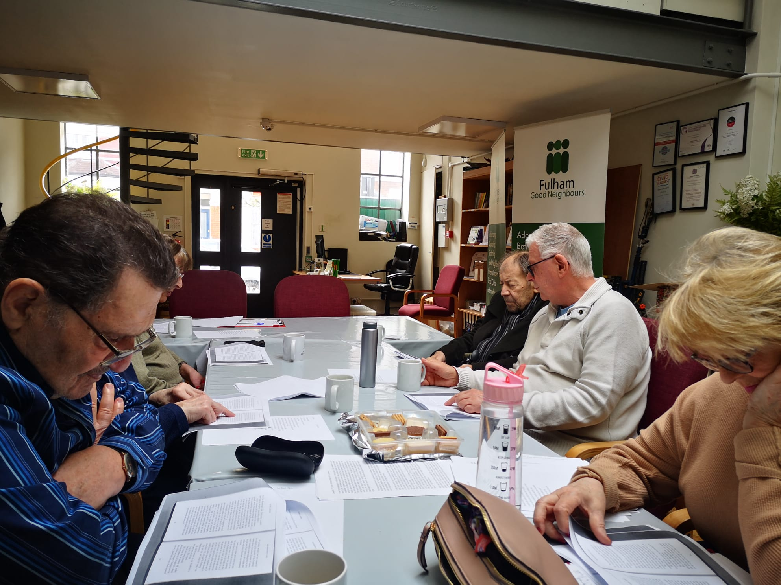
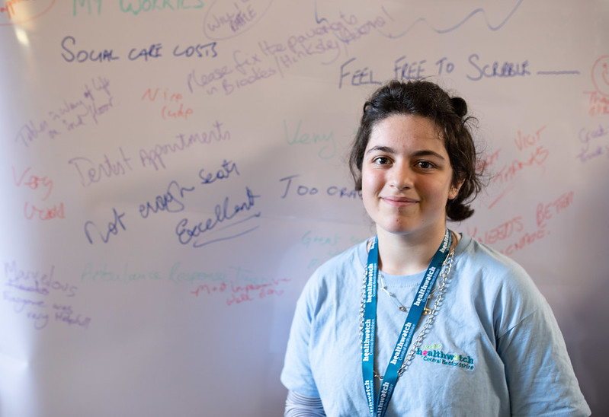
Any Questions?

Slide 27
Healthwatch Hammersmith & Fulham
141-143 King Street
Hammersmith
W6 9JG
www.healthwatchhf.co.uk
t: 0203 886 0386
e: info@healthwatchhf.co.uk
@HealthwatchHF
Facebook.com/HealthWHF
healthwatchhf
healthwatch-hammersmith-and-fulham
Get in touch!
Sign up to our mailing list:
https://tinyurl.com/healthwatchhfnewsletter
Notes:
Newsletter:
https://healthwatchhf.us19.list-manage.com/subscribe?u=5965ad46c12497d5201852331&id=457d66afbe

