Slide 1
PATIENT EXPERIENCE
REPORT 2020/2021
QUARTER 4
January-March

Slide 2
Contents
Hammersmith & Fulham Q4 | 2021
Introduction & Executive Summary
2
Our data explained
4
Overall Star Rating
5
Total Reviews per Service Category
8
Distribution of Positive, Neutral & Negative
9
Themes: GP, Hospital and Pharmacies
10
Other Positive Reviews
29
Other Negative and neutral reviews
32
Themes for Primary Care Network Area
36
9
48
Demographic Information
Conclusion
51
53
Action, impact and next steps
Appendix
55

Slide 3
Introduction & Executive Summary
Hammersmith & Fulham Q4 | 2021
Healthwatch was created by the health and social care reforms of 2012 with a powerful ambition of putting people at the centre of health and social care. To help realise this ambition Healthwatch has a number of duties around gathering and representing the views of patients and service users in the borough of Hammersmith & Fulham. In delivering these duties in Hammersmith & Fulham, we operate a comprehensive Patient Experience data collection programme. The successful and on-going implementation of the data collection programme and the Digital Feedback Centre will yield a minimum of 4,800 patient experiences per annum, all of which will be presented as they are received and considered as valid community opinion. Your Voice in Health and Social Care (YVHSC) took over the provision of Healthwatch Hammersmith & Fulham in April 2020. In April 2020, the Digital Feedback Centre was launched together with the Healthwatch Hammersmith & Fulham website. In May 2020, a part-time Patient Experience Officer was recruited to manage the Patient Experience Programme.
This is the fourth Patient Experience Report for Healthwatch Hammersmith & Fulham, covering the period from January to the end of March, 2021.
Normally, our Patient Experience Officer, supported by a team of volunteers, will visit health and social care services to talk to and hear from patients, service users, carers, and relatives about their experiences of local services. These patient experience comments and reviews are gathered using a standard form (see appendices). The form asks the patient for simple star ratings on their overall experience, likelihood to recommend a service, treatment, booking and a number of other areas. There is also a free text box where patients are asked to leave a review or feedback comments. We approach every patient, capture their experience in their own words and seek consent for their feedback to be published on the Healthwatch Hammersmith & Fulham website, through the Digital Feedback Centre. People can choose to leave their name or comment anonymously. At the end of each service visit, the Patient Experience Officer will relay any urgent matters requiring attention to the Operations Manager.
However, due to the COVID-19 social distancing measures put in place by the UK government, it was not possible to carry out our traditional face to face visits to engage with patients and collect patient experience feedback during this quarter. Therefore, to adapt to these challenging new circumstances, we developed and introduced a new model for our Patient Experience Programme. This involved direct engagement over the telephone, the collection of feedback via our Zoom engagement sessions, the collection of feedback via the NEXTDOOR APP and collecting and collating existing online reviews from relevant platforms such as NHS.uk and Google reviews. This new approach has benefited residents through additional provision of information and signposting and a level of befriending for many of those contacted over the telephone.

Slide 4
Introduction & Executive Summary cont.
Hammersmith & Fulham Q4 | 2021
In addition, we have worked extensively to promote our new service across the borough, driving direct reviews to our website for those with the ability to access the internet and have distributed paper feedback forms and Freepost return envelopes via Foodbanks, Pharmacies, GP surgeries and other groups and networks. We were also able to have our Widget on thirteen GP websites, Imperial Healthcare NHS Trust and other community and voluntary sector organisation websites. As our service becomes further embedded across the borough, we expect greater awareness of our service and a subsequent increase number of reviews made directly through our website or by calling the office to feedback.
Whilst we aim to gather patient experience comments and reviews from a representative sample of the population of Hammersmith and Fulham, we acknowledge that different people use different services at different times in their lives, and some not at all. Whilst all patients are asked for their monitoring information some do not wish to provide this. In support of our efforts to ensure feedback from all sections of the community, we recruit Patient Experience Volunteers who speak additional languages.
The outreach element of our Patient Experience Programme is supplemented by our community engagement work and our website (www.healthwatchhf. co.uk), which people may visit independently to provide service feedback and comments. Our questions are uniform across the Digital Feedback Centre as well as the physically collected forms.
This report covers the Quarter 4 period, January – March 2021. During this time, we collected 1218 reviews, achieving our quarterly target of 1200.
Out of the total number of patients experiences received
957 (78%) were positive with a star rating of 4-5,
94 (8%) were neutral with a star rating of 3, and;
167 (14%) were negative with a star rating 1-2 (this is based on the overall star rating provided by patients - see page 4 for further detail).
Alongside our Patient Experience work reported here, Healthwatch Hammersmith & Fulham carries out a number of different activities in order to hear from patients, carers and relatives and assess health and social care services from the patient’s perspective.

Slide 5
Our data explained
Hammersmith & Fulham Q4 | 2021
Healthwatch Hammersmith & Fulham uses a Digital Feedback Centre (on our website) and Informatics system (software sitting behind the Digital Feedback Centre) to capture and analyse patient experience feedback.
The Informatics system is currently used by approximately 1/3 of the Healthwatch Network across England and it captures feedback in a number of ways:
It asks for an overall star rating of the service, (between 1-5).
It provides a free text box for comment
It asks for a star rating against specific domain areas, (between 1-5).
In terms of reporting, the above provides Healthwatch with several data sets. Star ratings provide a simple snapshot average, both overall and against specific domain areas. When it comes to the free text comment box, this is analysed in two different ways resulting in two different data sets:
In the first instance, free text comments are broken down and analysed for themes and sub themes. Where relevant, up to 5 themes and sub themes can be applied to any one patient experience comment. Upon each application of a theme or sub theme, a positive, negative or neutral sentiment is also applied. This is a manual process undertaken by trained staff and specially trained volunteers. The process is overseen by the Patient Experience Officer and regularly audited in order to ensure consistency. Where themes and related sentiments are discussed in the report, it relates to this aspect of the process.
Each of the areas described above provides an independent set of results which can be viewed separately or in conjunction with one another in order to gain an insight into a service or service area. It is important to note that correlation between different data sets may not be apparent, for example, a service may have an overall star rating of 4/5 but much lower ratings against individual domain areas.

Slide 6
Overall Star Ratings
Hammersmith & Fulham Q4 | 2021
The table below shows a breakdown of the negative, neutral, and positive patient reviews (see the appendices for examples of our physical and online questionnaires). Each patient is asked to give an overall rating out of 5 stars for a service. Star ratings of 1 and 2 indicate a negative response, a star rating of 3 indicates a neutral response and star ratings of 4 and 5 indicate a positive response.
It is important to note that our experience has shown that people are very reluctant to give a negative rating of their care provider. When the 3* 'neutral' ratings are analysed in more detail we have traditionally found these to outline negative feedback. Therefore, where a significant number of 3* ratings are found, our experience tells us these areas are worthy of further attention to help identify areas for improvement. This quarter 957 positive responses, 167 negative responses and 94 neutral responses have been recorded.
Month | 1 – 2 Star Reviews (Negative) ★ ★ ☆ ☆ ☆ | 3 Star Reviews (Neutral) ★ ★ ★ ☆ ☆ | 4 - 5 Star Reviews (Positive) ★ ★ ★ ★ ★
January | 55 | 32 | 318
February | 41 | 32 | 336
March | 71 | 30 | 303
Total | 167 | 94 | 957

Slide 7
Overall Star Ratings
Hammersmith & Fulham Q4 | 2021
This chart provides a breakdown of negative, neutral, positive and total reviews for each month, based on the overall star rating provided.

Slide 8
Overall Star Ratings
Hammersmith & Fulham Q4 | 2021
These pie charts show the breakdown of star ratings for each month and for the whole quarter.
In each month the 5-star rating received the highest proportion of reviews, followed by the 4-star rating and 1-star rating.
In three months, the 5-star rating received almost 2/3 of the reviews.
The overall star ratings for services tell us that people are very satisfied.

Slide 9
Total Reviews per Service Category
Hammersmith & Fulham Q4 | 2021
The patient reviews recorded for this quarter cover 12 service categories, as seen in this chart.
The category with the highest number of reviews recorded was for GPs (402), followed by Dentists (279), Pharmacies (222), and then Hospitals (141).
For this quarter, the number of reviews for GP surgeries have increased significantly by 102 compared to Q3. This is likely due to our new presence on the NEXTDOOR app.
We were able to collect approximately 100 reviews per month for GP and Hospital services via the NEXTDOOR app and will, therefore, continue to promote our work using this method of engagement. Furthermore, we successfully signposted several patients/service users via NEXTDOOR.
Type of services
Number of reviews

Slide 10
Distribution of Positive, Neutral & Negative
Hammersmith & Fulham Q4 | 2021
This bar chart compares the number of positive, neutral and negative reviews for each category. This is based on the overall star rating.
33% of the reviews were about people's experiences of GP services, an increase of 7% from last quarter.
23% of the reviews were about people's experiences of Dentists, a decrease of 5% from last quarter.
18% of the reviews were about people's experiences with Pharmacies, an increase of 6% from last quarter.
12% of the reviews were about people’s experiences with Hospitals, a decrease of 4% from last quarter.
Other comments were about Opticians, COVID-19 Services, Community Health Services, Mental Health Services, Residential Care and Social Care.
Of these services:
Dentists received the highest proportion of positive reviews at 90%, followed by Pharmacies with 85%, Hospitals with 77% and GPs with 63%. There was an increase of 2% in the proportion of positive reviews from GPs for this quarter. Throughout the year, we have noticed that the GP service category received the lowest proportion of positive reviews compared to the other service categories where we have received a significant numbers of reviews.
Type of services
Number of reviews

Slide 11
Themes and Sub-Themes
Hammersmith & Fulham Q4 | 2021
After asking patients for an overall star rating of the service we ask them to "tell us more about your experience" – (see the appendices for examples of our physical and online questionnaires), each comment is uploaded to our Online Feedback Centre where up to five themes and sub-themes may be applied to the comment (see appendix 3 p59-61 for a full list). For this reason, the total numbers of theme-counts will differ from the total number of reviews for each service area. For each theme applied to a review, a positive, negative, or neutral 'sentiment' is given.
The application of themes, sub-themes and sentiments is a manual process and differs from the star rating patients provide.
This section shows a breakdown of the main themes and sub-themes for those service areas where we received a significant number of reviews.
In Q4 these areas are:
GPs
Hospitals and:
Pharmacies

Slide 12
GP Themes and Sub-Themes
Hammersmith & Fulham Q4 | 2021
Administration remains one of most applied themes for GPs this quarter. The theme was applied on 448 counts, with 53% (n.237) of these being positive, 6% (n.27) being neutral and 41% (n.184) were negative.
Booking an Appointment was one of the most popular sub-themes within this service category attracting 140 responses. Of these responses, 49% (n.69) were positive, 2% (n.3) neutral and 49% (n.68) were negative, with the negative reviews largely caused by patients being unable to book an appointment. Patients/service user continue to have issue accessing their GPs due to the pandemic. On a more encouraging note, 70% (n.115) of the 164 reviews which discussed Management of Service, mentioned it in a positive context.
For the Appointment Availability sub-theme, there were 41 counts of which, 56% (n.23) were positive, 3% (n.1) neutral and 41% (n.17) were negative. Patients\service uses are struggling to obtain a suitable appointment. The majority of the reviews relating to the sub-theme Getting through on the telephone were negative in sentiment with 77% (n.60) being negative, caused by patients not being able to speak to the receptionist on the phone when trying to book an appointment or ask for advice.
Positive reviews
“I am very happy with this app, can easily book an appointment to speak to a doctor.”
GP Surgery
“You can book and visit the practice on the same day, very efficient.”
GP surgery
Sub-themes
Negative reviews
“Difficult to get an appt, have to wait weeks to be seen.”
GP surgery
“Getting an appointment is not easy, I was trying to speak to the receptionist but could not get through.”
GP surgery
Number of reviews

Slide 13
GP Themes and Sub-Themes
Hammersmith & Fulham Q4 | 2021
In this quarter, Staff was the second most applied theme for GPs. It received 201 reviews: 77% (155) were positive, 2% (4) were neutral and 21% (42) were negative.
The chart below presents a more detailed breakdown, featuring the top two sub-themes for the Staff theme.
The majority of reviews focused on the sub-theme Attitude, with 77% of the reviews being positive. This shows that the majority of patients are satisfied with the attitude of the receptionists and doctors at their GP surgery.
Positive reviews
“Excellent treatment, staff are nice and helpful.”
GP surgery
“Overall very professional doctors and nurses that made the experience pleasant. Easy to talk to.”
GP surgery
Sub-themes
Negative / Neutral reviews
“…Rude receptionist- they are not helpful.
GP surgery
“…When I spoke to the receptionist she told me that I was lying and was unhelpful and dismissal.”
GP surgery
“The reception, however, could be more helpful..”
GP surgery
Number of reviews

Slide 14
GP Themes and Sub-Themes
Hammersmith & Fulham Q4 | 2021
Treatment of Care was the third most applied theme for GPs this quarter. It received 169 reviews with 71% (n.120) being positive, 5% (n.8) neutral and 24% (n.41) being negative.
The chart below shows the top five sub-themes for the Treatment and Care theme for GPs.
The sub-theme Experience received the highest proportion of feedback with a positive sentiment of 75% (n.82).
The second highest area of review for this theme is the Quality of Care sub-theme, which received 65% of positive reviews, lower compared to the previous quarter. Treatment Explanation and Effectiveness sub-theme also receive largely positive reviews.
Positive reviews
“Great experience. I have been a patient for many years and I am very happy with the service.”
GP surgery
“I had my COVID-19 vaccination today and wanted to say how brilliantly it was all organised. All the staff and co-ordinating assistants were helpful, friendly and efficient.”
GP surgery
Sub-themes
Negative/ Neutral reviews
“Disgusting! Incorrectly diagnosing cancer and that person living every day thinking that they do. Awful care.”
GP surgery
“There is only one doctor that is good. All the rest they are not.”
GP surgery
Number of reviews

Slide 15
GP Themes and Sub-Themes
Hammersmith & Fulham Q4 | 2021
Access to Services was the fourth most applied theme for GPs this quarter. It was applied 73 times with the majority of reviews relating to the sub-theme Waiting Times. This sub-theme was identified in 51 reviews with 41% (n.21) being positive, 8% (n.4) neutral and 51% (n.26) negative.
Over half of the reviews belonging to Waiting Times had a negative sentiment, indicating that patients have to wait a long time for their appointment.
On a positive note, 41% of the reviews had a positive sentiment.
Positive reviews
‘‘Great service, always fast access to lovely GPs and nurses.”
GP surgery
‘‘Called at 8am as advised by the reception team and was able to speak to a GP over the phone that day. The very helpful reception team and GPs. Quickly and efficiently sorted out my issue.
GP surgery
Sub-themes
Negative / Neutral reviews
‘‘Difficult to get an appointment, have to wait weeks to be seen”
GP surgery
‘‘It is not easy to book an appointment, and there is a very long wait.”
GP surgery
Number of reviews

Slide 16
Positive, Negative, Neutral and Total reviews for each Hospital
Hammersmith & Fulham Q4 | 2021
During this quarter we collected reviews covering a number of different hospitals. This section shows a breakdown of the main themes and sub-themes for the hospitals under the Imperial College Healthcare NHS Trust and Chelsea and Westminster Hospital NHS Foundation Trusts. These hospitals are:
Charing Cross Hospital: Out of the total reviews for the quarter (n.48), 60% (n.29) were positive, 11% (n.5) neutral and 29% (n.14) negative.
Hammersmith Hospital: Out of the total reviews for the quarter (n.18), 88% (n.16) were positive, (6% (n.1) neutral and 6% (n.1) negative.
St Mary’s Hospital: Out of the total reviews for the quarter (n.22), 73% (n.16) were positive, 9% (n.2) neutral and 18% (n.4) negative.
Queen Charlottes and Chelsea Hospital: Out of the total reviews for the quarter (n.10) , 90% (n.9) were positive and (10% n.1) negative.
Western Eye Hospital: Out of the total reviews for the quarter (n.9), (45% n.4) were positive, (33% n.3) neutral and (22% n.2) negative.
We have also looked at surrounding hospitals that most of our residents attend which are part of the Chelsea and Westminster Hospital NHS Foundation Trust. These hospitals are:
Chelsea & Westminster Hospital: Out of the total reviews for the quarter (n.13), 38% (n.5) were positive, 31% (n.4) were neutral and 31% (n.4) were negative.
West Middlesex University Hospital: No reviews collected for this quarter.
Other hospitals
The Royal Marsden: No reviews collected this quarter
Royal Brompton Hospital: A total of 4 reviews were collected this quarter.
In the next section we identify leading positive and negative themes at individual hospital sites and look in more detail at overall themes and sub-themes for each Trust. For this quarter these are Imperial College Healthcare NHS Trust and Chelsea and Westminster Hospital NHS Foundation Trust.

Slide 17
Summary of themes for each hospitals
Hammersmith & Fulham Q4 | 2021
Charing Cross Hospital:
During this quarter, the reviews for Charing Cross Hospital were overwhelmingly positive. The feedback showed that patients/service users were satisfied with the Treatment and Care they received at the hospital. In addition, they were also happy with staff attitude and the professionalism of the staff.
Access to Service received more balanced feedback, with half of the reviews being in support of current practices. However, some issues around Waiting Times were identified including, some patients having to wait longer for their appointments and others having their appointments postponed or cancelled all together. Over 60% of the reviews belonging to the Administration theme were positive, however, 24% of the reviews were negative. The main issues still remain around the sub-themes of Booking appointment and Appointment availability, indicating that patients are struggling to obtain an appointment at the hospital.
Themes
Number of reviews
Themes
Hammersmith Hospital:
Similarly to last quarter, Treatment and Care and Staff have been the themes with the most positive sentiment reviews. It indicates that patients/service users are happy with the quality of care they received at this hospital.
Overall, the reviews for Access to Services at Hammersmith Hospital over the last three quarters have been positive.
Number of reviews

Slide 18
Summary of themes for each hospitals
Hammersmith & Fulham Q4 | 2021
St Mary’s Hospital:
The reviews belonging to St Mary's Hospital have been largely positive this quarter. The theme Treatment and Care had the highest proportion of feedback with a positive sentiment.
The reviews related to the Staff and Administration themes were also mostly positive.
Sub-themes
Number of reviews
Queen Charlottes and Chelsea Hospital:
The reviews belonging to Queen Charlottes Hospital have been overwhelmingly positive this quarter, with all the reviews belonging to the Treatment and care and Staff themes being positive.
Sub-themes
Number of reviews

Slide 19
Summary of themes for each hospital
Hammersmith & Fulham Q4 | 2020
Western Eye Hospital:
The reviews belonging to Western Eye Hospital have been overwhelmingly positive this quarter. The theme Treatment and Care had the highest proportion of feedback with 83% of the reviews being positive in sentiment.
Sub-themes
Number of reviews
Chelsea and Westminster Hospital:
The reviews belonging to Chelsea and Westminster Hospital have been positive. Similarly to last quarter, the numbers of positive reviews remained low.
The Administration theme has a more balanced outlook between positive and negative reviews.
Over 60% of the reviews related to the Treatment and Care theme were positive as most patients/service users were satisfied with the quality of care that they received at the hospital. However, over 30% of the reviews were negative. The majority of the reviews belonging to the Access to services theme were negative.
Sub-themes
Number of reviews

Slide 20
Themes and Sub-Themes for Imperial College NHS Trust
Hammersmith & Fulham Q4 | 2021
Treatment and Care was one of the leading themes for Imperial College NHS Trust this quarter, with 68 comments highlighting this area. These reviews have been largely positive, as 84% (n.57) of patients/service users expressed their satisfaction, with 3% (n.2) neutral in sentiment and only 13% (n.9) negative in sentiment.
The chart underneath presents a breakdown of the sub-themes for Treatment and Care.
The sub-theme Experience had the highest proportion of feedback with a positive sentiment with 88% (n.28). In addition, the reviews belonging to the sub-theme Quality of Care have been overwhelmingly positive with 100% (n.10) being positive. The Treatment Explanation theme also received a predominantly positive sentiment.
Positive reviews
“I had a great experience, the staff were all nice, the doctor was very good as he explained my treatment well.”
Outpatients
“I had a prostate operation and it was a success.”
Cancer department
Sub-themes
Negative reviews
“…he said he wasn't prepared to treat her as she had gone privately. The treatment received at Charing Cross exacerbated my late wife’s fears..”
Outpatient
“My wife was referred to the Oncology department, where she suffered from lousy odds, poor communication and information being continually missed..”
Oncology department
Number of reviews

Slide 21
Themes and Sub-Themes for Imperial College NHS Trust
Hammersmith & Fulham Q4 | 2021
Administration was our second most popular theme for the Imperial College NHS Trust this quarter. It received 50 patient reviews, with 70% (n.35) being positive, 10% (n.5) being neutral and 20% (n.10) being negative.
The chart below presents a breakdown of the top two sub-themes for the Administration theme. Management of service was by far the most frequently mentioned sub-theme with two-thirds of the reviews focusing on this area. Moreover, Management of service received overwhelmingly positive comments, as 31 out of 37 of the reviews have been left by patients positively commenting about the management of the service at the hospital.
Positive reviews
“Good service, my mum is always very well looked after.”
Outpatient department
“After seeing my doctor he suggested I go for a blood test, it was very easy, I was able to book an appointment for the same day.”
Blood test department
Sub-themes
Negative / Neutral reviews
“I had 39 GP appointments because I fell through the hospital system. Endless waiting, cancellations. Have severe respiratory illness, NHS REFUSED to treat or see me.”
Outpatient department
“Waited for pre-planned phone consultation it did not happen impossible to ring the number back and now have to wait 6 months for next appointment .”
Outpatient department
Number of reviews

Slide 22
Themes and Sub-Themes for Imperial College NHS Trust
Hammersmith & Fulham Q4 | 2021
Staff was our third most common theme for Imperial College NHS Trust this quarter, with 46 patient reviews referencing this theme. In total, 93% (n.43) were positive, 3% (n.1) were neutral and just 4% (n.2) were negative. It also had the highest proportion of positive reviews out of all the main themes related to hospitals services.
The chart below presents a breakdown of the top two sub-themes for Staff. Staff Attitudes was by far the most frequently mentioned sub-theme, with approximately two-thirds (76%) of the reviews (n.35) within the Staff theme focusing on this area. Moreover, Staff Attitudes received overwhelmingly positive comments, as 32 out of 35 of reviews have been left by patients positively commenting on the hospital staff.
Positive reviews
“Excellent doctors and nursing staff. Blood tests provided on time. Queue times are low. Management are fantastic in flow of patients.”
Outpatients department
“Could not thank the hospital enough for their treatment, the staff members are very respectful and kind.”
Outpatient department
Sub-themes
Negative / Neutral reviews
“Was seen by a member of staff who made me feel uncomfortable and an inconvenience. I was absolutely horrified by the way he spoke to me.”
Outpatient department
“The doctor was rude to me, they are horrible.”
Outpatient department
Number of reviews

Slide 23
Themes and Sub-Themes for Imperial College NHS Trust
Hammersmith & Fulham Q4 | 2021
On this occasion, Access to Services was our fourth most popular theme, with 26 patient reviews focusing on this area. Out of the total number of reviews containing this theme, 58% (n.15) were positive and 42% (n.11) were negative. Similarly to the last three quarters, out of the main themes, Access to Services was the theme that had the lowest proportion of positive reviews.
The chart below presents a more detailed breakdown of the top two sub-themes for Access to Services. Unsurprisingly, the sub-theme related to Waiting Times was most frequently discussed with the majority (n.24) of all Access to Services issues focusing on this topic. In addition, Waiting Times contributed the highest number of reviews with a similar amount of positive and negatives reviews, suggesting that many patients/service users are having to wait a long time for their appointment.
Positive reviews
“On the day of my appointment it was very quick and I did not wait and I was happy with the explanation.” Outpatient department
“It was fine, very efficient, I went on Sunday and was seen very quickly.”
Urgent Care
Sub-themes
Negative reviews
“Before the pandemic, I needed an appointment to see a consultant but I had to wait a long time for the appointment. I ended up going privately.”
Outpatient department
“You can die waiting for your appointment in the corridor. Very long wait.”
Outpatient department
Number of reviews

Slide 24
Themes and Sub-Themes for Chelsea and Westminster NHS Foundation Trust
Hammersmith & Fulham Q4 | 2021
Treatment and Care was one of the leading themes for Chelsea and Westminster NHS Foundation Trust Hospitals this quarter, with 19 comments highlighting this area. This quarter, there has been a decrease in the number of positive reviews that we received, compared to quarter 3. Nevertheless 58% (n.11) of the reviews mentioning Treatment and care were positive.
The chart below shows the top two sub-themes for the Treatment and Care theme.
The sub-theme Experience was the most frequently mentioned with 13 counts. Of these, 69% (n.9) were positive, 8% (n.1) were neutral and 23% (n.3) were negative. Approximately two thirds of the reviews belonging to the sub-theme Experience were positive. However, one third of the reviews were negative, indicating that some patients were not satisfied with the care that they received at the hospital.
Positive reviews
“My daughter had an appointment and she is fine now. Treatment was excellent. The staff were great.
Outpatient department
“..a huge thank you to all the staff at the hospital. My Mother aged 93 spent her last 6 weeks at the hospital, the care and treatment she received from all the staff was outstanding.”
ICU department
Sub-themes
Negative reviews
“Absolutely appalling treatment by the radiology department and a member of their appointments booking team today.”
Radiology department
“... I was telling him I am not feeling well and he did not listen. I told him I could not breathe properly but he would not listen. I survived because of the nurse.”
ICU department
Number of reviews

Slide 25
Themes and Sub-Themes for Chelsea and Westminster NHS Foundation Trust
Hammersmith & Fulham Q4 | 2021
Administration was also one of the leading themes for Chelsea and Westminster NHS Foundation Trust Hospitals this quarter (n.17). A total of 53% (n.9) of the reviews relating to this theme were positive and 47% (n.8) were negative.
The chart below presents a breakdown of the top two sub-themes for the Administration theme. Management of service was by far the most frequently mentioned sub-theme, with just over half of the reviews 52% (n.9) within the Administration theme focusing on this area. Moreover, Management of service received overwhelmingly positive comments, as 8 out of 9 of reviews have been left by patients commenting about the management of the service at the hospital.
Positive reviews
“After my son had a fall, he needed an x-ray to check if his wrist was broken. We were very happy with the service and were seen on time by the imaging department.”
X-Ray department
“After a week of being referred, I received the appointment, it was very quick and very happy I don't have to wait.”
Outpatient department
Sub-themes
Negative reviews
“Took a while to hear back. I had trouble getting through to them and had to call back about 3 times to find out about my blood test and medication.”
Outpatient department
“...They make my mum's shoes and it is a 6 months process. My mum's feet already have sores on them feet and I can't even book an appointment to start to get her feet measured. ...”
Surgical department
Number of reviews

Slide 26
Pharmacies: Themes & Sub-Themes
Hammersmith & Fulham Q4 | 2021
For Pharmacies in Hammersmith & Fulham, during this quarter, the Staff theme was the most popular theme with 166 reviews focusing on this area, with 90% (n.149) being positive, 1% (n.2) neutral and 9% (n.15) negative.
The chart below presents a more detailed breakdown of the top two sub-themes for Staff.
Unsurprisingly, the sub-theme related to Attitudes was most frequently mentioned here, with 92% (n.142) being positive, 1% (n.2) neutral and 6% (n.10) negative. Patients are, therefore, generally happy with the staff attitude at individual pharmacies.
Positive reviews
“Great service, staff are nice, whenever I am looking for something they always help ”
Pharmacy
‘‘Best service, they always have my prescription on time. I have been with them for many years and would not change them .”
Pharmacy
Sub-themes
Negative / Neutral reviews
“Patronising and rude service. Was not wearing mask correctly .”
Pharmacy
“I mean, it depends who as at the till as some of the staff are rude and some are nice.”
Pharmacy
Number of reviews

Slide 27
Pharmacies: Themes & Sub-Themes
Hammersmith & Fulham Q4 | 2021
During this quarter, Medication was frequently discussed, with 104 reviews mentioning this theme. Out of all the reviews within the Medication theme, 83% (n. 86) were positive, 3% (n.3) neutral and 11% (n. 11) were negative.
The chart below illustrates a breakdown of the top two sub-themes for Medication.
The sub-theme relating to Medicines Management was most frequently mentioned. It was applied 69 times, 81% (n.56) being positive, 9% (n.6) neutral and 10% (n.7) negative. This shows that patients are generally happy with their ability to access medication. The sub-theme Pharmacy Repeat Prescription also received a largely positive sentiment as 30 out of 35 reviews have been positive.
Positive reviews
“They always have my prescription ready, staff are nice and helpful.”
Pharmacy
“They are very nice, I get all my prescriptions from them and there is not a problem.”
Pharmacy
Sub-themes
Negative / Neutral reviews
“The WORST pharmacy, they have never filled a single prescription correctly, sending me home because they didn’t see the prescription in their system.”
Pharmacy
“They are okay, the staff are nice but there is always a delay with prescriptions.”
Pharmacy
Number of reviews

Slide 28
Pharmacies: Themes & Sub-Themes
Hammersmith & Fulham Q4 | 2021
Access to Services was the third most applied theme for pharmacy services this quarter with 90 counts - 78% (n.70) being positive, 1% (n.1) neutral and 21% (n.19) negative. This shows that the overall sentiment towards the Access to Services theme is positive.
The chart below shows that the main sub-themes for Access to Services theme is Waiting Times. It received 40 reviews with 60% (n.24) being positive. This indicates that most patients do not have to wait too long for their prescription. However, a significant portion of reviews for this sub-theme were negative, suggesting that there is mixed experience and some Pharmacies have room for improvement.
The Information and Advice sub-theme was overwhelmingly positive.
Positive reviews
“Easy to contact. Good delivery. Staff members are very helpful.”
Pharmacy
“I had to book a last-minute PCR test and they were incredibly helpful and efficient! I received my results in under 24 hours.”
Pharmacy
Sub-themes
Negative / Neutral reviews
“it's not great, long waiting for prescription, always issue with medication.”
Pharmacy
“ They are okay, the service is not great they make a lot of mistakes. There is always a delay with medication. I moved from them.”
Pharmacy
Number of reviews

Slide 29
Pharmacies: Themes & Sub-Themes
Hammersmith & Fulham Q4 | 2021
Administration is the fourth most applied theme for Pharmacies this quarter with 57 counts. Overall, 74% (n.42) were positive, 10% (n.6) were neutral and 16% (n.9) were negative.
The Management of Service sub-theme dominated in terms of which sub-themes were identified, receiving 54 counts. Of which, 76% (n.41) were positive,9% (n.5) neutral and 15% (n.8) were negative. The sentiment toward the sub-theme Management of Service was mostly positive, indicating that patients are generally pleased with this aspect of the Pharmacies' service.
Positive reviews
“Prompt , efficient and friendly service.”
Pharmacy
“Very efficient, staff are very nice .”
Pharmacy
“Great delivery service. Always open and available. Pleasant experience with great staff members.”
Pharmacy
Sub-themes
Negative reviews
“The service is okay, long waiting for prescriptions however.”
Pharmacy
“Not many staff available like the rest of the chain. It used to be the top one but now the staff numbers have reduced dramatically and I am surprised because I think it is one if the only category that hasn't been affected much with pandemic.”
Pharmacy
Number of reviews

Slide 30
Other Positive Reviews
Hammersmith & Fulham Q4 | 2021
Looking at the positive reviews we have received allows us to highlight areas where a service is doing well and deserving of praise. This section provides an overview of the number of positive reviews by service area and goes on to give some examples of comments
received.
Type of Services
Positive Reviews

Slide 31
Dentist Services
“Nice service, staff are very nice and very helpful. Great treatment. Great experience every time I visit them.”
Dentist Services
“The staff are amazing and with the current situation I was scared but was put at ease with all Covid precautions that were put into place. The treatment was excellent and I will definitely go back.”
Dentist Services
“I had a filling and it was done well, always happy with the treatment I have been with them for a long time.”
Dentist Services
Pharmacy Services
“Great service, staff are very happy to help. My prescription is always ready on time.”
Pharmacy services
“The pharmacist is wonderful, very nice and very helpful. He even knows me personally now, when I walk in he will say hello to me.”
Pharmacy services
“Excellent service the staff are very nice and very helpful and they deliver my prescription.”
Pharmacy services

Slide 32
Opticians Services
“I had a great experience in this branch. They were very helpful and caring. Helped me to decide which lenses suit me more. Thank you for all your time.”
Opticians Services
“Excellent service! Had an eye test carried out for myself and my son. We were helped by Indy who was extremely helpful, patient and very professional.”
Opticians Services
“Amazing end to an awful service, credit to Mr P for putting customers 1st. I will definitely go back to them, living up to the true value of putting customers 1st. We are all human and yes we do make mistakes but Mr P has demonstrated how easy it is to solve a problem. Happy customer and would highly recommend this to all.”
Opticians Services
Community Health Service/ COVID-19
“I received a text message from my GP with a link to book my COVID-19 vaccine appointment. The whole process was very efficient.”
Community Health Services
“Over the phone, the MSK consultant asked about my symptoms and sent me a link to a PDF for physio to do at home. ”
Community Health Services
“I was in touch with someone who tested positive . It was very easy to book an appointment, I completed the form online and went on the same day for a test. Very happy . Great service. Its quite uncomfortable, you get the result on the same day.”
Community Health Services

Slide 33
Other Negative & Neutral Reviews
Hammersmith & Fulham Q4 | 2021
By looking at the negative and neutral reviews we have received from patients/service users from Hammersmith and Fulham each month, we can better understand where a service needs to improve in order to provide an all-round positive experience. This section provides an overview of the number of negative and neutral reviews by service area and goes on to give some examples of comments received. We include those reviews where we have classified the comment as being of ''neutral'' sentiment as experience tell us that these can generally highlight where improvements could be made.
Type of Services
Negative & Neutral Reviews

Slide 34
Dentist reviews
“I've been with them since I was young and wished I left them sooner. I came here for a root canal treatment a few months ago and ended up leaving in extreme shock and crying (they saw and let me leave that way). The dentist would not listen when I told him I was in pain and ended up causing further excruciating pain.”
Dentist Services
“Had a clean and general check up and although my teeth looked better, the dentist was extremely rough. She didn’t pull my mouth open so she hit my inner top lip twice with the metal buffing tool which meant my lip was really sore all day and hurt to drink.m There is possibly one coming Thurnterested.”
Dentist Services
“Not seeing new patients, so not helpful..”
Dentist Services
Pharmacy Services
“I never write reviews but the service was so poor I had to leave one. Pharmacist was incredibly unhelpful and couldn't suggest a single treatment for my very common request.”
Pharmacy Services
“Patronising and rude service. Was not wearing mask correctly..”
Pharmacy Services
“That woman on the counter is so rude, say good morning to her politely and they reply is 'Yes?' So unfriendly! She would do well at border control. I don't know why I bother going in there, I very rarely do..”
Pharmacy Services

Slide 35
Opticians Services
“Not happy with the service, the natural lens replacement surgery wasn't suitable for me. In fact my eyes were worst than before the surgery. They should not refer to the lens replacement as natural its an artificial lens.”
Opticians Services
“It was an OK experience. I was surprised to be asked all the same questions in the store, twice, as I was asked on the phone in the pre-appointment phone call. So in total I was asked the same questions 3 times.”
Opticians Services
“I have registered my parents here a year ago and I found the staff very unprofessional and careless. My father is a cancer patient and he only leaves home for medical reasons. Every time he booked his appointment and when he arrived at the time he is simply told that it has been double booked so we apologise we can’t see you today.”
Opticians Services
Community Health Services
“The physio exercises were based on his diagnosis that I had glutes or hamstring injury. The physio exercises he prescribed made it worse.”
Community Health Services
“I've had bad diagnostics because the MSK phone consultation was nothing like a live examination.”
Community Health Services

Slide 36
Mental Health Services
“I contacted them and they refused to take me because I am under Claybrook hospital.”
Mental Health Services
“I don't get on well with the staff. I have asked them to put me with another doctor but he keeps refusing. I am not happy, they stopped the ambulance a few time.”
Mental Health Services
“I am suffering from depression, anxiety but they do not help me. They say in order for me to receive the help I will need to move out of my house. At the moment I am at Claybrook hospital.”
Mental Health Services
Social Care Services
“Very hard to get online classes such as Zoom or any sort of help regarding mental health.”
Social Care Services
“I don't find it to be the best for me, and of course, the initiative behind it is great, however, I find that I don't have the mental capacity to talk as they sometimes call when I want to go to sleep”
Social Care Services
“The only thing they do is send me to some zoom classes but I don't have a phone that I can use to have access to these classes.”
Social Care Services

Slide 37
Hammersmith & Fulham Q4 | 2021
Themes for Primary Care Network Area
The following pages show the number of positive, negative and neutral reviews for each surgery based on the overall star ratings. The bar charts on the left reflects the overall star ratings for each service this quarter. Star ratings of 1 and 2 indicate a negative response, a star rating of 3 indicates a neutral response and star ratings of 4 and 5 indicate a positive response. The data on the right-hand side reflects the average star rating out of 5* given by patients to assess a number of specific additional areas, such as waiting times. These two data sets shown together give an overview of patient experience at each GP surgery. The London Borough of Hammersmith & Fulham is divided into five Primary Care Network areas (PCNs):
North H&F PCN
H&F Partnership
H&F Central PCN
Babylon GP at Hand
South Fulham PCN
The bar chart below shows the number of reviews received in each network area. The highest number of reviews received was in South Fulham PCN (31%, n.94) and the North H&F PCN (21%, n.94).
The following pages show services within these Network areas. GP surgeries that recorded less than 10 reviews for this quarter are not included in the averages, due to the sample size being too small and, therefore, unrepresentative.
We will attempt to increase feedback from those GP surgeries through targeted patient engagement work. Please note that whilst we are committed to only reporting averages (right-hand-side data) where a minimum of 10 reviews has been received - as shown in the left-hand-side bar charts data - there may be occasions where the averages reflect less than 10 reviews. This may occur when not all reviewers provide a star rating for each of the eight areas. For example, when calling patients, they may only needed to make an appointment and, therefore, not feel able to leave a star rating in relation to treatment as they have not yet attended the surgery. It is an interesting feature to note that significant numbers of negative star ratings do not necessarily translate into negative star ratings for specific domain areas.

Slide 38
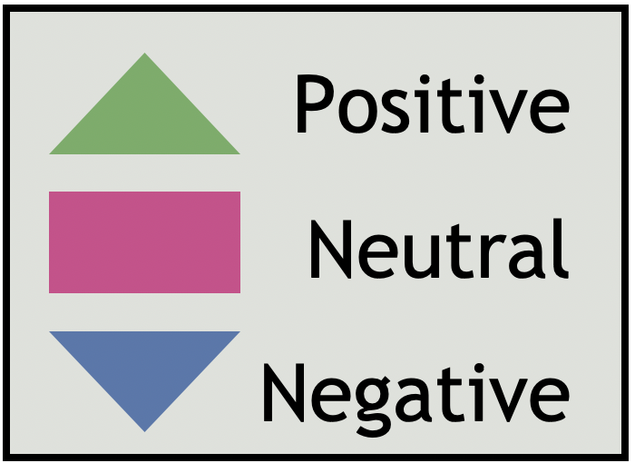
Hammersmith & Fulham Q4 | 2021
Network Area GP Reviews
North H&F PCN |  |  |  |  |  | Ease of gaining appointment | Convenience of appointment | Cleanliness | Staff Attitude | Waiting Time | Treatment Explanation | Quality of care | Generally how easy it is to get through ot someone on the phone?
Hammersmith & Fulham Centres for Healt |  |  |  |  |  | - | - | - | - | - | - | - | -
The Westway Surgery, Dr Dasgupta & partners |  |  |  |  |  | - | - | - | - | - | - | - | -
Parkview Practice |  |  |  |  |  | - | - | - | - | - | - | - | -
Canberra Old Oak Surgery |  |  |  |  |  | 4 | 4.5 | 4 | 4 | 4 | 4 | 4 | 4
Dr Uppal and Partners |  |  |  |  |  | - | - | - | - | - | - | - | -
Parkview Medical Centre, Dr Kukar |  |  |  |  |  | - | - | - | - | - | - | - | -
The Medical Centre Dr Kukar |  |  |  |  |  | - | - | - | - | - | - | - | -
The New Surgery, Dr Dassanayake & Partners |  |  |  |  |  | - | - | - | - | - | - | - | -
Shepherds Bush Medical Centre |  |  |  |  |  | - | - | - | - | - | - | - | -
Number of reviews

Slide 39
Hammersmith & Fulham Q4 | 2021
Network Area GP Reviews
H&F Partnership |  |  |  |  |  | Ease of gaining appointment | Convenience of appointment | Cleanliness | Staff Attitude | Waiting Time | Treatment Explanation | Quality of care | Generally how easy it is to get through ot someone on the phone?
Park Medical Centre |  |  |  |  |  | 4 | 4 | 4.5 | 4 | 4 | 5 | 4.5 | 5
Richford Gate Medical Practice |  |  |  |  |  | 3 | 3 | 3 | 3 | 3 | 3 | 3.5 | 3
The Bush Doctors (HFP Medical) |  |  |  |  |  | 3 | 3 | 4 | 3 | 3 | 3.5 | 4 | 3.5
Brook Green Medical Centre (HFP Medical) |  |  |  |  |  | 4 | 4 | 4 | 4 | 4 | 4 | 4 | 4
North End Medical Centre (HFP Medical) |  |  |  |  |  | 4 | 4 | 4 | 4 | 4 | 4 | 4 | 3
Number of reviews

Slide 40
Hammersmith & Fulham Q4 | 2021
Network Area GP Reviews
H&F Central PCN |  |  |  |  |  | Ease of gaining appointment | Convenience of appointment | Cleanliness | Staff Attitude | Waiting Time | Treatment Explanation | Quality of care | Generally how easy it is to get through ot someone on the phone?
The Ashchurch Medical Centre |  |  |  |  |  | - | - | - | - | - | - | - | -
Sterndale Surgery |  |  |  |  |  | 3.5 | 3.5 | 4 | 4 | 4 | 4 | 4 | 3
Brook Green Surgery |  |  |  |  |  | 4 | 4 | 4 | 4 | 4 | 4 | 4 | 4
Hammersmith Surgery |  |  |  |  |  | 3 | 4 | 4 | 3.5 | 3.5 | 3.5 | 3.5 | 3
North Fulham Surgery |  |  |  |  |  | 5 | 4 | 5 | 5 | 4 | 5 | 4.5 | 4.5
Number of reviews

Slide 41
Hammersmith & Fulham Q4 | 2021
Network Area GP Reviews
Babylon GP at Hand |  |  |  |  |  | Ease of gaining appointment | Convenience of appointment | Cleanliness | Staff Attitude | Waiting Time | Treatment Explanation | Quality of care | Generally how easy it is to get through ot someone on the phone?
Babylon GP at Hand, The Medical Centre, Dr. S Jefferies and partners |  |  |  |  |  | 3.5 | 4 | 4 | 4 | 4 | 4 | 4 | 4
Babylon GP at Hand, Dr. S Jefferies and partners |  |  |  |  |  | 4 | 4.5 | 4.5 | 4 | 4 | 4.5 | 4.5 | 4
Number of reviews

Slide 42
Hammersmith & Fulham Q4 | 2021
Network Area GP Reviews
South Fulham PCN |  |  |  |  |  | Ease of gaining appointment | Convenience of appointment | Cleanliness | Staff Attitude | Waiting Time | Treatment Explanation | Quality of care | Generally how easy it is to get through ot someone on the phone?
Fulham Cross Medical Centre |  |  |  |  |  | 4 | 4 | 4.5 | 5 | 4.5 | 4.5 | 4.5 | 4
The Salisbury Surgery, Dr Ravindrasena |  |  |  |  |  | - | - | - | - | - | - | - | -
The Palace Surgery, Dr Mangwana and Partners |  |  |  |  |  | 3 | 3 | 4 | 3 | 3 | 3 | 3 | 3
Cassidy Medical Centre (West London Group Practices) |  |  |  |  |  | 3 | 3 | 3.5 | 3 | 3 | 3 | 3 | 2
Lilyville Surgery @ Parsons Green |  |  |  |  |  | 2 | 3 | 3.5 | 3 | 3 | 4 | 3.5 | 2
Ashville Surgery |  |  |  |  |  | 3 | 4 | 4.5 | 4 | 4 | 4 | 4 | 4
Fulham Medical Centre |  |  |  |  |  | 4 | 4.5 | 4.5 | 4 | 4 | 4 | 4 | 5
Sands End Health Clinic |  |  |  |  |  | 2 | 2.5 | 2.5 | 2 | 2 | 2 | 2 | 2
Number of reviews

Slide 43
Hammersmith & Fulham Q4 | 2021
Themes for primary Network Area
During Q4, we were able to capture reviews across all 5 PCN areas. The following pages show the top themes for each PCN, based on the qualitative analysis of comments received and the application of themes thereafter. For this report, theme counts below 20 were deemed as too low to draw any firm conclusions from. Themes and sentiments will be monitored over the coming quarters to identify any emerging trends. We can only show the main themes for each Primary Care Network (PCN) where we received a significant number of reviews.
The London borough of Hammersmith & Fulham is divided into five PCNs:
North H&F PCN
H&F Partnership
H&F Central PCN
Babylon GP at Hand
South Fulham PCN
In Q4, the PCNs which received a significant number of reviews and were thereby subject to thematic analysis were: North H&F PCN, H&F Partnership, H&F Central PCN, Babylon GP at Hand and South Fulham PCN. After patients give their overall star rating for the service, there is a section that says "tell us more about your experience". Each comment is uploaded to our Online Feedback Centre where up to five themes and sub-themes may be applied to the comment (see appendix 3 p59-61; for a full list).
For this reason, the total numbers of themes-counts will differ from the total number of reviews for each service area. For each theme applied to a review, a positive, negative or neutral 'sentiment' is given. The application of themes, sub-themes and sentiment is a manual process.

Slide 44
Themes for North H&F PCN Network
Hammersmith & Fulham Q4 | 2021
This quarter we collected 63 reviews for North H&F PCN, of which 65% (n.41) were positive, 5% (n.3) were neutral and 30% (n.19) were negative. The chart below shows the top three themes for North H&F PCN.
The Administration, Staff and Treatment and Care themes have, by far, been the most popular themes identified in the reviews for North H&F PCN. The patient feedback related to the Administration theme was mostly positive with 45 out of 69 being positive. However, 30% (n.20) of the comments related to Administration theme had a negative sentiment. The main issues were around getting through on the telephone and booking an appointment. The Treatment and Care and Staff theme both received mostly positive reviews.
Positive reviews
“Care given was individualised and compassionate. Thank you very much Joy.”
GP Surgery
“They are excellent, I had my flu jab and also requested a repeat prescription. I am very happy with the treatment, Dr is great. Know me well.”
GP Surgery
Themes
Negative / Neutral reviews
“Some of the reception staff are extremely rude and cold hearted. It's hard to get an appointment or help these days when we most need it.”
GP Surgery
“Don't get confused for a nice new place, there are many issues, like every time I want to book a blood test, they give excuses as to why they can't do it.”
GP Surgery
Number of reviews

Slide 45
Themes for H&F Partnership Network
Hammersmith & Fulham Q4 | 2021
This quarter we collected 84 reviews for H&F Partnership of which 51% (n.43) were positive, 13% (n.11) were neutral and 36% (n.30) were negative. This chart shows the top four themes for H&F Partnership. Unfortunately, during this quarter, the number of negative reviews for GP surgeries in the H&F Partnership outweighed the positive reviews.
Administration, Treatment and Care, Access to Service and Staff were the most common themes identified this quarter. The patient feedback related to the Staff theme was very positive with 32 out of 45 being positive, whereas the majority of reviews belonging to the Administration theme received a negative sentiment (n.57). This has been caused by patients/service users being unable to get an appointment or unable to get through to anyone on the telephone. Most of the reviews that referenced the Treatment and Care theme have been positive. Another theme that received a largely negative sentiment is the Access to Service with 11 out 18 (61%) reviews being negative.
Positive reviews
“Excellent service, staff are very helpful.”
GP Surgery
“I was nervous! Greeted by smiling, warm people who are out in the freezing weather. Do form, upstairs, see Doctor, go to Nurse, who was the gorgeous Ms P, seeing her face made me relax…”
GP Surgery
Themes
Negative /Neutral reviews
“These are the worst doctors. I cant believe so many others have had the same experience and nothing changes.”
GP Surgery
“I understand that times are busy, but I just rang to speak to someone urgently. After holding on for 30 minutes, being 5th in the queue, they cut me off when I was 1st in the queue. When I rang back, I was put back to 8th in the queue..”
GP Surgery
Number of reviews

Slide 46
Themes for H&F Central PCN Network
Hammersmith & Fulham Q4 | 2021
This quarter we collected 65 reviews for H&F Central PCN of which 55% (n.36) were positive, 11% (n.7) were neutral and 34% (n.22) were negative.
The chart below shows the top three themes for H&F Central PCN.
The Administration theme (n.73) was, by far, the most common theme identified in the reviews for H&F Central PCN.
The patient feedback relating to Staff and Treatment and Care was positive, with 16 out of 22 and 22 out of 27 reviews being positive in sentiment, respectively. Administration received more balanced feedback between positive and negative sentiment.
Positive reviews
“The nurses and reception staff have been so supportive throughout the pandemic and I think they have made the surgery a very safe place to visit.”
GP Surgery
“Team members in the practice are nice. They always accommodate your requests in booking appointments. Also, Nurse P is amazing and very helpful.”
GP Surgery
Themes
Negative /Neutral reviews
“This practice cannot be trusted. Hopeless, awful service. They deleted my registration and details without notification. I find I am now unable to get a covid vaccine because I'm not registered with a GP.”
GP Surgery
“Very bad, the doctor told me to … off. It is also very hard to book a appointment, the treatment I received was poorly done. The staff treated me like shit”
GP Surgery
Number of reviews

Slide 47
Themes for Babylon GP at Hand
Hammersmith & Fulham Q4 | 2021
This quarter we collected 57 reviews for Babylon GP at Hand of which 65% (n.37) were positive, 12% (n.7) were neutral and 23% (n.13) were negative. This chart shows the top three themes for Babylon GP at Hand.
Administration was, once again, the most popular theme identified in the reviews for this PCN as well, with 63% (n.42) being positive in sentiment. However, 34% (n.23) of the reviews belonging to this theme receive a negative sentiment, which was mainly caused by patients not being able to get through to a receptionist on the telephone or book an appointment.
The Staff and Access to Service theme were overwhelmingly positive, this quarter.
Positive reviews
“I have nothing bad to say about the service I received. I am very happy with the staff and the doctors. I don't have a problem getting an appointment.”
GP Surgery
“I’ve found this to be a great service. It’s usually easy to get same day and weekend appointments (however, recently I’ve had to wait a few days for an appointment).”
GP Surgery
Themes
Negative / Neutral reviews
“Appointments cancelled multiple times without any specified reason, without apologies, without offering alternate earliest appointments.”
GP Surgery
“I was supposed to have a blood test here today. I was told to go to the hospital as there was no nurse there and no one called to let me no bad service.”
GP Surgery
Number of reviews

Slide 48
Themes for South Fulham PCN
Hammersmith & Fulham Q4 | 2021
This quarter we collected 108 reviews for South Fulham PCN of which 58% (n.63) were positive, 13% (n.14) were neutral and 29% (n.31) were negative. The chart below shows the top three themes for South Fulham PCN.
Staff and Administration were by far most common themes identified. The patient feedback related to Staff was very positive (60 out of 78), whereas Administration received more balanced feedback between positive and negative reviews with 52 out 103 being positive and the remaining reviews being negative (n.46) and neutral (n.6) in sentiment. Treatment and Care received less attention than the two leading themes, but the reviews were mostly positive (28 out of 41).
Positive reviews
"A very efficient GP surgery. Friendly staff, phones are answered promptly. You couldn't ask for more.”
GP Surgery
‘‘Brilliant Doctors, nurses and reception staff. Friendly, helpful and considerate. We wouldn't want to go anywhere else. Keep up the good work!.”
GP Surgery
Themes
Negative reviews
“The recent service experienced by my pregnant partner and I has been nothing short of thoroughly incompetent.”
GP Surgery
“I've never spoken to someone so rude in my life. The receptionist is reluctant to provide any information, makes you feel completely undermined and it feels like everything you say is being disregarded.”
GP Surgery
Number of reviews

Slide 49
Demographic Information
Hammersmith & Fulham Q4 | 2021
The pie chart below shows the breakdown of participants by religion. A large proportion (53%) of people left this question blank or chose not to identify their religion, while 27% (n.334) identified as being Christian, 5% (n.54) practice Other religions and 4% (n.51) practice Islam. A total of 11% (n.134) identified as having no religion. We will seek to improve the completion of monitoring data going forward through our direct telephone engagement and face to face engagement. Further guidance is being provided to volunteers to support this.
The pie chart below shows the number of reviews received this quarter from different age groups. Aside from the large proportion of people that chose not to indicate their age (49%), individuals in the 65-74 age bracket made up 13% (n.160) of our population sample, followed by the 55-64 age bracket with 9% (n.104), and the 45-54 age bracket with 8% (n.97). Although there is some representation in the lower age brackets, given the boroughs profile, further work will be done to increase feedback from these groups in future quarters.
Religion of Patients
Age of Patients

Slide 50
Demographic Information
Hammersmith & Fulham Q4 | 2021
In terms of ethnicity, excluding the 49% (n.601) who did not complete this section, the largest proportion of feedback received this quarter was from people who identified as ‘White British’ (30%, n.360), an increase of 11% from last quarter. The next highest category was from people who identify as ‘Black British - African’ at 6% (n.77), followed by ‘White - Any other White background’ at 5% (n.65). Further monitoring of ethnicity data will take place to help direct targeted engagement work in the future.
The pie chart below shows the number of reviews received by gender from January to March 2021. Excluding the 49% (n.598) that chose not to answer this question, the majority of the reviews received this quarter are from females with 35% (n.430), an increase of 14% compare to last quarter. Males made up 16% (n.11) of the sample population also demonstrating an increase of 6%. During our Direct Telephone Engagement work we have noticed that women are more willing to share their experiences. Further work will be undertaken to better appeal to men in the future.
Ethnicity of Patients
Gender of Patients

Slide 51
Demographic Information
Hammersmith & Fulham Q4 | 2021
During our direct telephone engagement, we have managed to speak to people living in 17 different areas across the borough of Hammersmith & Fulham. The highest number of the reviews was received from residents in the North End Ward (8%, n.95), by the Hammersmith Broadway Ward (6%, n.73) and the Avonmore & Brook Green Ward (6%, n.73). The least number of reviews were received from the Sands End Ward (1%, n.5). Compared to last quarter, we have seen an increase in reviews for some areas whilst others have decreased. In Quarter 1 of the 2021/2022 year, we will continue to try and reach more people in the areas where we have received the fewest reviews.
Patient's area of residence | Number of reviews | Percentage
North End ward | 95 | 8%
Hammersmith Broadway Ward | 73 | 6%
Avonmore & Brook Green Ward | 73 | 6%
Town ward | 57 | 5%
Addison Ward | 55 | 5%
Munster Ward | 44 | 4%
Wormholt and White City | 44 | 4%
Parsons Green and Walham Ward | 34 | 3%
Revenscourt Park Ward | 30 | 2%
Palace Riverside Ward | 27 | 2%
College Park and Old Oak Ward | 26 | 2%
Askew Ward | 18 | 1%
Fulham Broadway Ward | 17 | 1%
Fulham Reach ward | 17 | 1%
Sands End Ward | 5 | 1%
Out of borough | 5 | 1%
Prefer not to say | 598 | 49%
Patient’s area of residence

Slide 52
Hammersmith & Fulham Q4 | 2021
Conclusion
Our Patient Experience model has developed significantly from Q1 to Q4 2020/21 and now incorporates a large degree of Direct Telephone Engagement, allowing us to speak with individuals to gather feedback and rely less on online reviews as a predominant source of feedback. The former provides a more balanced overview of experiences akin to our original, face-to-face outreach and engagement model. This new approach has also benefited residents through additional provision of information and signposting and a level of befriending for many of those contacted over the telephone. Through our calls and our presence on the NEXTDOOR app, we have signposted many individuals to Age UK, CAN, Mental Health Services, Foodbanks, Mutual Aid Groups and more. People have also expressed gratitude in being contacted, having someone to talk to and sadly, reported a great deal of isolation, temporarily alleviated by our call.
For this quarter we collected 1218 reviews. There were 957 (78%) positive reviews with a star rating 4-5, 94 (8%) neutral reviews with a star rating of 3 and 167 (14%) negative reviews with a star rating 1-2. As we saw in Q3, the positive experiences far outweigh the negative experiences, overall. Similar, to Q2 and Q3 the 1-star rating in Q4 received a higher proportion of reviews than we are perhaps used to seeing when compared with previous patient experience data from neighbouring boroughs. This may be due in part to the continuing impact of the pandemic on experiences and may also be due to online reviews still being a feature of our data. Nevertheless, the numbers of positive reviews have decreased compared to the previous quarter. We believe that once we begin face to face engagement, the numbers will change. The percentage of 1-star ratings will continue to be monitored in future quarters.
In term of the demographic information, compared to the last three quarters, the numbers have increased massively. This was due to our presence on NEXTDOOR app and an increase in our direct telephone engagement, where patients were able to leave their demographic information.
If we look beyond the broader picture and at specific service areas, findings indicate the following:
GP services
Positive feedback remains high around the Treatment and Care theme (71%) and Staff theme (75%), as well as associated sub themes (Experience, Quality of Care and Staff Attitudes). The Access to Services theme received significant amount of negative feedback (45%), as did Waiting Times. Looking at previous quarters we can say that the negative theme within Access to Services is a continuing trend, receiving the highest proportion of negative sentiment, when compared to other themes. The Administration theme demonstrated a relatively equal balance between positive and negative feedback (53% positive, 40% negative and 7% Neutral). The main issues were with the sub-themes Booking Appointment and Getting through to someone on the telephone.

Slide 53
Hammersmith & Fulham Q4 | 2021
Conclusion Cont.
Hospital Services (Imperial College NHS Trust)
In terms of hospital services for Imperial College NHS Trust, the predominant area in which the Imperial College NHS Trust can improve its services is around Waiting Times, with 46% of the reviews this quarter being negative in sentiment. On the other hand, areas of good practice can be found across the following themes and sub-themes: Treatment and care – Experience (88% positive); Staff – Staff attitudes (93% positive).
Hospital Services (Chelsea and Westminster NHS Foundation Trust)
In terms of hospital services at Chelsea and Westminster NHS Foundation Trust, for this quarter we were able to only obtain robust data for the Treatment and Care and Administration themes. Only 58% of the reviews belonging to the Treatment and Care theme were positive, compared to the same theme for reviews relating to Imperial College NHS Trust Hospitals, which were overwhelmingly positive. Similar to quarter 3, the reviews belonging to Chelsea and Westminster NHS Trust are more positive than negative overall.
Pharmacy Services
Overall, patients/service users are satisfied with the Staff Attitude at their respective pharmacy and are happy with the way that it is being managed.
PCN specific Network
If we look at the individual PCN areas on pages 38-43, we see that for the majority of PCN's there are issues around Administration, Booking Appointments, Getting through to someone on the telephone, Appointment Availability and Waiting Times. The feedback referencing the Treatment and Care and Staff themes were generally positive. The PCN that had the most negative reviews was the H&F Partnership (51% positive and 36% negative). Similarly to quarter 3, we can see that the numbers of negative reviews have increased, and this is most likely due to Patients/service users struggling to get through on the telephone to book an appointment or unable to speak to a receptionist as some of the GPs do not allow appointments to be booked over the phone. This has been an issue since quarter 2.

Slide 54
Hammersmith & Fulham Q4 | 2021
Action, impact and next steps
Action, impact and next steps
Healthwatch Hammersmith and Fulham will share the findings contained within this report at various commissioning, provider and local authority led boards and committees. These include:
Hammersmith and Fulham Health and Wellbeing Board
Hammersmith and Fulham Scrutiny Committee Health Inclusion and Social Care Policy and Inclusion Committee
Hammersmith and Fulham Clinical Commissioning Group - Patient Reference Group
Hammersmith and Fulham Safeguarding Adults Board
As well as these formal meetings, we attend and co-ordinate a number of meetings with partners in order to share the findings of the report highlighting areas of concern and interest.
In December 2020, the eight Clinical Commissioning Groups in North West London moved to a single staffing structure in January 2021 ahead of the planned CCG Merger in April 2021, which has changed local decision-making structures.
We at Healthwatch Hammersmith and Fulham will identify opportunities to share our findings within this new structure. We will continue to develop and grow the Patient Experience Programme and explore ways to remotely engage with service users under the continuing COVID-19 measures and as we come out of the lockdown, including:
Promoting our service through Health and Social Care services
Collecting feedback by direct telephone engagement
Using Social Media platforms, such as twitter, Next Door, and Facebook to raise awareness of our service
Seeking feedback from local patients and service users and encouraging patients/service users to visit our website.
Working with key partners such as Local Authority, CCG, voluntary and community sector.
Training more volunteers to continue to support our Patient Experience Programme .
Attending community forums to promote our service.
This quarter we have relied less on external online review platforms and we will continue to do so as we collect feedback from residents over the telephone and through our social media channels. We have created a Patient Experience survey and shared this on our Social Media platforms which has subsequently increased the numbers of reviews that we have received during this quarter. In addition, the widget we have created and added to a number of GP websites has also contributed to this increase in the number of reviews received.

Slide 55
Hammersmith & Fulham Q4 | 2021
Action, impact and next steps cont.
The following actions and next steps have been identified or are being considered further:
- We will continue to identify opportunities for sharing our findings at different forums and settings within the Borough to inform our priorities and our Research Studies for Q1 2021/22. This includes the POPS Forum and the CCG Patient Reference Group.
- We aim to conduct more specific research on Mental Health services as we received very low levels of patient experience feedback for Mental Health Services in the Borough during this quarter.
- We are prioritising our focus on collecting reviews from mental health services and are working to produce a survey specifically for Mental Health services, to obtain a more robust indication of how these services are delivering care and treatment in Hammersmith & Fulham.
- Develop a plan for a Youth Healthwatch for Hammersmith & Fulham as we receive very little patient feedback from young people.
- Carry out a series of joint webinars with colleagues in Healthwatch Ealing and Hounslow to engage with local residents on their experience of COVID-19 and the vaccination.
- Work collaboratively with the Hammersmith & Fulham Youth Council, the extended Inclusive Youth Voice Network and other local organisations such as MIND, Young Hammersmith & Fulham and The Shepherds Bush Family Project, to undertake a piece of research to understand the issues and challenges faced by young people in the borough, today.
- In line with government guidelines and the roadmap we will take a stepped approach to resuming our usual face to face engagement and will rely less on online reviews.

Slide 56
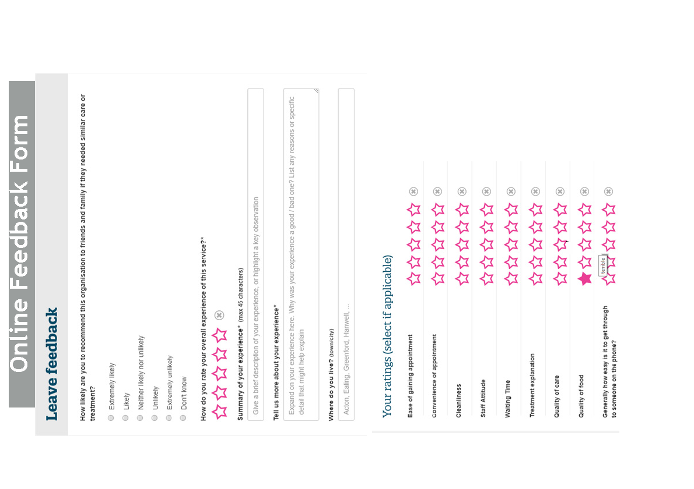

Slide 57
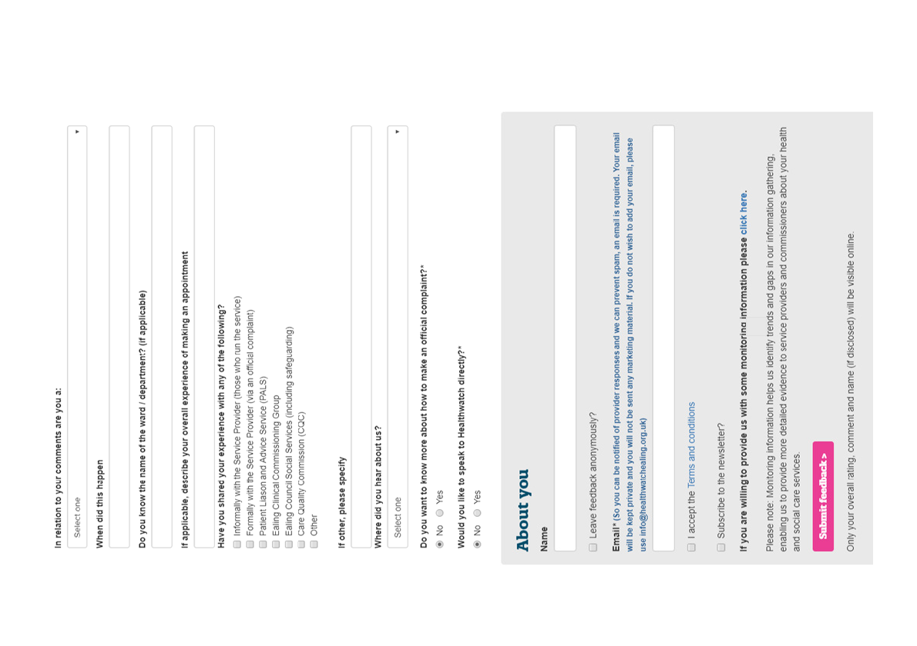

Slide 58
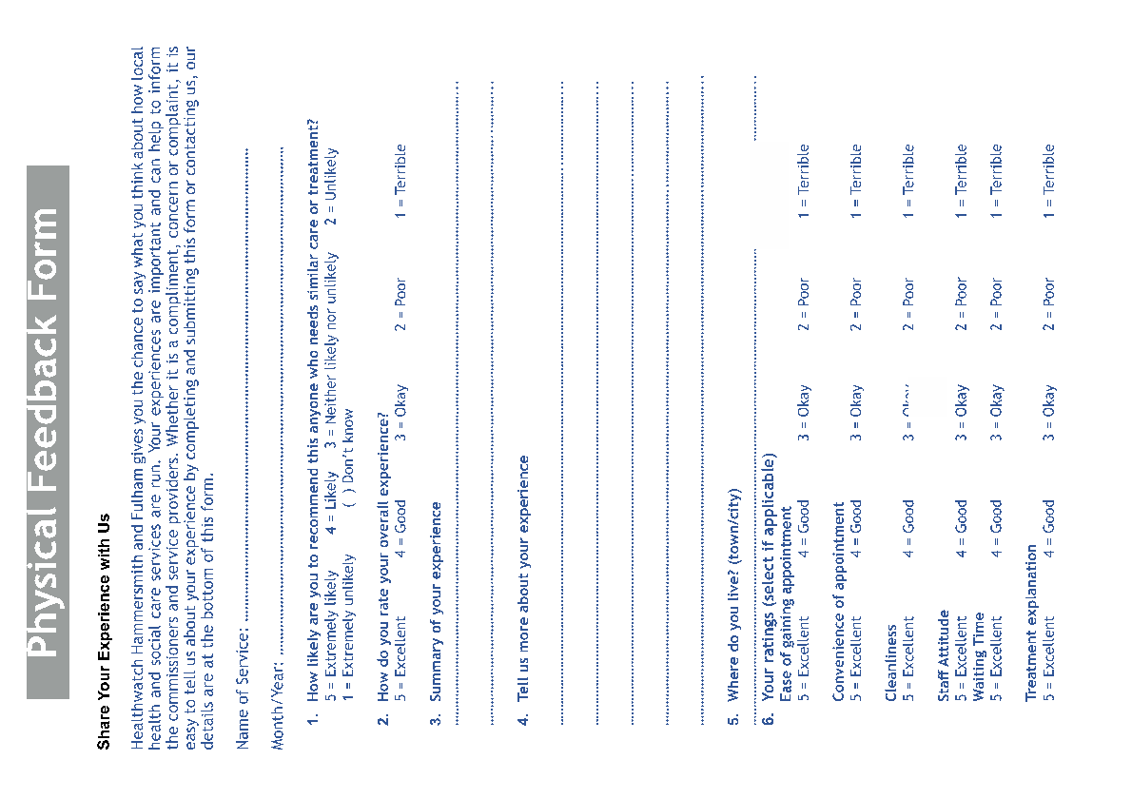

Slide 59
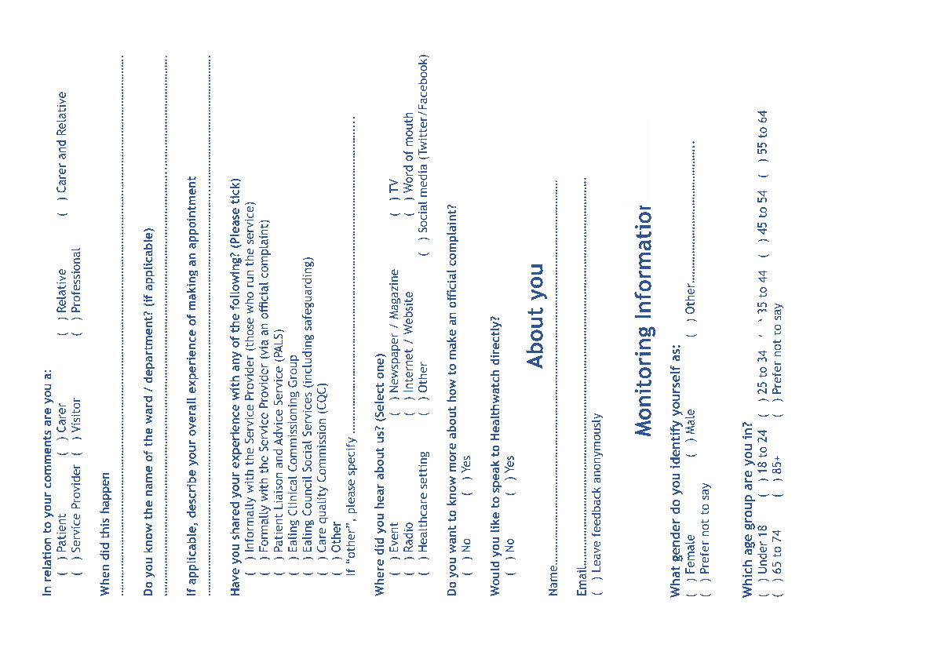

Slide 60
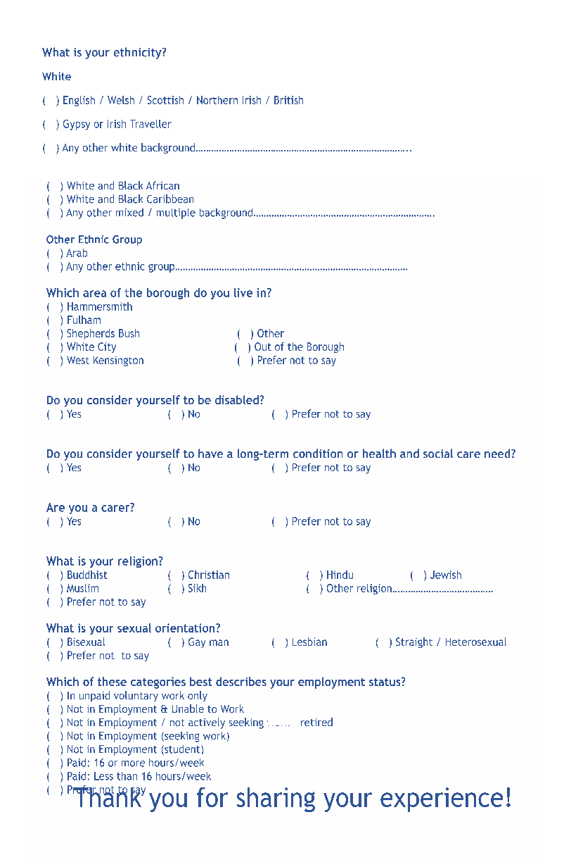

Slide 61
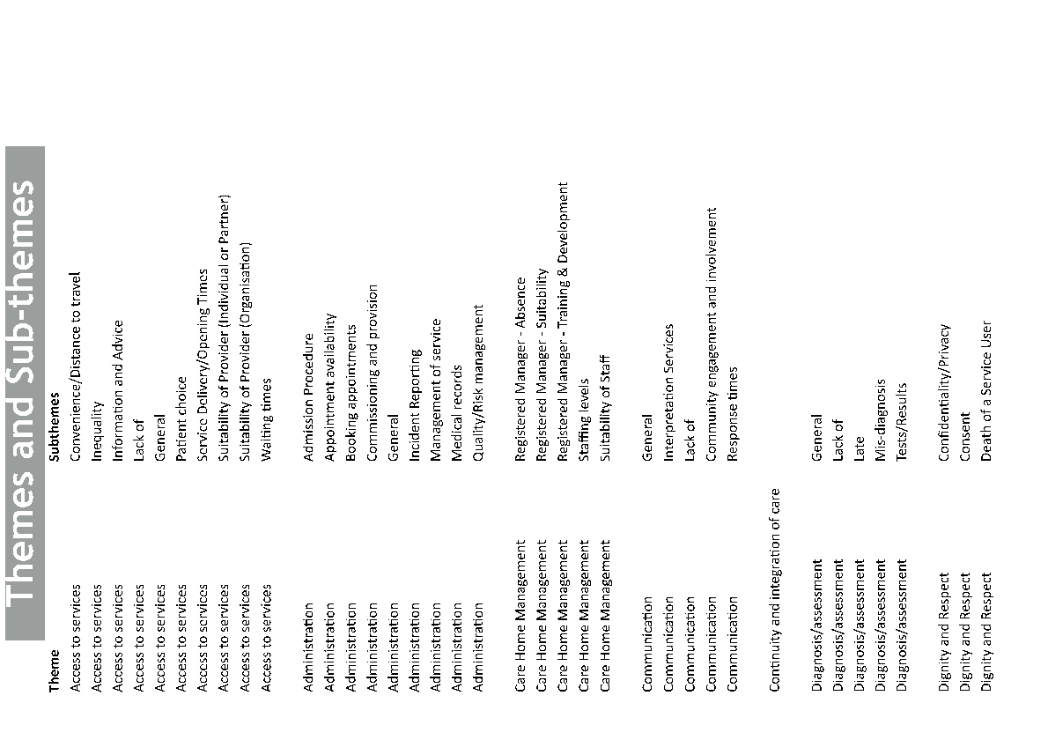

Slide 62
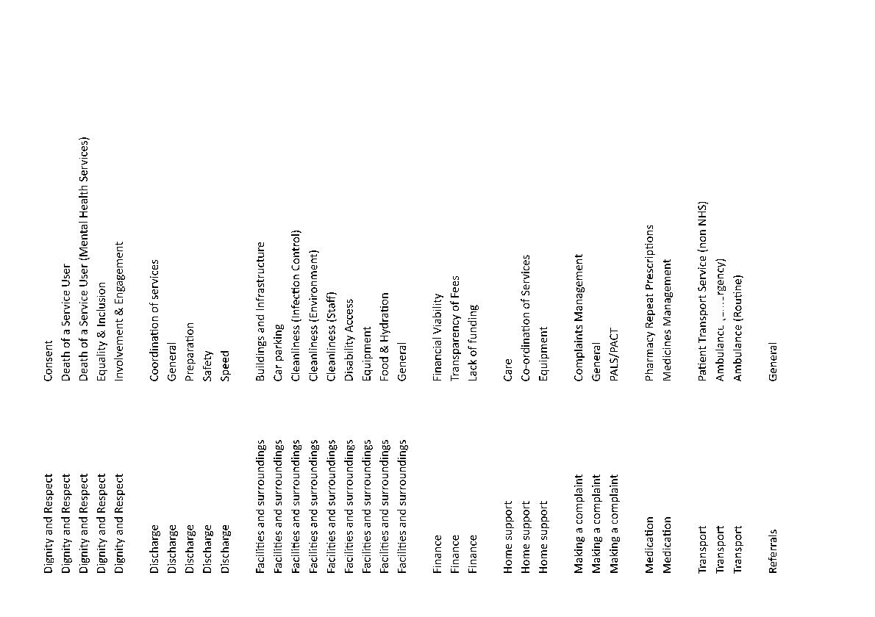

Slide 63
