Slide 1
PATIENT EXPERIENCE
REPORT 2021/2022
QUARTER 1
April-June

Slide 2
Contents
Hammersmith & Fulham Q1 | 2021/22
Introduction & Executive Summary
2
Our data explained
4
Overall Star Rating
5
Total Reviews per Service Category
8
Distribution of Positive, Neutral & Negative
9
Themes: GP, Hospital and Pharmacies
10
Other Positive Reviews
28
Other Negative and neutral reviews
32
Themes for Primary Care Network Area
36
9
Demographic Information
48
Conclusion
51
53
Action, impact and next steps
Appendix
55

Slide 3
Introduction & Executive Summary
Hammersmith & Fulham Q1 | 2021/22
Healthwatch was created by the health and social care reforms of 2012 with a powerful ambition of putting people at the centre of health and social care. To help realise that ambition Healthwatch Hammersmith & Fulham (H&F) delivers a number of services to gather and represent the views of patients and service users of health and social care in the H&F borough. One of the ways we do this is through a comprehensive Patient Experience data collection programme. The successful implementation of this programme, including the use of our Digital Feedback Centre, will yield a minimum of 4,800 patient experiences per annum, all of which will be presented as they are received and considered as valid community opinion. Your Voice in Health and Social Care (YVHSC) took over the provision of Healthwatch H&F in April 2020. In April 2020, the Digital Feedback Centre, which is integral to the Patient Experience programme, was launched together with the Healthwatch H&F website.
Normally, our Patient Experience Officer, supported by a team of volunteers, will visit health and social care services to talk to and hear from patients, service users, carers, and relatives about their experiences of local services. Patients' comments and reviews are gathered using a standard form (see appendices). The form asks the individual for simple star ratings on their overall experience, likelihood to recommend a service, treatment, appointment booking and a number of other areas. There is also a free textbox where patients are asked to provide further insight into their experience. We approach every patient, capture their experience in their own words and seek consent for their feedback to be published on the Healthwatch H&F website, through the Digital Feedback Centre. People can choose to leave their name or comment anonymously. At the end of each service visit, the Patient Experience Officer will relay any urgent matters requiring attention to the Operations Manager of Healthwatch H&F.
In May of 2021 we were able to restart our face-to-face engagement in GP surgeries in a limited capacity. Healthwatch H&F is taking a stepped-approach to moving back to our traditional model of face-to-face engagement for the Patient Experience programme to prioritise the safety of patients and Healthwatch staff and volunteers as well as ensuring that we do not interfere with GP surgery operations. During this quarter, we therefore implemented both our new and pre-pandemic model of engagement, combining in-person GP surgery visits with direct engagement over the telephone, the collection of feedback via the Nextdoor – Neighbourhood App and collecting and collating existing online reviews from relevant platforms such as NHS.uk and Google reviews. This new 'digital' model that we have implemented throughout the pandemic has benefited residents by providing additional information and signposting and a level of befriending for many of those contacted over the telephone.

Slide 4
Introduction & Executive Summary cont.
Hammersmith & Fulham Q1 | 2021/22
In addition, we have worked extensively to promote our new service across the borough, driving direct reviews to our website for those with internet access. We have distributed our poster and leaflet in each of the GP surgeries that we have visited this quarter.
We also added our Healthwatch H&F Widget to thirteen GP surgeries, Imperial Healthcare NHS Trust and other community and voluntary sector organisation websites. We would like to thank all of these service providers for their ongoing support. As our service becomes further embedded across the borough, we expect greater awareness of our service and a subsequent increase in the number of reviews made directly through our website or by calling our office.
We aim to gather patient experience comments and reviews from a representative sample of the population of H&F. However, we acknowledge that different people use different services at different times in their lives, and some not at all. Although patients are asked for their monitoring information some do not wish to provide this. In our efforts to ensure feedback represents all sections of the community, we recruit Patient Experience Volunteers who speak additional languages.
The outreach element of our Patient Experience Programme is supplemented by our community engagement work and our website (www.healthwatchhf. co.uk), which people may visit independently to provide service feedback and comments. Our questions are uniform across the Digital Feedback Centre and the physical copies of our Patient Experience forms.
This report covers the Quarter 1 period, April – June 2021. During this time, we collected 1215 reviews, achieving our quarterly target of 1200.
Out of the total number of patients experiences received:
894 (73%) were positive with a star rating of 4-5,
92 (8%) were neutral with a star rating of 3, and;
229 (19%) were negative with a star rating 1-2 (this is based on the overall star rating provided by patients - see page 4 for further detail).

Slide 5
Our data explained
Hammersmith & Fulham Q1 | 2021/22
Healthwatch H&F uses a Digital Feedback Centre (on our website) and Informatics system (software behind the Digital Feedback Centre) to capture and analyse patient experience feedback.
The Informatics system is currently used by approximately 1/3 of the Healthwatch Network across England and it captures feedback in a number of ways:
It asks for an overall star rating of the service, (between 1-5).
It provides a free text box for comments
It asks for a star rating against specific domain areas, (between 1-5).
The above provides Healthwatch with several data sets.
Star ratings provide a simple snapshot average, both overall and against specific domain areas. The free text comment box is analysed in two different ways, with two different data set results:
In the first instance, free text comments are broken down and analysed for themes and sub themes. Where relevant, up to 5 themes and sub themes can be applied to any one patient experience comment. Upon each application of a theme or sub theme, a positive, negative or neutral sentiment is also applied. This is a manual process undertaken by trained staff and specially trained volunteers. The process is overseen by the Patient Experience Officer and regularly audited in order to ensure consistency. Where themes and related sentiments are discussed in the report, it relates to this aspect of the process.
Each of the areas described above provides an independent set of results which can be viewed separately or in conjunction with one another in order to gain an insight into a service or service area. It is important to note that correlation between different data sets may not be apparent, for example, a service may have an overall star rating of 4/5 but much lower ratings against individual domain areas.

Slide 6
Overall Star Ratings
Hammersmith & Fulham Q1 | 2021/22
The table below shows a breakdown of the negative, neutral, and positive patient reviews (see the appendices for examples of our physical and online questionnaires). Each patient is asked to give an overall rating out of 5 stars for a service. Star ratings of 1 and 2 indicate a negative response, a star rating of 3 indicates a neutral response and star ratings of 4 and 5 indicate a positive response.
It is important to note that our experience has shown that people are very reluctant to give a negative rating of their care provider. When the 3* 'neutral' ratings are analysed in more detail we have traditionally found these to outline negative feedback. Therefore, where a significant number of 3* ratings are found, our experience tells us these areas are worthy of further attention to help identify areas for improvement. This quarter 894 positive responses, 229 negative responses and 92 neutral responses have been recorded.
Month | 1 – 2 Star Reviews (Negative) ★ ★ ☆ ☆ ☆ | 3 Star Reviews (Neutral) ★ ★ ★ ☆ ☆ | 4 - 5 Star Reviews (Positive) ★ ★ ★ ★ ★
April | 73 | 29 | 304
May | 101 | 28 | 276
June | 55 | 35 | 314
Total | 229 | 92 | 894

Slide 7
Overall Star Ratings
Hammersmith & Fulham Q1 | 2021/22
This chart provides a breakdown of negative, neutral, positive and total reviews for each month, based on the overall star rating provided.

Slide 8
Overall Star Ratings
Hammersmith & Fulham Q1 | 2021/22
Individuals are asked to provide an overall star rating for the service that they are reviewing. With five stars being the highest and one star being the lowest. These pie charts show the breakdown of star ratings for each month and for the whole quarter.
In each month, the 5-star rating received the highest proportion of reviews, followed by the 1-star rating and 4-star rating.
In April, the 5-star rating received two thirds (n.267) of the reviews with 5-star ratings in May making up 60% (n.230) of the monthly total. However, in June the number of 5-star ratings has reduced to 43% (n.143). One contributory factor could be the increased face-to-face engagement in GP surgeries where we approach patients/service user and ask them to share their feedback.
The overall star ratings for services tell us that people are satisfied.

Slide 9
Total Reviews per Service Category
Hammersmith & Fulham Q1 | 2021/22
The patient reviews recorded for this quarter cover nine service categories, as seen in this chart.
The category with the highest number of reviews recorded was for GPs (n.570), followed by Dentists (n.274), Hospitals (n.176) and then Pharmacies (n.139).
Compared to quarter 4 of the last financial year (Jan-Mar 2021), the number of reviews for GP surgeries have increased significantly, by 168.
Since the 17th of May we have restarted our face-to-face engagement work in the community, predominantly visiting GP practices and thereby increasing reviews for the service this quarter.
Type of services
Number of reviews

Slide 10
Distribution of Positive, Neutral & Negative
Hammersmith & Fulham Q1 | 2021/22
The bar chart compares the number of positive, neutral and negative reviews for each service category. This is based on the overall star rating.
47% of the reviews were about people's experiences of GP services. This is an increase of 14% from last quarter.
23% of the reviews were about people's experiences of Dentists. It remains the same as last quarter.
14% of the reviews were about people’s experiences with Hospitals, an increase of 2% from last quarter.
11% of the reviews were about people's experiences with Pharmacies, a decrease of 7% from last quarter.
Other comments were about Opticians, COVID-19 Services, Community Health Services, Mental Health Services and Residential Care.
Of these services:
Dentists received the highest proportion of positive reviews at 90%, followed by Pharmacies with 87%, Hospitals with 72% and GPs with 61%. There was a 2% decrease in the proportion of positive reviews reported for GPs this quarter, compared to last quarter.
Type of services
Number of reviews

Slide 11
Themes and Sub-Themes
Hammersmith & Fulham Q1 | 2021/22
After asking patients for an overall star rating of the service we encourage them to "tell us more about your experience" (see the appendices for examples of our physical and online questionnaires). Qualitative analysis is conducted on individuals' comments to identify emerging or trending themes and sub-themes. To do this each comment is uploaded to our Online Feedback Centre where up to five themes and sub-themes may be applied to the comment (see appendix 3 p59-61 for a full list). For this reason, the total number of theme-counts will differ from the total number of reviews for each service area. For each theme applied to a review, a positive, negative, or neutral 'sentiment' is given.
The application of themes, sub-themes and sentiments is a manual process undertaken by trained staff and differs from the star rating patients provide.
This section shows a breakdown of the main themes and sub-themes for those service areas where we received a significant number of reviews.
In Q4 these areas are:
GP surgeries;
Trusts and individual Hospitals;
Pharmacies

Slide 12
GP Themes and Sub-Themes
Hammersmith & Fulham Q1 | 2021/22
Administration, remains one of most applied themes for GPs this quarter. The theme was applied on 478 counts, with 39% (n.186) of these being positive, 2% (n.10) being neutral and 59% (n.282) were negative.
Booking an Appointment, was one of the most applied sub-themes within this service category, identified in 217 responses. Of these responses, 45% (n.98) were positive, 3% (n.7) neutral and 52% (n.112) were negative, with the negative reviews largely caused by patients being unable to book an appointment. This quarter negative sentiment outweighs positive sentiment. Patients/service users continue to have issues accessing their GP due to the pandemic. On a more encouraging note, 61% (n.44) of the 72 individuals who mentioned matters relating to the Management of Service sub-theme, mentioned it in a positive context.
For the Appointment Availability sub-theme, there were 53 counts, of which, 26% (n.14) were positive, 6% (n.3) neutral and 68% (n.36) were negative. Patients\service users are struggling to obtain a suitable appointment. Many of the reviews relating to the sub-theme, Getting through on the telephone, were negative in sentiment, at 80% (n.90). This was due to patients not being able to speak to the receptionist on the phone when trying to book an appointment or ask for advice. This issue has been identified as an ongoing trend in GP surgery reviews since quarter 2 2020/2021.
Positive reviews
“I had a telephone consultation and found booking appointments online was very useful.”
GP Surgery
“User-friendly, helpful and supportive, easy to book appointment online. Staff are nice and doctors are very supportive..”
GP surgery
Sub-themes
Negative reviews
“No appointments available, no phone appointments either it is impossible to speak to doctor.”
GP surgery
“I have been trying to get an appointment for a few weeks now but I am unable to get one. I can't get anyone through the phone. If I could give them zero I would have.”
GP surgery
Number of reviews

Slide 13
GP Themes and Sub-Themes
Hammersmith & Fulham Q1 | 2021/22
In this quarter, Staff, was the second most applied theme for GPs. It applied to 348 reviews, of which 68% (n.237) were positive, 4% (n.14) were neutral and 28% (n.97) were negative.
The chart below presents a more detailed breakdown, featuring the top three sub-themes for the Staff theme.
The majority of reviews focused on the sub-theme Attitude, where 64% (n.173) of the reviews were positive in sentiment. Taken together with the positivity regarding the sub-themes Capacity and General, this suggests that despite areas for improvement, the majority of patients/service users were satisfied with the professionalism provided by the administrative and clinical teams at their respective GP surgeries.
Positive reviews
“Staff are always nice and helpful. Since I moved here I have not changed surgery yet.”
GP surgery
“The staff has always been professional, friendly, and helpful.”
GP surgery
Sub-themes
Negative / Neutral reviews
“The staff have been rude, unprofessional, it seems that rather than see patients as individuals they are seen as profit or loss margins.”
GP surgery
“It used to be OK, now it's quite bad. One of the GPs in particular was very rude and aggressive towards me a couple of years ago.”
GP surgery
Number of reviews

Slide 14
GP Themes and Sub-Themes
Hammersmith & Fulham Q1 | 2021/22
Treatment of Care, was the third most applied theme for GPs this quarter. It received 186 reviews. Of the total count 75% (n.140) were positive, 5% (n.9) were neutral and 20% (n.37) were negative. The chart below shows the breakdown for the Treatment and Care theme into the top four sub-themes.
Experience was the most applied sub-theme this quarter. This sub-theme was identified as largely positive in sentiment; 71% (n.59). The second highest identified sub-theme was Quality-of-Care, with 82% (n.53) of these reviews being positive in sentiment, an increase compared to last quarter. The Safety of Care sub-theme was almost equally identified in postive (n.8) and negative (n.7) reviews, indicating that there could be some concerns over the safety of patients when attending GP surgeries. This may, however, be due to a hesitency to attend the GP clinic or in-person treatments available during Covid-19. Patients/service users are generally satisfied with the treatment and care received at their respective GP surgeries.
Positive reviews
“The Doctor I see is outstanding and he really listens and helps me any way he can.”
GP surgery
“I have always had a good experience and whenever I have had issue with them they always try to resolve it.”
GP surgery
Sub-themes
Negative/ Neutral reviews
“Condescending and dismissive. Malpractice by constant delaying diagnosis on anything and deferring tests. Avoid!”
GP surgery
“Awful experience as the doctors don't care and are not consistent. No appointment availability and the receptionists are rude.”
GP surgery
Number of reviews

Slide 15
GP Themes and Sub-Themes
Hammersmith & Fulham Q1 | 2021/22
Access to Services, was the fourth most applied theme for GPs this quarter. It was applied 147 times with the majority of reviews relating to the sub-theme, Waiting Times. This sub-theme was identified in 80 reviews with 20% (n.16) being positive, 14% (n.11) neutral and 66% (n.53) negative.
In addition, the reviews relating to the sub-theme, Lack of Appointment Availability, were entirely negative in sentiment (n.23). This indicates that there remains significant concerns from patients with length of time waiting for an appointment as well as the amount of choice and availability of appointments. Compared to Q4 of the 2020/21 year, negative reviews relating to the Access to Service theme have increased, significantly. This insight must be viewed within the current context of the pandemic and is a trend which we will continue to monitor, sharing this insight with providers and key health partners.
Positive reviews
‘‘The registration process was quick and easy, it was always easy to get an appointment and the waiting times were not crazy.”
GP surgery
‘‘I emailed the surgery explaining my symptoms. Within 1 hour a medical student rang to take my medical history. After finishing within the next 10 minutes a doctor from the surgery rang to offer me an appointment that very afternoon.”
GP surgery
Sub-themes
Negative / Neutral reviews
‘‘The appointment is half an hour late and no explanation given. I have been sitting here since.”
GP surgery
‘‘It is very difficult and it takes a long time to book an appointment.”
GP surgery
Number of reviews

Slide 16
Positive, Negative, Neutral and Total reviews for each Hospital
Hammersmith & Fulham Q1 | 2021/22
This section shows a breakdown of the main themes and sub-themes identified in the reviews that Healthwatch received for the hospitals under Imperial College Healthcare NHS Trust and Chelsea and Westminster Hospital NHS Foundation Trusts. These hospitals are:
Charing Cross Hospital: Out of the total reviews for the quarter (n.46), 65% (n.30) were positive, 15% (n.7) neutral and 20% (n.15) negative
Hammersmith Hospital: Out of the total reviews for the quarter (n.22), 68% (n.15) were positive, 18% (n.4) neutral and 14% (n.3) negative
St Mary’s Hospital: Out of the total reviews for the quarter (n.25), 68% (n.17) were positive, 12% (n.3) neutral and 20% (n.5) negative
Queen Charlottes and Chelsea Hospital: Out of the total reviews for the quarter (n.12) , 83% (n.10) were positive and 17% (n.2) negative
Western Eye Hospital: Out of the total reviews for the quarter (n.11), 45% (n.5) were positive, 10% (n.1) neutral and 45% (n.5) negative.
Chelsea & Westminster Hospital: Out of the total reviews for the quarter (n.53), 62% (n.33) were positive, 11% (n.6) neutral and 27% (n.14) negative
West Middlesex University Hospital: No reviews were collected for this hospital during this quarter
Other hospitals:
The Royal Marsden: Out of the total reviews for this quarter (n.8), 75% (n.5) were positive and 25% (n.2) were negative
Royal Brompton Hospital: Only 3 reviews were collected for this hospital during this quarter
In the next section we identify leading positive and negative themes at individual hospital sites and look in more detail at the overall themes and sub-themes for each Trust. For this quarter these are Imperial College Healthcare NHS Trust and Chelsea and Westminster Hospital NHS Foundation Trust.

Slide 17
Summary of themes for each hospitals
Hammersmith & Fulham Q1 | 2021/22
Charing Cross Hospital:
The Treatment and Care (69%) and Staff (93%) themes were regularly identified as positive. This strongly suggests that staff's general professionalism, bedside manner and ability to meet the needs of their patients is a consistent feature of care at Charing Cross Hospital. Out of the 28 reviews in which the theme Access to Services was identified, 46% (n.13) were negative in sentiment. The main issues remain around the sub-theme Waiting Times. Some patients report longer waiting times whilst others mention that their appointments have been postponed or cancelled, altogether. Over 60% of the reviews applied to the Administration theme were negative. The main issues remain around the sub-themes Booking appointment and Appointment availability. This indicates that patients struggled to obtain an appointment at the hospital during this quarter.
Themes
Number of reviews
Hammersmith Hospital:
Similar to last quarter, the reviews relating to the themes Treatment and Care (100%) and Staff (89%) identified were entirely or almost entirely positive in sentiment. These findings indicate that patients are happy with the service provided by healthcare professionals at Hammersmith Hospital and happy with the manner in which members of staff provide them. Access to Service, received more balanced feedback, with 40% (n.4) of the reviews, in support of current practices. However, some issues around the sub-theme, Waiting Times were identified with patients having to wait a long time for their appointments.
Themes
Number of reviews

Slide 18
Summary of themes for each hospitals
Hammersmith & Fulham Q1 | 2021/22
St Mary’s Hospital:
The reviews belonging to St Mary's Hospital have been largely positive this quarter. The highest proportion of feedback was identified as relating to the Staff theme with the majortiy of reviews being positive in sentiment (73%).
The reviews related to the Treatment and Care were also largely positive (86%).
Sub-themes
Number of reviews
Queen Charlottes and Chelsea Hospital:
The reviews belonging to Queen Charlottes Hospital have been overwhelmingly positive this quarter. All of the reviews relating to the Staff theme and the Treatment and Care theme were positive. Taken together, the evidence strongly suggests that patients at Queen Charlotte’s and Chelsea Hospital were very happy with how their needs were met and how the staff cared for them during their time in the hospital.
Sub-themes
Number of reviews

Slide 19
Summary of themes for each hospital
Hammersmith & Fulham Q1 | 2021/22
Chelsea and Westminster Hospital:
Compared to last quarter, the total number of positive reviews for this hospital have increased.
The number of reviews relating to the Access to services theme were equally positive (n.7) and negative (n.7). Reviews of a negative sentiment once again referenced issues around waiting times and difficulties in obtaining an appointment. This could provide insight into further areas of improvement for Chelsea and Westminster Hospital.
Approximately 77% (n.23) of the reviews relating to the theme Treatment and Care were positive. This indicates that most patients/service users were satisfied with the quality of treatment that they received at the hospital.
The majority of the reviews relating to the theme Staff were positive (78%). This suggest that - as well as the quality of care - most patients are happy with the manner in which care is provided by healthcare professionals at Chelsea and Westminster Hospital.
Sub-themes
Number of reviews

Slide 20
Themes and Sub-Themes for Imperial College NHS Trust
Hammersmith & Fulham Q1 | 2021/22
If we look overall, Treatment and Care was one of the leading themes identified for Imperial College NHS Trust this quarter, with 74 comments highlighting this area. These reviews have been largely positive, as 76% (n.56) of patients/service users expressed their satisfaction, whilst 24% (n.18) were negative in sentiment. The chart below shows the breakdown for the Treatment and Care theme into the top four sub-themes.
The sub-theme Experience was the most regularly identified with 69% (n.18) of the feedback relating to this sub-theme being positive in sentiment. In addition, 96% (n.22) of the reviews that made reference to the sub-theme, Quality of Care were positive in sentiment. The Effectiveness sub-theme was also predominantly identified in reviews that were positive (90%). Overall, these findings indicate that patients are happy with the quality of care being received. However, there remains room for improvement to ensure that patients overall experience of care at the Trust's hospitals are positive in nature.
Positive reviews
“Excellent care for my husband, who was in the ICU for a week, and he was looked after well by staff.”
ICU
“I was seen by Neurosurgery. Ease of appointments. Receptions were very good, very supportive and the operation by the surgeons was good.”
Neurosurgery department
Sub-themes
Negative reviews
“No treatment or face to face appointments because of the Corona Virus National Pandemic. No advise about serious diagnosis given.”
Outpatient
“Bad experience and delay in diagnosis just keep blaming it on covid. And staff were insensitive”
Outpatient
Number of reviews

Slide 21
Themes and Sub-Themes for Imperial College NHS Trust
Hammersmith & Fulham Q1 | 2021/22
Staff was our second most popular theme for Imperial College NHS Trust this quarter, with 48 patient reviews being identified to this theme. In total, 92% (n.44) were positive and 8% (n.4) were negative. It also had the highest proportion of positive reviews out of all the main themes relating to hospital services. This suggests that the professionalism and manner of care from Imperial College NHS Trust staff is exemplary.
The chart below presents a breakdown of the top two sub-themes for Staff. Attitudes was the most regularly identified sub-theme, with approximately two-thirds (67%) of the reviews (n.32) within the Staff theme referencing this sub-theme. Out of the total number of these reviews, 91% were positive in sentiment, providing strong evidence that patient-facing staff at the Imperial College NHS Trust are delivering care to a very high standard.
Positive reviews
“I went for a blood test I found the staff friendly, efficient and pro-active.”
Blood test department
“I recently underwent surgery at this hospital and I cannot praise all the hospital and staff enough. Everyone was amazing and so helpful and thoughtful. The best!”
Outpatient department
Sub-themes
Negative / Neutral reviews
“Terrible A&E medical staff, rude, uncaring, not even bothered to check for water and food in 8 hours. I hope NHS take note of this inhumane behaviour.”
A&E department
“The worker at the desk was very rude and aggressive about not knowing the procedure.”
Outpatient department
Number of reviews

Slide 22
Themes and Sub-Themes for Imperial College NHS Trust
Hammersmith & Fulham Q1 | 2021/22
On this occasion, Access to Services was our third most identified theme, with 46 patient reviews focusing on this area. Out of the total number of times this theme was identified, 37% (n.17) were positive, 11% (n.5) were neutral and 52% (n.24) were negative. Following on from the last four quarters this demonstrates that the sentiment around, Access to Services is largely negative.
The chart below presents a more detailed breakdown of the top two sub-themes for Access to Services.
Unsurprisingly, the sub-theme related to Waiting Times was most frequently identified with the majority (n.34) of all Access to Services issues focusing on this topic. In addition, the sentiment around this sub-theme was negative in the majority of these reviews (53%). This indicates that patients are having to wait longer then they would like, to get the necessary service they need. On a more encouraging note 35% of the reviews belonging to this sub-theme were identified as positive.
Positive reviews
“I went in following an accident with a van whilst on my bicycle the week before. I was seen promptly and given a very thorough check.”
Outpatient department
“Blood test was fast and simple.”
Blood test department
Sub-themes
Negative reviews
“…I had to wait a long time to get my appointment.”
Outpatient department
“…after waiting for 4h and just after taking my temperature and blood pressure they let me go saying I had nothing.”
A&E department
Number of reviews

Slide 23
Themes and Sub-Themes for Chelsea
and Westminster NHS Foundation Trust
Hammersmith & Fulham Q1 | 2021/22
Overall, Treatment and Care was the most identified theme for Chelsea and Westminster NHS Foundation Trust Hospitals this quarter, with 30 comments highlighting this aspect of service delivery. This quarter, there has been an increase in the number of positive reviews that we received, compared to quarter 4. This quarter 77% (n.23) of the instances identifying Treatment and care were positive. This is an increase of 19% compared to quarter 4.
The chart below shows the top two sub-themes for the Treatment and Care theme.
The sub-theme Quality of Care was the most frequently mentioned with 14 counts. Of these, 86% (n.12) were positive and 14% (n.2) were negative. This shows that patients/service users are happy with the care their receive at the Trust's hospitals.
Positive reviews
“I was admitted recently for an operation and received such amazing care that melted my heart. Thanks to all the staff at the Treatment centre.
Outpatient department
“The best hospital I recently gave birth and I was treated like a queen, the midwives were helpful caring and understanding.”
Maternity department
Sub-themes
Negative reviews
“Absolutely appalling treatment by the radiology department....”
Radiology department
“Absolutely shambles the Neurology department don't know how to diagnose.”
Neurology department
Number of reviews

Slide 24
Themes and Sub-Themes for Chelsea
and Westminster NHS Foundation Trust
Hammersmith & Fulham Q1 | 2021/22
Staff was also one of the leading themes for Chelsea and Westminster NHS Foundation Trust Hospitals this quarter (n.23). A total of 78% (n.18) of the reviews relating to this theme were positive whilst 22% (n.5) were negative.
The chart below presents a breakdown of the top two sub-themes for the Staff theme. Attitude was by far the most frequently mentioned sub-theme, with over 60% reviews (n.9) within the Staff theme focusing on this area. The Attitude sub-theme received overwhelmingly positive comments, as 69% of reviews relating to this theme were left by patients commending the attitude and professionalism of staff at Chelsea and Westminster NHS Foundation Trust Hospitals.
Positive reviews
“I was not feeling well on the weekend and went to the Urgent Care and the staff were very helpful.”
Urgent Care department
“Great service, very diligent staff, I feel in safe hands there.”
Outpatient department
Sub-themes
Negative reviews
“The care is horrendous and midwives are so difficult to get hold of!..”
Maternity department
“…I was not treated like a human, I was given incomplete information with regards to my medical condition, just so that they can get rid of me sooner.”
A&E department
Number of reviews

Slide 25
Pharmacies: Themes & Sub-Themes
Hammersmith & Fulham Q1 | 2021/22
For Pharmacies in H&F, during this quarter the Staff theme was the most identified theme with 99 reviews focusing on this area, with 97% (n.96) being positive, 1% (n.1) neutral and 2% (n.2) negative.
The chart below presents a more detailed breakdown of the top two sub-themes for Staff.
Unsurprisingly, the sub-theme related to Attitudes was most frequently mentioned here, with 96% (n.79) being positive, 1% (n.1) neutral and 3% (n.2) negative. Patients are, therefore, generally happy with staff members' attitudes toward them as patients at their respective pharmacies.
Positive reviews
“Very friendly staff, they are the best..”
Pharmacy
‘‘I find the staff very helpful and I told my GP to contact them for my prescription..”
Pharmacy
Sub-themes
Negative / Neutral reviews
“There is a long waiting time and the staff is rude and unhelpful. My prescription was once completely wrong.”
Pharmacy
“I It is not a pleasant experience to shop here. The staff are rude and aggressive!.”
Pharmacy
Number of reviews

Slide 26
Pharmacies: Themes & Sub-Themes
Hammersmith & Fulham Q1 | 2021/22
During this quarter, Medication was frequently discussed, with 49 reviews mentioning this theme. Out of these reviews, 74% (n. 36) were positive, 6% (n.3) neutral and 20% (n. 10) were negative.
The chart below illustrates a breakdown of the top two sub-themes for Medication.
The sub-theme relating to Medicines Management was most frequently mentioned. It was applied 33 times, 70% (n.23) being positive, 6% (n.2) neutral and 24% (n.8) negative. Overall, this shows that patients are happy with their ability to access their medication. The sub-theme Pharmacy Repeat Prescription also received a largely positive sentiment as 13 out of 16 reviews have been positive.
Positive reviews
“They are really helpful, they deliver my prescription because I can't get there.”
Pharmacy
“It's been good. The prescription is done smoothly and I received a text when my medication is ready.”
Pharmacy
Sub-themes
Negative / Neutral reviews
“It's a nightmare. There is always a problem with the prescription, even if they work together with the GP. They don't deliver your prescription on time.”
Pharmacy
“I was with them and I had to leave because there was always an issue with my prescription.”
Pharmacy
Number of reviews

Slide 27
Pharmacies: Themes & Sub-Themes
Hammersmith & Fulham Q1 | 2021/22
Access to Services was the third most applied theme for pharmacy services this quarter with 29 counts - 52% (n.15) being positive, 10% (n.3) neutral and 38% (n.11) negative.
The chart below shows that the main sub-themes for Access to Services theme is Waiting Times.
It received 20 reviews with only 35% (n.7) being positive and 50% (n.10) being negative. This indicates that most patients had to wait longer than they would have liked to receive their prescription, understandably causing frustration amongst service users. However, these findings must be viewed and noted within the context of the current COVID-19 pandemic.
Positive reviews
“ I do not have to wait and I am helped straight away.”
Pharmacy
“This is a great pharmacy with quick service. I went to get my prescription and I received the right medication, with no trouble at all.”
Pharmacy
Sub-themes
Negative / Neutral reviews
“…there is always a long waiting..”
Pharmacy
“There is a long waiting time and the staff is rude.”
Pharmacy
Number of reviews

Slide 28
Pharmacies: Themes & Sub-Themes
Hammersmith & Fulham Q1 | 2021/22
Administration is the fourth most applied theme for Pharmacies this quarter, with 28 counts. Overall, 93% (n.26) were positive and 7% (n.2) were negative.
The Management of Service sub-theme was the most frequently referenced from this theme with 22 counts. Of this total, 91% (n.20) were positive and 9% (n.2) were negative. This largely positive sentiment from service users indicates that patients are generally pleased with the Administrative aspects of their respective pharmacy services.
Positive reviews
“It's pretty good, everyone wears their masks I have honestly not had any problems with the service during the lockdown.”
Pharmacy
“It is very well organized. The staff are nice. I have been going there for many years and always been looked after.”
Pharmacy
Sub-themes
Negative reviews
“They are okay. The service is okay. The staff are okay.”
Pharmacy
“They are okay. It is not well organized. They make mistakes with prescriptions quite often.”
Pharmacy
Number of reviews

Slide 29
Other Positive Reviews
Hammersmith & Fulham Q1 | 2021/22
Looking at the positive reviews we have received allows us to highlight areas where a service is doing well and deserving of praise. This section provides an overview of the number of positive reviews by service category and goes on to give some examples of the comments received, during this quarter.
Type of Services
Positive Reviews

Slide 30
Dentist Services
“The dentist I see is outstanding and he is very professional and listens to you. It's very easy to book an appointment and all the staff are outstanding.”
Dentist Services
“Excellent! I have been with Dr P for many years and I don't see myself going anywhere. He is professional, he knows what he is doing. I am very happy.”
Dentist Services
“I am happy with my check-up and hygiene cleanse with Dr S and dental nurse Z. They were very attentive and professional. Thank you both for your care.”
Dentist Services
Opticians Services
“The staff is very helpful and very nice. It is very easy to make an appointment.”
Opticians Services
“They are good, they were able to refer me and got an appointment at the hospital. Very happy with the service.”
Opticians Services
“Great service and super friendly staff. I highly recommend it.”
Opticians Services

Slide 31
COVID-19
“I booked it online it was very quick and easy on the day.”
Covid-19 service
“It was good. I did not feel well after I received my vaccine. I have already had both doses. The staff were very nice. It was well organised.”
Covid-19 service
“I received a text message from my GP with a link to book an appointment. The whole process was very efficient.”
Covid-19 service
Community Health Service/ COVID-19
“They are good, very supportive and nice. They helped me with my son. I am really happy with the staff.”
Community Health Services
“They offer a good service, a great range of support available when you need it.”
Community Health Services
“It's has been great, the appointment was done virtually and I liked it. My hand is getting better. I waited for so long to get this appointment.”
Community Health Services

Slide 32
Residential Care
“I have a carer who comes to help me, but I like to do a lot myself. She is very nice.”
Residential Care
“I have a carer that comes to help me. I can't go out so she is been really helpful. Very nice lady.”
Residential Care
“They are fine. They are very helpful. They clean and cook. I am very happy with the staff.”
Residential Care

Slide 33
Other Negative & Neutral Reviews
Hammersmith & Fulham Q1 | 2021/22
By looking at the negative and neutral reviews we have received from patients/service users from H&F each month, we can better understand where a service needs to improve in order to provide an all-round positive experience. This section provides an overview of the number of negative and neutral reviews by service category and goes on to give some examples of comments received. We include those reviews where we have classified the comment as being of ''neutral'' sentiment as experience tell us that these can generally highlight where improvements could be made.
Type of Services
Negative & Neutral Reviews

Slide 34
Dentist reviews
“Had 2 procedures done six months ago. Both came out, one same day, one a week later. Had six months of trying to communicate & get another appointment to try to do the work which has become urgent.”
Dentist Services
“One of the receptionists is very professional. Unfortunately, another is very rude & dismissive. They just have failed to make me an appointment. It takes an hour to get through on phone.”
Dentist Services
“The owner of this clinic is an awful dentist. I had Invisalign for which it is recommended that your teeth are perfectly healthy. I was not made aware of this and so the procedures were painful as I have 12 cavities.”
Dentist Services
COVID-19 Services
“When I went for my jab no one took my temperature. People were milling around. I didn't see the person who gave me a jab wash or sterilize her hands before reaching for the needle. I asked her to. I also asked for the chair to be wiped before I sat down. DID I REALLY HAVE TO DO THIS?”
COVID-19 Services
“I felt like there were no safety measures in place. After the jab, I was told to leave immediately and not wait the required 15 mins as is what I understand to be normal.”
COVID-19 Services

Slide 35
Opticians Services
“I had a bad experience using this optician, I was recommended this optician by Vivid Vision who provide vision therapy. The therapy programme was going perfectly at the beginning, however, the practice forgot to upgrade my licence which meant I had to stop the therapy halfway through treatment and then when I requested them to upgrade my licence by email I received no response for months.”
Opticians Services
“Only a small store, so not the choice available in larger stores. Pleasant staff.”
Opticians Services
“I would just like to say that before today I wasn't happy with Specsavers but Ms M. helped me out so much and solved everything.”
Opticians Services
Community Health Services
“It was all just awful and traumatic. I desperately wanted to breastfeed exclusively and did everything I could, everything that was recommended to increase supply. I barely left the house or saw anyone because of the time I was devoting to it. But instead of encouragement, I received threats. In what world does having a PhD in education and a background in developmental psychology and early years education get interpreted as 'well-positioned to hide the abuse' - I was told that because I was abusing my child by giving him formula and thus they would be watching me closely to pick up on other abuse.”
Community Health Services
“I hardly know where to begin - phrases like 'some children aren't meant to thrive', 'formula is like poison' and 'mixed feeding is abuse', and 'with such good family support and strong educational background, you're very well positioned to hide the abuse' and 'if you actually love your child, it's impossible not to produce enough milk.”
Community Health Services

Slide 36
Mental Health Services
“I called to speak to a duty worker as my son was feeling very depressed and has suicidal thoughts. The reception was very rude to me and told me that it was not an emergency to speak to someone. I manage to get my son to see his GP for her to tell only CAHMS can help. So what am I meant to do to get my son help? No wonder why many teenagers actually kill themselves because there is not support. CAHMS are absolutely useless service.”
Mental Health Services
Residential Care
I haven't had an appointment in a very long time. This is because no one answers my phone calls. There is only a machine answering. My medication has changed, but I do not know why because I cannot communicate with my GP. I also can no longer get referrals to the hospital because of that..”
Social Care Services

Slide 37
Hammersmith & Fulham Q1 | 2021/22
Themes for Primary Care Network Area
The following pages show the number of positive, negative and neutral reviews for each surgery based on the overall star ratings. The bar charts on the left reflects the overall star ratings for each service this quarter. Star ratings of 1 and 2 indicate a negative response, a star rating of 3 indicates a neutral response and star ratings of 4 and 5 indicate a positive response. The data on the right-hand side reflects the average star rating out of 5* given by patients to assess a number of specific areas of the service, such as waiting times. These two data sets shown together give an overview of patient experience at each GP surgery. The London Borough of H&F is divided into five Primary Care Network areas (PCNs):
North H&F PCN
H&F Partnership
H&F Central PCN
Babylon GP at Hand
South Fulham PCN
The pie chart below shows the number of reviews received in each network area. South Fulham (47%, n.268) and H&F Central (16%, n.94) were the most reviewed PCNs.
The following pages show services within each of these Network areas. GP surgeries that recorded less than 10 reviews for this quarter are not included in the averages, due to the sample size being too small and, therefore, unrepresentative.
We will attempt to increase feedback from those GP surgeries through targeted patient engagement work. Please note that whilst we are committed to only reporting averages (right-hand-side data) where a minimum of 10 reviews has been received - as shown in the left-hand-side bar charts data - there may be occasions where the averages reflect less than 10 reviews. This may occur when not all reviewers provide a star rating for each of the eight areas. For example, when calling patients, they may have only just made an appointment and, therefore, not feel able to leave a star rating in relation to treatment as they have not yet attended the surgery. It is an interesting feature to note that significant numbers of negative star ratings do not necessarily translate into negative star ratings for specific domain areas.

Slide 38
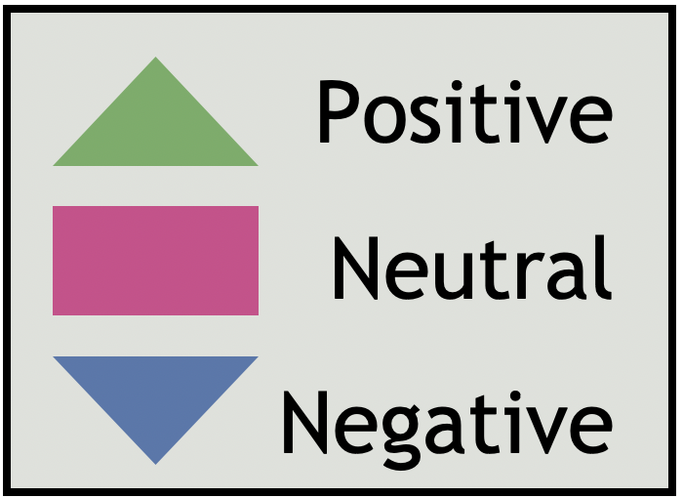
Hammersmith & Fulham Q1 | 2021/22
Network Area GP Reviews
North H&F PCN |  |  |  |  |  | Ease of gaining appointment | Convenience of appointment | Cleanliness | Staff Attitude | Waiting Time | Treatment Explanation | Quality of care | Generally how easy it is to get through ot someone on the phone?
Hammersmith & Fulham Centres for Healt |  |  |  |  |  | - | - | - | - | - | - | - | -
The Westway Surgery, Dr Dasgupta & partners |  |  |  |  |  | - | - | - | - | - | - | - | -
Parkview Practice |  |  |  |  |  | - | - | - | - | - | - | - | -
Canberra Old Oak Surgery |  |  |  |  |  | 3.5 | 3.5 | 4 | 3.5 | 3.5 | 4 | 4 | 3.5
Dr Uppal and Partners |  |  |  |  |  | - | - | - | - | - | - | - | -
Parkview Medical Centre, Dr Kukar |  |  |  |  |  | 3.5 | 5 | 3.5 | 3.5 | 3 | 3 | 3 | 3
The Medical Centre Dr Kukar |  |  |  |  |  | - | - | - | - | - | - | - | -
The New Surgery, Dr Dassanayake & Partners |  |  |  |  |  | 4.5 | 4 | 5 | 5 | 4.5 | 4.5 | 4.5 | 4
Shepherds Bush Medical Centre |  |  |  |  |  | - | - | - | - | - | - | - | -
Number of reviews

Slide 39
Hammersmith & Fulham Q1 | 2021/22
Network Area GP Reviews
H&F Partnership |  |  |  |  |  | Ease of gaining appointment | Convenience of appointment | Cleanliness | Staff Attitude | Waiting Time | Treatment Explanation | Quality of care | Generally how easy it is to get through ot someone on the phone?
Park Medical Centre |  |  |  |  |  | 3.5 | 4 | 4 | 4 | 3.5 | 4 | 4 | 3
Richford Gate Medical Practice |  |  |  |  |  | 3 | 4 | 4 | 4 | 3.5 | 4 | 4 | 5
The Bush Doctors (HFP Medical) |  |  |  |  |  | 3.5 | 4 | 4.5 | 4 | 3.5 | 4.5 | 4.5 | 4.5
Brook Green Medical Centre (HFP Medical) |  |  |  |  |  | 3 | 3 | 3 | 4 | 3 | 3 | 3 | 3.5
North End Medical Centre (HFP Medical) |  |  |  |  |  | 3 | 3.5 | 4 | 4 | 3.5 | 4 | 3.5 | 3
Number of reviews

Slide 40
Hammersmith & Fulham Q1 | 2021/22
Network Area GP Reviews
H&F Central PCN |  |  |  |  |  | Ease of gaining appointment | Convenience of appointment | Cleanliness | Staff Attitude | Waiting Time | Treatment Explanation | Quality of care | Generally how easy it is to get through ot someone on the phone?
The Ashchurch Medical Centre |  |  |  |  |  | - | - | - | - | - | - | - | -
Sterndale Surgery |  |  |  |  |  | 2 | 3 | 4 | 4 | 3 | 4 | 3 | 4
Brook Green Surgery |  |  |  |  |  | 5 | 5 | 5 | 5 | 5 | 5 | 5 | 5
Hammersmith Surgery |  |  |  |  |  | 3 | 3.5 | 4 | 4 | 3.5 | 4 | 4 | 3
North Fulham Surgery |  |  |  |  |  | 4 | 4 | 4 | 4 | 4 | 4 | 4 | 4
Number of reviews

Slide 41
Hammersmith & Fulham Q1 | 2021/22
Network Area GP Reviews
Babylon GP at Hand |  |  |  |  |  | Ease of gaining appointment | Convenience of appointment | Cleanliness | Staff Attitude | Waiting Time | Treatment Explanation | Quality of care | Generally how easy it is to get through ot someone on the phone?
Babylon GP at Hand, The Medical Centre, Dr. S Jefferies and partners |  |  |  |  |  | 4 | 4 | 4 | 4 | 4 | 4 | 4 | 1
Babylon GP at Hand, Dr. S Jefferies and partners |  |  |  |  |  | 3 | 3 | 3 | 3 | 3 | 3 | 3 | 4
Number of reviews

Slide 42
Hammersmith & Fulham Q1 | 2021/22
Network Area GP Reviews
South Fulham PCN |  |  |  |  |  | Ease of gaining appointment | Convenience of appointment | Cleanliness | Staff Attitude | Waiting Time | Treatment Explanation | Quality of care | Generally how easy it is to get through ot someone on the phone?
Fulham Cross Medical Centre |  |  |  |  |  | 2 | 2 | 4 | 4 | 2 | 3.5 | 3 | 2
The Salisbury Surgery, Dr Ravindrasena |  |  |  |  |  | - | - | - | - | - | - | - | -
The Palace Surgery, Dr Mangwana and Partners |  |  |  |  |  | 3 | 3 | 4 | 4 | 5 | 3 | 3 | 3
Cassidy Medical Centre (West London Group Practices) |  |  |  |  |  | 2 | 2 | 3 | 2 | 2.5 | 2 | 2 | 2
Lilyville Surgery @ Parsons Green |  |  |  |  |  | 3 | 3 | 3.5 | 3 | 3 | 3.5 | 3 | 3
Ashville Surgery |  |  |  |  |  | 4 | 4 | 4 | 4 | 4 | 4 | 4 | 4
Fulham Medical Centre |  |  |  |  |  | 3 | 4 | 4 | 4 | 3.5 | 4 | 4 | 4
Sands End Health Clinic |  |  |  |  |  | 3 | 3 | 4 | 3 | 3 | 4 | 4 | 3
Number of reviews

Slide 43
Hammersmith & Fulham Q1 | 2021/22
Themes for primary Network Area
During Q1, we were able to capture reviews across all 5 PCN areas. The following pages show the top themes for each PCN, based on the qualitative analysis of comments received and the application of themes thereafter. For this report, theme counts below 20 were deemed as too low to draw any firm conclusions from. Themes and sentiments will be monitored over the coming quarters to identify any emerging trends. We can only show the main themes for each Primary Care Network (PCN) where we received a significant number of reviews.
In Q1, the PCNs which received a significant number of reviews and were thereby subject to thematic analysis were: North H&F PCN, H&F Partnership, H&F Central PCN, Babylon GP at Hand and South Fulham PCN.
After patients give their overall star rating for the service, there is a section that says "tell us more about your experience". Each comment is uploaded to our Online Feedback Centre where up to five themes and sub-themes may be applied to the comment (see appendix 3 p59-61; for a full list). For this reason, the total numbers of themes-counts will differ from the total number of reviews for each service area. For each theme applied to a review, a positive, negative or neutral 'sentiment' is given. The application of themes, sub-themes and sentiment is a manual process.

Slide 44
Themes for North H&F PCN Network
Hammersmith & Fulham Q1 | 2021/22
This quarter, Healthwatch H&F collected 86 reviews for North H&F PCN, of which 61% (n.52) were positive, 9% (n.8) were neutral and 30% (n.26) were negative. The chart below shows the top three themes for North H&F PCN. The Administration, Staff and Treatment and Care themes have, by far, been the most regularly identified themes in the reviews for the surgeries within the North H&F PCN.
Patient feedback relating to the Administration theme was mostly positive in sentiment (55%). However, 42% (n.22) of the comments relating to the Administration theme had a negative sentiment. The main issues identified were around appointment availability and booking an appointment. The Treatment and Care (70%) and Staff (70%) theme both received mostly positive reviews.
Positive reviews
“The service here is excellent, they are efficient, professional, they listen to you and it's very easy to book an appointment.”
GP Surgery
“I am fine, am always able to get appointments and I don't have a problem with my doctor. He help me a lot. Compare to my country the service here is very good.”
GP Surgery
Themes
Negative / Neutral reviews
“Some of the reception staff are extremely rude and cold hearted. It's hard to get an appointment or help these days when we most need it.”
GP Surgery
“I had a few good experiences, but I also had a really bad experience as well and when it's good it's good, but when it's bad it's very bad. One of the receptionist, she is nice.”
GP Surgery
Number of reviews

Slide 45
Themes for H&F Partnership Network
Hammersmith & Fulham Q1 | 2021/22
This quarter, Healthwatch H&F collected 79 reviews for H&F Partnership of which 51% (n.40) were positive, 17% (n.13) were neutral and 32% (n.25) were negative. The chart below shows the top four themes for the H&F Partnership Network. During this quarter, the number of positive reviews for GP surgeries in the H&F Partnership have increased, compared last quarter.
Administration, Treatment and Care, Access to Service and Staff were the most common themes identified this quarter. The patient feedback related to the Staff theme was mostly positive with 57% (n.24) being positive in sentiment, whereas the majority of reviews belonging to the Administration theme received a negative sentiment – 55%, n.28.
One factor which may contribute to the negative sentiment fed back by some services users is the inability to book an appointment with their GP due to being unable to get through to an administrator on the phone and subsequently having to wait a long time for their next GP appointment. Lastly, the Access to Service theme received primarily negative sentiment reviews with 12 out 18 (67%).
Positive reviews
“I am very happy with my doctor because when I am sick and I need an appointment, I get it.”
GP Surgery
“A good surgery that is easy to contact. Doctor P. is excellent and explains everything well.”
GP Surgery
Themes
Negative /Neutral reviews
“… I ask for a GP call back but was refused an appointment by the surgery and kept being told to call back...”
GP Surgery
“I rang for an appointment and the receptionist was abrupt came across as not interested.”
GP Surgery
Number of reviews

Slide 46
Themes for H&F Central PCN Network
Hammersmith & Fulham Q1 | 2021/22
This quarter, Healthwatch H&F collected 94 reviews for H&F Central PCN of which 52% (n.49) were positive, 10% (n.9) were neutral and 38% (n.36) were negative.
The chart below shows the top four themes for H&F Central PCN.
The Administration theme and the Staff theme have been, the most common themes identified in the reviews for H&F Central PCN.
The patient feedback relating to Staff and Treatment and Care was positive, with 60% and 71% reviews being positive in sentiment, respectively. However, 36% of the reviews that mentioned Staff theme were negative. Administration also received a negative sentiment as 57%% of the reviews belonging to this theme were negative. Once again, this shows that patients/service users are struggling to obtain an appointment or get through to the administrative team on the telephone at their respective GP surgeries.
Positive reviews
“I have been a patient at this surgery for nearly 15 years and have found the doctors to be thorough and kind.”
GP Surgery
“Very fast service and the staff were very good. The environment was clean.”
GP Surgery
Themes
Negative /Neutral reviews
“Treatment is quite bad no appointments because of Covid-19 and some doctors don't care about patients health..”
GP Surgery
“I can't seem to get an appointment, whenever I call I am left in the call queue and been hanged up on once I became number 1.”
GP Surgery
Number of reviews

Slide 47
Themes for Babylon GP at Hand
Hammersmith & Fulham Q1 | 2021/22
This quarter, Healthwatch H&F collected 43 reviews for Babylon GP at Hand PCN. Of these reviews, 56% (n.24) were positive, 11% (n.5) were neutral and 33% (n.14) were negative. This chart shows the top three themes for Babylon GP at Hand.
Administration was, once again, the most common theme identified in the reviews for this PCN, with 43% (n.22) being positive in sentiment. However, 57% (n.29) of the reviews belonging to this theme were negative in sentiment, which seemed to be largely caused by patients not being able to get through to a receptionist on the telephone to book an appointment. The Staff theme was largely positive this quarter (61%), with patients praising the staff members' attitudes at their respective surgeries. However, this quarter the feedback that highlighted the Access to Service theme were mostly negative in sentiment with 52% (n.11) of the reviews being negative.
Positive reviews
“I am very happy to use this service. It's so easy and convenient to get an appointment either face to face or by telephone consultation.”
GP Surgery
“I don't know how they do it but referrals were amazingly quick.”
GP Surgery
Themes
Negative / Neutral reviews
“The service standard is very poor! Every time I come across with admin dept, there is an issue!.”
GP Surgery
“Worst experience. I have been trying to contact them for months, but the phone is always ignored.”
GP Surgery
Number of reviews

Slide 48
Themes for South Fulham PCN
Hammersmith & Fulham Q1 | 2021/22
This quarter, Healthwatch H&F collected 268 reviews for South Fulham PCN. Of these, 59% (n.158) were positive, 13% (n.35) were neutral and 28% (n.75) were negative. The chart below shows the top four themes for South Fulham PCN.
Staff and Administration were by far most common themes identified. Patient feedback relating to Staff was very positive, making up 75% of the total number of these reviews. On the other hand, almost two thirds of the reviews referencing the Administration theme were negative, with 62% (n.135) being negative in sentiment. Reviews that were related to the Access to services were largely negative in sentiment, making up 73% (n.49) of the total numer of reviews. Lastly, whilst the Treatment and Care theme was identified less frequently than the two leading themes, the reviews were mostly positive (77%).
Positive reviews
"The staff has always been professional, friendly, and helpful. I have always been treated nicely and always been able to get an appointment.”
GP Surgery
‘‘I have always had a good experience and whenever I have had issue with them they always try to resolve it. The staff are nice and helpful and the doctor I see is really nice.”
GP Surgery
Themes
Negative / Neutral reviews
“The admin staff believe they are qualified doctors, they are very rude.”
GP Surgery
“Have been a patient at the practice for years. Usually good. This time the doctor was rude, unsympathetic and showed a lack of concern for my issues.”
GP Surgery
Number of reviews

Slide 49
Demographic Information
Hammersmith & Fulham Q1 | 2021/22
The pie chart below shows the breakdown of participants by religion. A large proportion of people leave this question blank or chose not to identify their religion. Out of the total number of participants this quarter, 23% (n.274) identified as being Christian, 7% (n.88) practice Islam and 3% (n.36) practice Other religions. 14% (n.166) identified as having no religion. We will seek to improve the completion of monitoring data through our face to face engagement.
The pie chart below shows the breakdown of participants by age group. Aside from the majority of participants who left this question blank (n.625), the age group to provide the most feedback was the 55-64 at approixamtely 11% (n.136). This was followed by the 65-74 age group at approximately 11% (n.132), and the 45-54 age group accounting for 9% (n.104) of the population sample. Although there is representation in the lower age groups, given the boroughs profile, further work will be done to increase feedback from these groups and subsequently produce more robust conclusions about their interactions with services.
Religion of Patients
Age of Patients

Slide 50
Demographic Information
Hammersmith & Fulham Q1 | 2021/22
In terms of ethnicity, aside from the 49% (n.601) who did not complete this section, the largest proportion of feedback received this quarter was from people who identified as ‘White British’ (30%, n.360), an increase of 11% from last quarter. The next highest category was from people who identify as ‘Black British - African’ at 6% (n.77), followed by ‘White - Any other White background’ at 5% (n.65). Further monitoring of ethnicity data will take place to help direct targeted engagement work in the future.
The pie chart below shows the number of reviews received by gender. When comparing the number of individuals who identified as either Male or Female, the majority of the reviews received this quarter are from females with 33% (n.396) of the total population sample - a decrease of 2% compared to last quarter. Males made up 16% (n.194) of the sample population this quarter, representing an increase of 5% compared to last quarter. As we have noticed that women are more willing to share their experiences, further work will be undertaken to gather feedback from men.
Ethnicity of Patients
Gender of Patients

Slide 51
Demographic Information
Hammersmith & Fulham Q1 | 2021/22
During our direct telephone and face to face engagement, we have spoken to residents living in 15 different areas across the borough of H&F. The highest number of the reviews received was from residents in the Parsons Green and Walham Ward
(10%, n.124), the Town Ward (6%, n.76) and the North End Ward (6%, n.69). The least number of reviews received was from the Ravenscourt Park Ward (1%, n.4). Compared to last quarter, we have seen an increase in reviews for some areas whilst others have decreased. In Quarter 2, we will continue to try and reach more people in the areas where we have received the fewest reviews, through face to face engagement.
Patient’s area of residence | Number of reviews | Percentage
Parsons Green and Walham Ward | 124 | 10%
Town ward | 76 | 6%
North End Ward | 69 | 6%
Hammersmith Broadway Ward | 59 | 5%
Sands End Ward | 54 | 4%
Workholt and White City ward | 48 | 4%
Avonmore & Brook Green Ward | 44 | 4%
Munster Ward | 30 | 2%
Addison Ward | 22 | 2%
Askew Ward | 17 | 1%
Fulham Broadway Ward | 15 | 1%
College Park and Old Oak Ward | 12 | 1%
Palace Riverside Ward | 13 | 1%
Fulham Reach | 8 | 1%
Ravenscourt Park Ward | 4 | 1%
Prefer not to say | 620 | 51%
Patient area of residence

Slide 52
Hammersmith & Fulham Q1 | 2021/22
Conclusion
Our Patient Experience model has developed significantly from Q4 2020/2021 to Q1 2021/2022. Most significantly, we are now incorporating a degree of face-to-face engagement, allowing us to gather feedback from individuals in person and rely less on online reviews and direct telephone engagement as our primary sources of feedback. We will continue to take a stepped approach to our face-to-face engagement work to ensure the safety of the public and our Patient Experience team remain a priority. As an example of the impact this shift back to our preferred model of engagement has had on our work, we have seen an increase this quarter in the number of reviews that we received for GP surgeries. We hope to continue this great work with GP surgeries in the borough during the coming quarters.
For this quarter, we collected a total of 1215 reviews. There were 894 (73%) positive reviews with a star rating 4-5, 92 (8%) neutral reviews with a star rating of 3 and 229 (19%) negative reviews with a star rating 1-2. As we saw in Q4 (January – March 2021), positive patient experiences far outweigh the negative experiences, overall. Unfortunately, a trend that we see continuing on from Q3 and Q4 of 2020/2021 is the high proportion of 1-star ratings. This is a trend that is not as prominent in neighbouring boroughs and therefore will be an area that we continue to monitor and feedback on, providing evidence for how we can address the prominent issues. During this quarter, one contributing factor to these 1-star reviews may be due in part to the continuing impact of the pandemic on experiences and may also be due to online reviews still being a feature of our data.
In comparison to the previous three quarterly reports, the rate at which we have received demographic information from patients/service users has increased. One factor which may have contributed to this increase is the return to face-to-face engagement and we would therefore expect this upward trajectory for demographic information to continue in future quarters.
If we look beyond the broader picture and at specific service categories, our findings indicate the following:
GP services
Positive feedback remains high around the Treatment and Care theme (75%) and Staff theme (68%), as well as associated sub-themes (Experience, Quality of Care and Staff Attitudes). The Access to Services theme received a significant amount of negative feedback (71%), as did Waiting Times (66%). Looking at previous quarters alongside this evidence, the Access to Services theme has consistently received the highest, or one of the highest, proportions of negative sentiment compared to other themes. The Administration theme received a significant number of negative reviews compared to the previous quarter (39% positive, 59% negative and 10% Neutral). The main issues were with the sub-themes Booking Appointment (52% negative) and Getting through to someone on the telephone (80% negative).

Slide 53
Hammersmith & Fulham Q1 | 2021/22
Conclusion Cont.
Hospital Services (Imperial College NHS Trust)
Our findings indicate that the area in which the Imperial College NHS Trust can further improve is by reducing the length of time that individuals wait for their hospital appointment, as 52% of the reviews relating to the Waiting Times theme this quarter were negative in sentiment. Similarly, to the previous 3 quarters, the theme Access to services and the sub-theme Waiting Times received the lowest number of positive reviews compared to other themes and sub-themes for Imperial College NHS Trust Hospitals. Areas of good practice can be found in the overall Treatment and Care Experience (69% positive) for patients – an increase of 19% compared to last quarter. There was also an overwhelming number of positive reviews (87%) for the members of staff at the Trust's hospitals, highlighting the incredible efforts of the staff to deliver their duties to the highest standard.
Hospital Services (Chelsea and Westminster NHS Foundation Trust)
During this quarter, we were only able to obtain a significant amount of feedback for the Treatment and Care and Staff themes for Chelsea and Westminster NHS Foundation Trust Hospitals. In total 77% of the reviews referencing the Treatment and Care theme were positive, with 86% of the reviews referencing the Quality-of-Care sub-theme being positive in sentiment. Similarly, to quarter 4 of last year, the reviews belonging to Chelsea and Westminster NHS Trust are more positive than negative, overall.
Pharmacy Services
Overall, H&F patients/service users are satisfied with the Staff Attitudes at their respective pharmacies and are happy with the way that the service, and concurrently their prescriptions, are being managed. However, it seems that there are some issues around the Waiting Times sub-theme as patients/service users, await longer than desired, their prescriptions.
PCN specific Network
If we look at the individual PCN areas on pages 36-47, we see that for the majority of PCN's there are issues around Administration, Booking Appointments, Getting through to someone on the telephone, Appointment Availability and Waiting Times. The feedback referencing the Treatment and Care and Staff themes were generally positive. The PCN that had the most negative reviews was the South Fulham PCN (59% positive, 13% neutral and 38% negative). Similarly, to quarter 4, we can see that the number of negative reviews have increased. This is most likely due to patients/service users struggling to get through on the telephone to book an appointment or being unable to speak to a receptionist. This may also be a result of some of the GPs not allowing appointments to be booked over the phone. This has been an issue since quarter 2 of the 2020/21 financial year which has been a source of frustration for many individuals that we have spoken to.

Slide 54
Hammersmith & Fulham Q1 | 2021/22
Action, impact and next steps
Action, impact and next steps
Healthwatch H&F will share the findings contained within this report at various commissioning, provider and local authority led boards and committees. These include:
Hammersmith and Fulham Health and Wellbeing Board
Hammersmith and Fulham Scrutiny – Health, Inclusion and Social Care Policy and Accountability Committee
Hammersmith and Fulham Clinical Commissioning Group - Patient Reference Group
Hammersmith and Fulham Safeguarding Adults Board
As well as these formal meetings, we attend and co-ordinate a number of meetings with partners in order to share the findings of the report highlighting areas of concern and interest.
In December 2020, the eight Clinical Commissioning Groups in Northwest London moved to a single staffing structure ahead of the planned CCG Merger in April 2021, which has changed local decision-making structures.
We at Healthwatch H&F will identify opportunities to share our findings within this new structure. Whilst we are hopeful of moving back to our preferred model of face-to-face patient experience engagement, we will continue to explore innovative ways in which we can remotely engage with service users under the continuing COVID-19 measures as we tentatively move out of the lockdown. This will include:
Promoting our Patient Experience programme through Health and Social Care service partners, such as the Local Authority and the CCG.
Collecting feedback via direct telephone engagement.
Using Social Media platforms, such as Twitter and Facebook to raise awareness of our service.
Using community applications such as Nextdoor- Neighbourhood App to promote Healthwatch H&F's work including our Patient Experience programme.
Working with the GP Federation and our GP surgeries to continue to utilise our Healthwatch Patient Experience widget on GP websites – This has already resulted in an increase in the number of reviews received.
Seeking feedback from local patients and service users on how to expand our outreach methods and encouraging patients/service users to visit our website.
Continuing to establish and grow our relationships with key partners in the voluntary and community sector.
Further developing our volunteer programme to ensure volunteers continue to learn the skills and gain the experience necessary to support our Patient Experience programme.
Continue to attend community forums to support other ongoing work in the borough and to promote our service.

Slide 55
Action, impact and next steps cont.
Hammersmith & Fulham Q1 | 2021/22
We will continue to identify opportunities for sharing our findings at different forums and settings within the Borough to inform our own work priorities and research studies for Q2 2021/22. This includes the POPS Forum and the CCG Patient Reference Group. We will also:
Produce an in-depth analysis on the level of access to GP services during the last year. This analysis of previous patient experience data will allow us to identify the key areas in which service delviery can be improved in the borough as well as highlighting the areas in which GP surgeries are doing particularly well, to ensure that best practices are shared.
Prioritise the feedback gathering process for Mental Health Support Services. To identify how Mental Health support services in the borough have been providing care during the last few months our Patient Experience team have created a shortened version of the Patient Experience feedback form (see appendices) to take a much more tailored approach to capturing service user feedback. We will look to promote this survey via our networks during the coming quarters and continue to build relationships within the community to understand how we can gain feedback for Mental Health services.
Further explore patient access to Dental services and Pharmacies. Our Patient Experience team will build upon the collaborative work we recently completed with YVHSC to provide further insight into how residents are managing to access dentists and pharmacies. This will be a focus for our staff and volunteers conducting face to face outreach, as we recognise that the aforementioned reports only captured the views of those that had been able to use these services and not those who had been unable to access them.
Further analysis into our Patient Experience demographic data. Through analysing our Patient Experience data, Healthwatch H&F will work with YVHSC to explore whether there are any significant differences in the level of access and care that different ethnicities have experienced, throughout the Pandemic. The findings from this report can subsequently inform our own internal workplans and indeed the local and regional inequalities agendas.
Continue to build relationships with H&F GPs, PCNs and the GP Federation. Healthwatch H&F were able to further establish and develop our relationship with statutory bodies during this quarter and we will continue to work closely with these organisations and individuals to ensure that the reach of our Patient Experience program grows and that in turn, the evidence that we present is utilised in the most effective ways.
Continue to build relationships with Imperial College NHS Trust. Healthwatch H&F will work with the Trust to understand how we can best channel our reports and recommendations through their governance structure and collaboratively create a plan for our Patient Experience outreach at the Trust's sites, when they are able to safely welcome back our team.

Slide 56
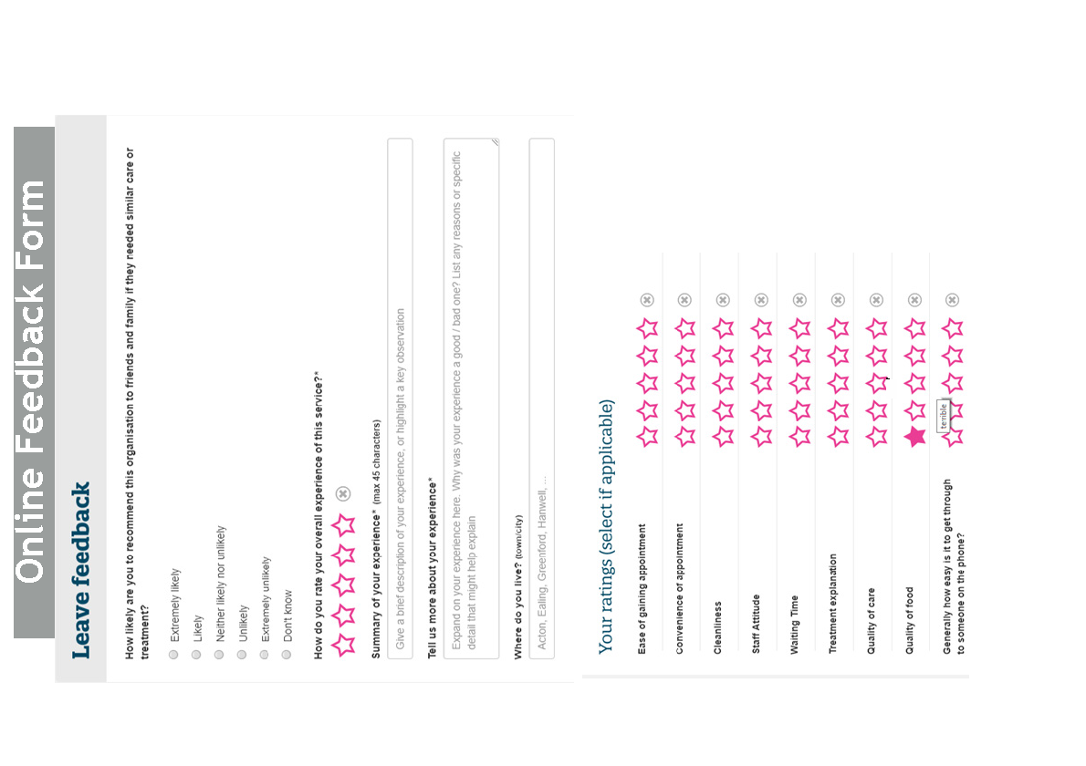

Slide 57
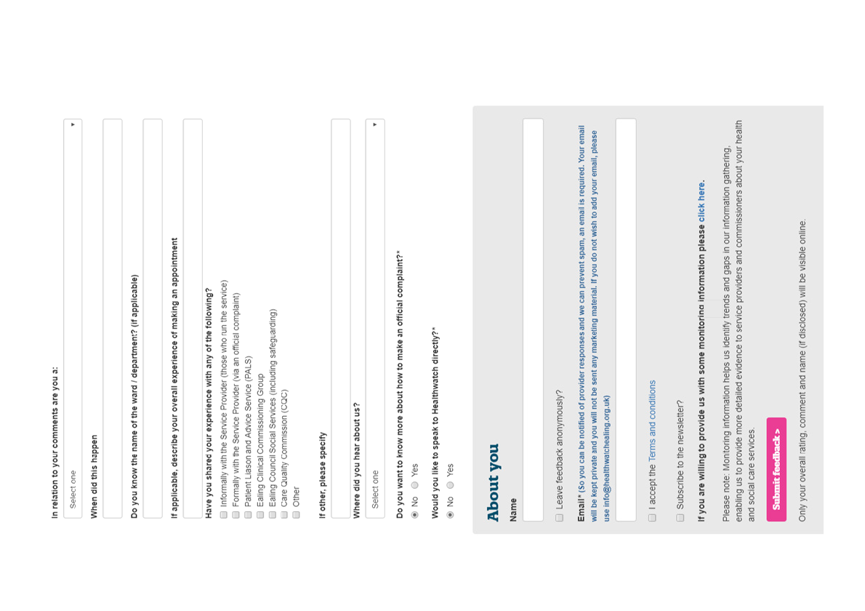

Slide 58
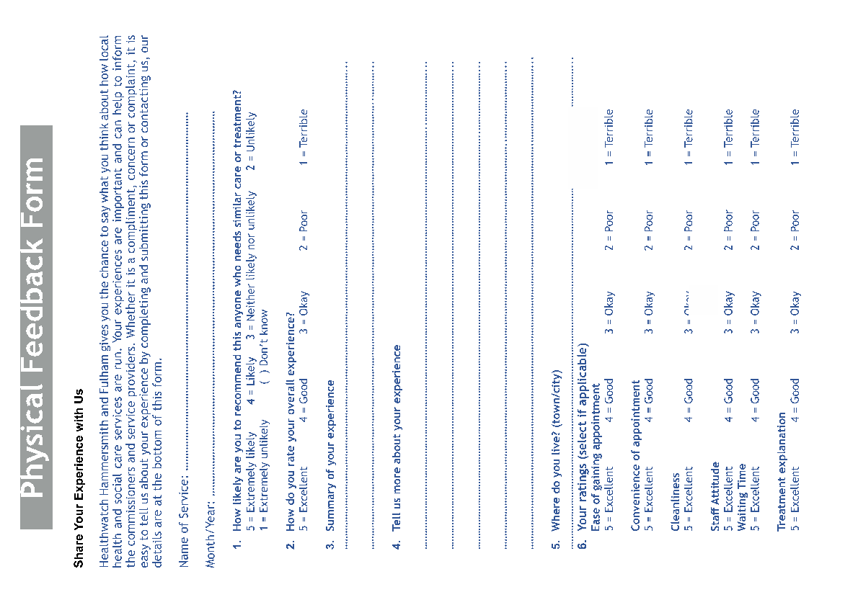

Slide 59
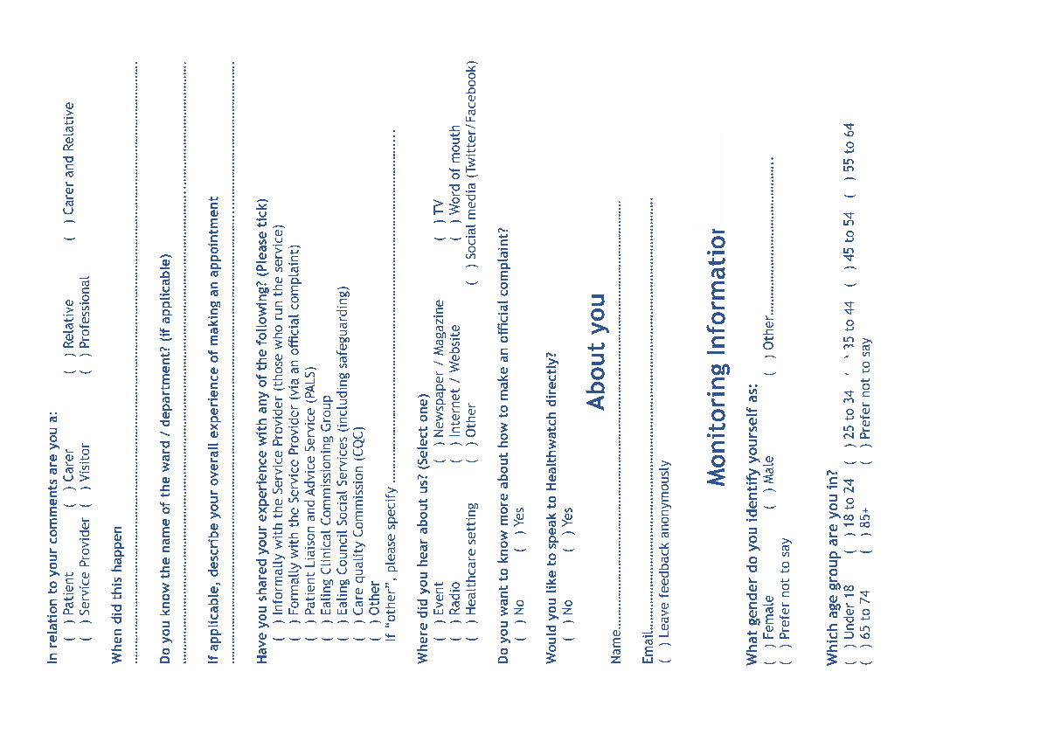

Slide 60
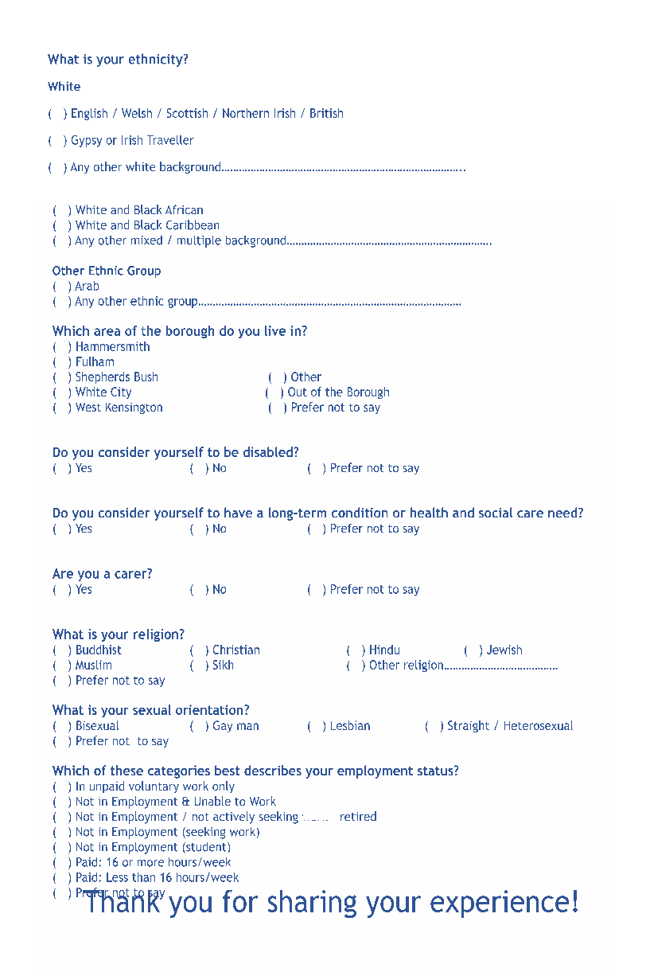

Slide 61
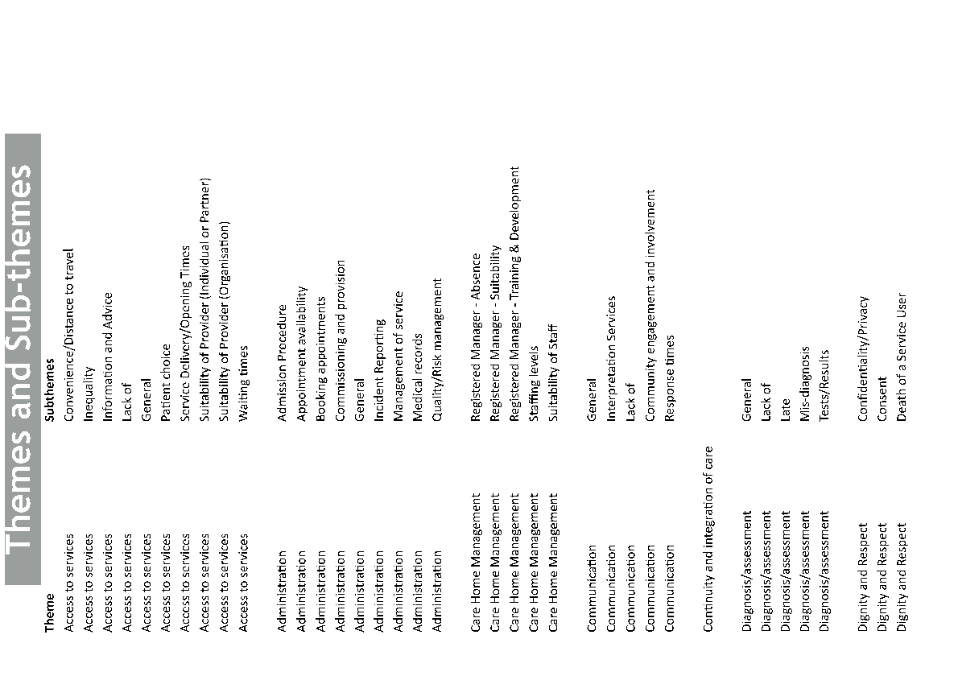

Slide 62
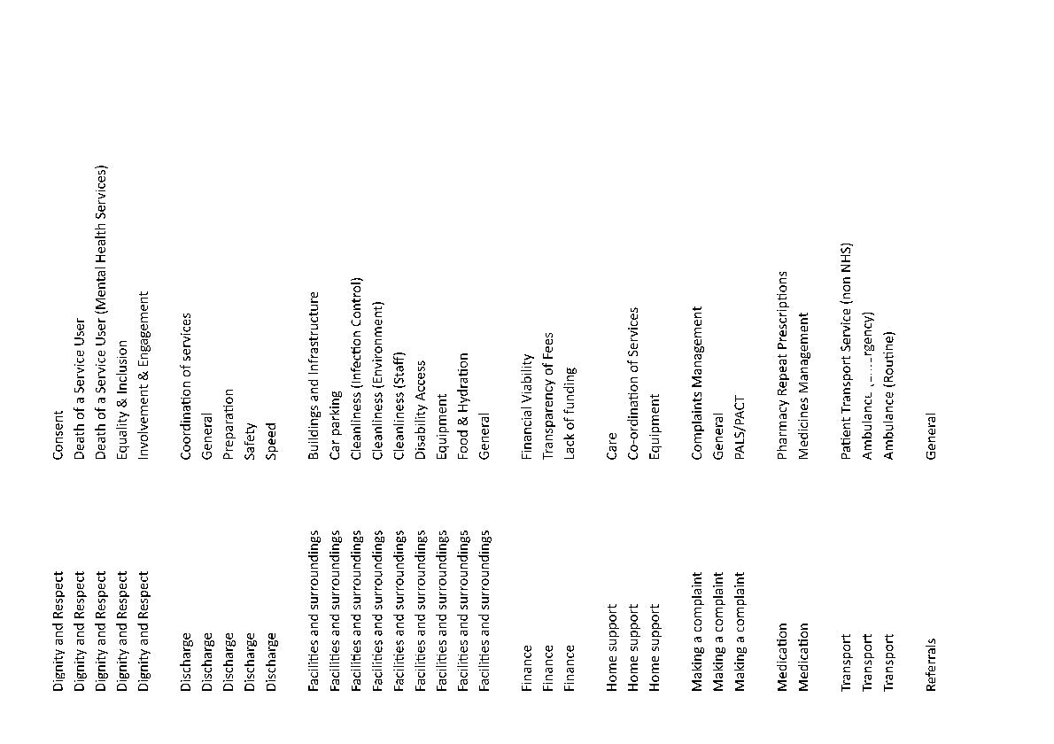

Slide 63
