Slide 1
PATIENT EXPERIENCE
REPORT 2021/2022
QUARTER 2
July-September

Slide 2
Contents
Hammersmith & Fulham Q2 | 2021/22
Introduction & Executive Summary
2
Our data explained
4
Overall Star Rating
5
Total Reviews per Service Category
8
Distribution of Positive, Neutral & Negative
9
Themes: GP, Hospital and Pharmacies
10
Other Positive Reviews
26
Other Negative and neutral reviews
30
Themes for Primary Care Network Area
34
9
Demographic Information
46
Conclusion
49
51
Action, impact and next steps
Appendix
53

Slide 3
Introduction & Executive Summary
Hammersmith & Fulham Q2 | 2021/22
Healthwatch was created by the health and social care reforms of 2012 with a powerful ambition of putting people at the centre of health and social care. To help realise that ambition Healthwatch Hammersmith & Fulham delivers a number of services to gather and represent the views of patients and service users of health and social care in the Hammersmith & Fulham borough. One of the ways we do this is through a comprehensive Patient Experience data collection programme. The successful implementation of this programme, including the use of our Digital Feedback Centre, will yield a minimum of 4,800 patient experiences per annum, all of which will be presented as they are received and considered as a valid community opinion. Your Voice in Health and Social Care (YVHSC) took over the provision of Healthwatch Hammersmith & Fulham in April 2020. In April 2020, the Digital Feedback Centre which is integral to the Patient Experience programme was launched together with the Healthwatch Hammersmith & Fulham website.
Our Patient Experience Officer, supported by a team of volunteers, will visit health and social care services to talk to and hear from patients, service users, carers, and relatives about their experiences of local services. The Healthwatch Team captures this information using our standardised Patient Experience Form (see appendices) that they fill in with the individual. This form includes questions for individuals to provide their overall ratings for the service, ratings for specific aspects of the service; such as ease of booking appointments and staff attitudes, and the opportunity to provide further detail about their experience in a free text box, should they see fit. This engagement method is supplemented by independent feedback that individuals are able to provide for the service in question, by visiting our website and filling out the exact same Patient Experience Form online through the Digital Feedback Centre. People can choose to leave their name or comment anonymously. At the end of each service visit, the Patient Experience Officer will relay any urgent matters requiring attention to the Operations Manager of Healthwatch Hammersmith & Fulham.
In May of 2021 we were able to restart our face-to-face engagement in GP surgeries in a limited capacity. Healthwatch H&F is taking a stepped-approach to moving back to our traditional model of face-to-face engagement for the Patient Experience programme to prioritise the safety of patients and Healthwatch staff and volunteers as well as ensuring that we do not interfere with GP surgery operations. During this quarter, we therefore implemented both our new and pre-pandemic model of engagement, combining in-person GP surgery visits with direct engagement over the telephone, the collection of feedback via the NEXTDOOR APP and collecting and collating existing online reviews from relevant platforms such as NHS.uk and Google reviews. This new 'digital' model that we have implemented throughout the pandemic has benefited residents by providing additional information and signposting and a level of befriending for many of those contacted over the telephone.

Slide 4
Introduction & Executive Summary cont.
Hammersmith & Fulham Q2 | 2021/22
Of course, these new methods of feedback collection bring their own limitations. First, although every effort is made to ensure
participant diversity, there is less opportunity through telephone and online contact, to speak to the diverse range of residents
that Patient Experience Officers would usually speak to in Primary and Secondary Care settings. A second limitation of collecting
online reviews is that there is the potential for a Selection Bias regarding the sentiment of feedback - individuals are more likely to
input a negative experience online than a positive one. Both these limitations, the general context of the COVID-19 pandemic and
indeed the strain that it is putting on healthcare services and patients' own wellbeing, must be taken into account when reviewing the
findings of these reports.
This report covers the period of Quarter 2, from July to September, 2021. In ordinary circumstances, face-to-face community outreach
yields a minimum of 1,200 patient experience feedbacks, per quarter. In spite of being in this time of adapted engagement, we were
able to gather a total of 1213, achieving our quarterly target of 1200.
Out of the total number of patients experiences received:
898 (74%) were positive with a star rating of 4-5,
130 (11%) were neutral with a star rating of 3, and;
185 (15%) were negative with a star rating 1-2 (this is based on the overall star rating provided by patients - see page 4 for further detail).
In addition, we have worked extensively to promote our new service across the borough, driving direct reviews to our website for those with internet access. We have distributed our poster and leaflet in each of the GP surgeries that we have visited this quarter.
We also continue to make use of the Healthwatch Hammersmith and Fulham Widget which is currently used in thirteen GP surgeries, Imperial Healthcare NHS Trust and other community and voluntary sector organisation websites. We would like to thank all of these service providers for their ongoing support. As our service becomes further embedded across the borough, we expect greater awareness of our service and a subsequent increase in the number of reviews made directly through our website or by calling our office.

Slide 5
Our data explained
Hammersmith & Fulham Q2 | 2021/22
Healthwatch Hammersmith & Fulham uses a Digital Feedback Centre (on our website) and Informatics system (software behind the Digital Feedback Centre) to capture and analyse patient experience feedback.
The Informatics system is currently used by approximately 1/3 of the Healthwatch Network across England and it captures feedback in a number of ways:
It asks for an overall star rating of the service, (between 1-5).
It provides a free text box for comments
It asks for a star rating against specific domain areas, (between 1-5).
The above provides Healthwatch with several data sets.
Star ratings provide a simple snapshot average, both overall and against specific domain areas. The free text comment box is analysed in two different ways, with two different data set results:
In the first instance, free text comments are broken down and analysed for themes and sub themes. Where relevant, up to 5 themes and sub themes can be applied to any one patient experience comment. Upon each application of a theme or sub theme, a positive, negative or neutral sentiment is also applied. This is a manual process undertaken by trained staff and specially trained volunteers. The process is overseen by the Patient Experience Officer and regularly audited in order to ensure consistency. Where themes and related sentiments are discussed in the report, it relates to this aspect of the process.
Each of the areas described above provides an independent set of results which can be viewed separately or in conjunction with one another in order to gain an insight into a service or service area. It is important to note that correlation between different data sets may not be apparent, for example, a service may have an overall star rating of 4/5 but much lower ratings against individual domain areas.

Slide 6
Overall Star Ratings
Hammersmith & Fulham Q2 | 2021/22
The table below shows a breakdown of the negative, neutral, and positive patient reviews (see the appendices for examples of our physical and online questionnaires). Each patient is asked to give an overall rating out of 5 stars for a service. Star ratings of 1 and 2 indicate a negative response, a star rating of 3 indicates a neutral response and star ratings of 4 and 5 indicate a positive response.
It is important to note that our experience has shown that people are very reluctant to give a negative rating of their care provider. When the 3* 'neutral' ratings are analysed in more detail we have traditionally found these to outline negative feedback. Therefore, where a significant number of 3* ratings are found, our experience tells us these areas are worthy of further attention to help identify areas for improvement. This quarter 898 positive responses, 185 negative responses and 130 neutral responses have been recorded.
Month | 1 – 2 Star Reviews (Negative) ★ ★ ☆ ☆ ☆ | 3 Star Reviews (Neutral) ★ ★ ★ ☆ ☆ | 4 - 5 Star Reviews (Positive) ★ ★ ★ ★ ★
July | 42 | 34 | 328
August | 63 | 44 | 298
September | 80 | 52 | 272
Total | 185 | 130 | 898

Slide 7
Overall Star Ratings
Hammersmith & Fulham Q1 | 2021/22
This chart provides a breakdown of negative, neutral, positive and total reviews for each month, based on the overall star rating provided.

Slide 8
Overall Star Ratings
Hammersmith & Fulham Q2 | 2021/22
Individuals are asked to provide an overall star rating for the service that they are reviewing. With five stars being the highest and one star being the lowest. These pie charts show the breakdown of star ratings for each month and for the whole quarter.
In each month, the 5-star rating received the highest proportion of reviews, followed by the 4-star rating and 1-star rating.
In July, the 5-star rating received almost two thirds (n.226) of the reviews with 5-star rating, in August making up 47% (n.188) of the monthly total. However, in September the number of 5-star ratings has reduced to 40% (n.162). We have also noticed a reduction in the numbers of negative reviews compared to previous quarters. One contributory factor could be the increased face-to-face engagement in GP surgeries where we approach patients/service user and ask them to share their feedback.
The overall star ratings for services tell us that people are satisfied.

Slide 9
Total Reviews per Service Category
Hammersmith & Fulham Q2 | 2021/22
The patient reviews recorded for this quarter cover twelve service categories, as seen in this chart.
The category with the highest number of reviews recorded was for GPs (n.605), followed by Dentists (n.202), Pharmacies (n.158) and then Hospitals (n.152).
Compared to quarter 1 of this financial year (April-June 2021), the number of reviews for GP surgeries has increased.
Since the 17th of May we have restarted our face-to-face engagement work in the community. This factor likely contributed to the increase in GP reviews this quarter.
Type of services
Number of reviews

Slide 10
Distribution of Positive, Neutral & Negative
Hammersmith & Fulham Q2 | 2021/22
The bar chart compares the number of positive, neutral and negative reviews for each service category. This is based on the overall star rating.
50% of the reviews were about people's experiences of GP services. This is an increase of 3% from last quarter.
17% of the reviews were about people's experiences of Dentists. This shows a decrease of 6% from last quarter.
13% of the reviews were about people's experiences with Pharmacies. An increase of 2% from last quarter.
13% of the reviews were about people’s experiences with Hospitals. A decrease of 1% from last quarter.
Other comments were about Opticians, COVID-19 Services, Community Health Services, Mental Health Services, Social Care and Residential Care.
Of these services:
Dentists received the highest proportion of positive reviews at 92%, followed by Pharmacies with 87%, GPs with 68% and Hospitals with 60%. There was a 6% decrease in the proportion of positive reviews reported for GPs this quarter, compared to last quarter and also a decrease of 12% in the proportion of positive reviews reported this quarter for Hospitals.
Type of service
Number of reviews

Slide 11
Themes and Sub-Themes
Hammersmith & Fulham Q2 | 2021/22
After asking patients for an overall star rating of the service we encourage them to "tell us more about your experience" (see the appendices for examples of our physical and online questionnaires). Qualitative analysis is conducted on individuals' comments to identify emerging or trending themes and sub-themes. To do this each comment is uploaded to our Online Feedback Centre where up to five themes and sub-themes may be applied to the comment (see appendix 3 p59-61 for a full list). For this reason, the total number of theme-counts will differ from the total number of reviews for each service area. For each theme applied to a review, a positive, negative, or neutral 'sentiment' is given.
The application of themes, sub-themes and sentiments is a manual process undertaken by trained staff and differs from the star rating patients provide.
This section shows a breakdown of the main themes and sub-themes for those service areas where we received a significant number of reviews.
In Q2 these areas are:
GP surgeries;
Hospitals and their Trusts;
Pharmacies

Slide 12
GP Themes and Sub-Themes
Hammersmith & Fulham Q2 | 2021/22
Administration, remains one of most applied themes for GPs this quarter. The theme was applied on 593 counts, with 40% (n.237) of these being positive, 5% (n.30) being neutral and 55% (n.326) were negative.
Booking an Appointment, was one of the most applied sub-themes within this service category, identified in 286 responses. Of these responses, 48% (n.137) were positive, 4% (n.12) neutral and 48% (n.137) were negative, with the negative reviews largely caused by patients being unable to book an appointment. This quarter there is a balance between positive and negative sentiment. Patients/service users continue to have issues accessing their GPs due to the pandemic. On a more encouraging note, 78% (n.45) of the 58 individuals who mentioned the Management of Service sub-theme, mentioned it in a positive context.
For the Appointment Availability sub-theme, there were 73 counts, of which, 30% (n.22) were positive, 3% (n.2) neutral and 69% (n.49) were negative. Patients\service uses are struggling to obtain a suitable appointment. Many of the reviews relating to the sub-theme, Getting through on the telephone, were negative in sentiment with 77% (n.128) being negative. This was due to unanswered calls, long waiting times and patients unable to speak to the receptionist on the phone when trying to book an appointment or ask for advice. This issue has been identified as an ongoing trend in GP surgery reviews since quarter 2 2020/2021.
Positive reviews
“It's very easy to book an appointment, I had mine booked here, I came here and ask for an appointment.”
GP Surgery
“I rang on Thursday and was able to get an appointment for Monday and it's not too bad, the staff are great.”
GP surgery
Sub-themes
Negative reviews
“I can never get an appointment and I only ever make appointments if it’s urgent.”
GP surgery
“There is long waiting for an appointment. It's easy to get the appointment but you will need to wait for 2 to 3 weeks before seeing the doctor.”
GP surgery
Number of reviews

Slide 13
GP Themes and Sub-Themes
Hammersmith & Fulham Q2 | 2021/22
In this quarter, Staff, was the second most applied theme for GPs. It applied to 375 reviews, of which 79% (n.300) were positive, 6% (n.22) were neutral and 14% (n.53) were negative.
The chart below presents a more detailed breakdown, featuring the top three sub-themes for the Staff theme.
The majority of reviews focused on the sub-theme Attitude, where 79% (n.223) of the reviews were positive in sentiment. Taken together with the positivity regarding the sub-themes Capacity and General, this strongly suggests that the majority of patients/service users were satisfied with the professionalism provided by the administrative and clinical teams at their respective GP surgeries.
Positive reviews
“Very efficient and friendly service. Mr. P was great and incredibly helpful.”
GP surgery
“The receptionists are very nice, last week I had my cervical check-up done with the nurse and she was very good and very nice.”
GP surgery
Sub-themes
Negative / Neutral reviews
“It's impossible to book an appointment, the receptionist staff are rude and unhelpful. They never answer the phone, however, the doctors are great.”
GP surgery
“The place is an absolute shambles. They have no idea as to what's going on with their own patients nor are they willing to help even when the fault is their own . The staff are rude, careless, and obnoxious.”
GP surgery
Number of reviews

Slide 14
GP Themes and Sub-Themes
Hammersmith & Fulham Q2 | 2021/22
Access to Services, was the third most applied theme for GPs this quarter. It was applied 203 times with the majority of reviews relating to the sub-theme, Waiting Times. This sub-theme was identified in 154 reviews with 34% (n.52) being positive, 5% (n.8) neutral and 61% (n.94) negative.
In addition, the reviews relating to the sub-theme, Patient Choice, were mostly negative in sentiment (91% n.20). This indicates that there remains significant concerns from patients with length of time waiting for an appointment as well as the amount of choice and availability of appointments. Compared to Q4 of the 2020/21 year, negative reviews relating to the Access to Service theme have increased, significantly and continue to increase. This insight must be viewed within the current context of the pandemic and is a trend which we will continue to monitor, sharing this insight with providers and key health partners.
Positive reviews
‘‘Very good service, very easy to book an appointment, I do everything online, its pretty quick, no need to call. I have not dealt with the receptionist for a very long time.”
GP surgery
‘‘I have not been here for many year after having a cardiac arrest. I came to see the staff if they can book an appointment for me, but they offered me one straight away.”
GP surgery
Sub-themes
Negative / Neutral reviews
‘‘It's literally impossible to speak to the receptionist if you can see my phone now, it took me over 1 hour to get through the receptionist.”
GP surgery
‘‘Very poor service. They do not reply to support tickets or emails, and it is very hard to get them on the phone.”
GP surgery
Number of reviews

Slide 15
GP Themes and Sub-Themes
Hammersmith & Fulham Q2 | 2021/22
Treatment of Care, was the fourth most applied theme for GPs this quarter. It received 185 reviews. Of the total count 77% (n.142) were positive, 3% (n.6) were neutral and 20% (n.37) were negative. The chart below shows the breakdown for the Treatment and Care theme into the top four sub-themes.
Quality of Care was the most applied sub-theme this quarter. This sub-theme was identified as largely positive in sentiment; 86% (n.70). The second highest identified sub-theme was Experience, with 70% (n.44) of these reviews being positive in sentiment, an increase compared to last quarter. The Safety of Care sub-theme was almost equally identified in postive (n.8) and negative (n.6) reviews, indicating that there could be some concerns over the safety of patients when attending GP surgeries. This may, however, be due to a hesitancy to attend the GP clinic or in-person treatments available during Covid-19. Patients/service users are generally satisfied with the treatment and care received at their respective GP surgeries.
Positive reviews
“The doctors go the extra mile for their patients. I had a very tough time with multiple health issues during the pandemic and I was looked after amazingly. They are particularly good with mental health issues and the level of care is exemplary.”
GP surgery
“Mr. P was great while doing my blood test this morning. He guided me through the steps and was quick and painless. Can't recommend him enough!!.”
GP surgery
Sub-themes
Negative/ Neutral reviews
“Very unprofessional and the worst experience ever! They are not helpful, I had a procedure done at the dentist and I was in pain I went to see the GP and told me I had to go private because this was done at the dentist. He left me in pain.”
GP surgery
“Awful experience as the doctors don't care and are not consistent. No appointment availability and the receptionists are rude.”
GP surgery
Number of reviews

Slide 16
Positive, Negative, Neutral and Total reviews for each Hospital
Hammersmith & Fulham Q2 | 2021/22
This section shows a breakdown of the main themes and sub-themes identified in the reviews that Healthwatch received for the hospitals under the Imperial College Healthcare NHS Trust and Chelsea and Westminster Hospital NHS Foundation Trusts. These hospitals are:
Charing Cross Hospital: Out of the total reviews for the quarter (n.42), 48% (n.20) were positive, 21% (n.9) neutral and 31% (n.13) negative
Hammersmith Hospital: Out of the total reviews for the quarter (n.22), 68% (n.15) were positive, 14% (n.3) neutral and 18% (n.4) negative
St Mary’s Hospital: Out of the total reviews for the quarter (n.25), 60% (n.15) were positive, 20% (n.5) neutral and 20% (n.5) negative
Queen Charlottes and Chelsea Hospital: Out of the total reviews for the quarter (n.18) , 67% (n.12) were positive, 5% (n.1) neutral and 28% (n.5) negative
Western Eye Hospital: Out of the total reviews for the quarter (n.6), 50% (n.3) were positive, 17% (n.1) neutral and 33% (n.2) negative.
We have also looked at surrounding hospitals that most of our residents attend which are part of the Chelsea and Westminster Hospital NHS Foundation Trust. These hospitals are:
Chelsea & Westminster Hospital: Out of the total reviews for the quarter (n.33), 49% (n.16) were positive, 18% (n.6) neutral and 33% (n.11) negative
West Middlesex University Hospital: No reviews were collected for this hospital during this quarter
Other hospitals:
The Royal Marsden: Only 1 review was collected for this hospital during this quarter
Royal Brompton Hospital: Only 3 reviews were collected for this hospital during this quarter
In the next section we identify leading positive and negative themes at individual hospital sites and look in more detail at the overall themes and sub-themes for each Trust. For this quarter these are Imperial College Healthcare NHS Trust and Chelsea and Westminster Hospital NHS Foundation Trust.

Slide 17
Summary of themes for each hospital
Hammersmith & Fulham Q2 | 2021/22
Charing Cross Hospital:
The Treatment and Care (91%) and Staff (73%) themes were regularly identified as positive. This strongly suggests that staff's general professionalism, bedside manner and ability to meet the needs of their patients is a consistent feature of care at Charing Cross Hospital.
Out of the 14 reviews in which the theme Access to Services was identified, 72% (n.10) were negative in sentiment. The main issues remain around the sub-theme Waiting Times. Some patients report longer waiting times whilst others mention that their appointments have been postponed or cancelled, altogether.
All of the reviews applied to the Administration theme 100% (n.7) were negative in sentiment. The main issues remain around the sub-themes Booking appointment and Appointment availability. This indicates that patients struggled to obtain an appointment at the hospital during this quarter.
Themes
Number of reviews
Hammersmith Hospital:
Similar to last quarter, the reviews relating to the themes Treatment and Care (78%) and Staff (100%) identified were entirely or almost entirely positive in sentiment. These findings indicate that patients are happy with the service provided by healthcare professionals at Hammersmith Hospital and happy with the manner in which members of staff provide them.
Themes
Number of reviews

Slide 18
Summary of themes for each hospitals
Hammersmith & Fulham Q2 | 2021/22
St Mary’s Hospital:
The reviews belonging to St Mary's Hospital have been largely positive this quarter. The highest proportion of feedback was identified as relating to the Treatment and care theme with the majority of reviews being positive in sentiment (60%). However, 40% of the reviews were negative, suggesting that some patients are not satisfied with the care their receive at St Mary’s Hospital.
The reviews related to the Staff were also largely positive (86%).
Sub-themes
Number of reviews
Queen Charlottes and Chelsea Hospital:
The reviews belonging to Queen Charlottes Hospital have been overwhelmingly positive this quarter. All of the reviews relating to the Staff theme an the Treatment and Care theme were positive. Taken together, the evidence strongly suggests that patients at Queen Charlotte’s and Chelsea Hospital were very happy with how their needs were met and how the staff cared for them during their time in the hospital.
Sub-themes
Number of reviews

Slide 19
Summary of themes for each hospital
Hammersmith & Fulham Q2 | 2021/22
Chelsea and Westminster Hospital:
Compared to last quarter, the total number of positive reviews for this hospital have increased.
Over 50% (n.56) of the reviews relating to the theme Treatment and Care were positive. This indicates that most patients/service users were satisfied with the quality of treatment that they received at the hospital. However, 44% (n.4) of the reviews were negative. This indicate that patients are not satisfied with the treatment they currently receive from Chelsea and Westminster hospital.
The majority of the reviews relating to the theme Staff were positive (91%). This suggest that, most patients are happy with the manner in which care is provided by healthcare professionals at Chelsea and Westminster Hospital.
Sub-themes
Number of reviews

Slide 20
Themes and Sub-Themes for Imperial College NHS Trust
Hammersmith & Fulham Q2 | 2021/22
Staff was one of the leading themes identified for Imperial College NHS Trust this quarter, with 52 patient reviews being identified to this theme. In total, 77% (n.40) were positive, 2% (n.1) and 21% (n.11) were negative. It also had the highest proportion of positive reviews out of all the main themes relating to hospital services. This suggests that the professionalism and manner of care from Imperial College NHS Trust staff is exemplary.
The chart below presents a breakdown of the top two sub-themes for Staff. Attitudes was the most regularly identified sub-theme, with (56%) of the reviews (n.29) within the Staff theme referencing this sub-theme. Out of the total number of these reviews, 83% were positive in sentiment, providing strong evidence that patient-facing staff at the Imperial College NHS Trust are delivering care to a very high standard.
Positive reviews
“Through my experience with the urology department great consultants great surgeons great nurses they are very professional.”
Outpatient department
“My wife gave birth on the 22nd of July but she was inpatient for the following 5 days in Edith Ward. I am going to tell the experience, my wife underwent. The day shift staff was very helpful and very professional.!”
Maternity department
Sub-themes
Negative / Neutral reviews
“Understaffed, very long wait for appointments. Staff are good but there are not nearly enough and there is a huge turnover.”
Outpatient department
“Some Staffs are helpful others are a waste of space and rude and moody. Social distancing is in effect unless you use the lift then you are squashed in by staff!!.”
Outpatient department
Number of reviews

Slide 21
Themes and Sub-Themes for Imperial College NHS Trust
Hammersmith & Fulham Q2 | 2021/22
Treatment and Care was our second most popular theme identified for Imperial College NHS Trust this quarter, with 35 comments highlighting this area. These reviews have been largely positive, as 80% (n.28) of patients/service users expressed their satisfaction, whilst 16% (n.6) were negative in sentiment. The chart below shows the breakdown for the Treatment and Care theme into the top three sub-themes.
The sub-theme Quality of Care was the most regularly theme identified with 84% (n.16) of the feedback relating to this sub-theme being positive in sentiment. In addition, 79% (n.5) of the reviews that made reference to the sub-theme, Experience were positive in sentiment. Overall, these findings indicate that patients are happy with the quality of care being received. However, there remains room for improvement to ensure that patients overall experience of care at the Trust's hospitals are positive in nature.
Positive reviews
“I go here often to see Dr. Varnava for my heart condition. She is very knowledgeable and has helped a lot with my rare condition
Outpatient department
“I would never choose as amazing a hospital as queen Charlotte giving birth to my little prince. The midwives team and doctors were amazing, they showed wonderful care that I haven’t experienced before.”
Maternity department
Sub-themes
Negative reviews
“I left the A&E with antibiotics however there was no exact diagnosis, just that there is infection in my blood. If a hospital cant get to the bottom of a disease then we are doomed.”
A&E department
“I have never been treated so diabolical by a few nurses. The Left-hand doesn't know what the right is doing. They could learn a thing or two from the royal free or gosh or the UCH.”
Outpatient department
Number of reviews

Slide 22
Themes and Sub-Themes for Imperial College NHS Trust
Hammersmith & Fulham Q2 | 2021/22
On this occasion, Access to Services was our third most identified theme, with 32 patient reviews focusing on this area. Out of the total number of times this theme was identified, 31% (n.10) were positive, 6% (n.2) were neutral and 63% (n.20) were negative. Following on from the last four quarters this demonstrates that the sentiment around, Access to Services is largely negative.
The chart below presents a more detailed breakdown of the top sub-theme for Access to Services.
Unsurprisingly, the sub-theme related to Waiting Times was most frequently identified with all the reviews (n.32) of all Access to Services issues focusing on this topic. In addition, the sentiment around this sub-theme was negative in the majority of these reviews (63%). This indicates that patients are having to wait longer then they would like, to get the necessary service they need. On a more encouraging note 31% of the reviews belonging to this sub-theme were identified as positive.
Positive reviews
“I was seen absolutely on the dot of my appointment time and all in all, I just wanted to relay my thanks for a really good experience.”
Radiology department
“Very easy and quick appointment, my doctor referred me as I have some ongoing issue, got an appointment for the same week. It was very quick..”
Blood test department
Sub-themes
Negative reviews
“A friend of mine fell and went to the A&E she waited for 8 hours before she saw a doctor, horrible service.”
A&E department
“The nurse saying 5 mins wait till the room gets cleaned and it turns out an hour and counting. Leaving pregnant women reeling in pain in the corridor with waiting men.”
Maternity department
Number of reviews

Slide 23
Themes and Sub-Themes for Chelsea and Westminster NHS Foundation Trust
Hammersmith & Fulham Q2 | 2021/22
Staff was the leading theme for Chelsea and Westminster NHS Foundation Trust Hospitals this quarter (n.20). A total of 70% (n.14) of the reviews relating to this theme were positive whilst 30% (n.6) were negative.
The chart below presents a breakdown of the top two sub-themes for the Staff theme.
Attitude was by far the most frequently mentioned sub-theme, with 60% reviews (n.12) within the Staff theme focusing on this area. The Attitude sub-theme received overwhelmingly positive comments, as 92% of reviews relating to this theme were left by patients commending the attitude and professionalism of staff at Chelsea and Westminster NHS Foundation Trust Hospitals.
Positive reviews
“Through my experience with the urology department great consultants great surgeons great nurses they are very professional.”
Outpatient department
“My wife gave birth on the 22nd of July but she was inpatient for the following 5 days in Edith Ward. I am going to tell the experience, my wife underwent. The day shift staff was very helpful and very professional.!”
Maternity department
Sub-themes
Negative / Neutral reviews
“Understaffed, very long wait for appointments. Staff are good but there are not nearly enough and there is a huge turnover.”
Outpatient department
“Some Staffs are helpful others are a waste of space and rude and moody. Social distancing is in effect unless you use the lift then you are squashed in by staff!!.”
Outpatient department
Number of reviews

Slide 24
Pharmacies: Themes & Sub-Themes
Hammersmith & Fulham Q2 | 2021/22
For Pharmacies in Hammersmith & Fulham, during this quarter the Staff theme was the most identified theme with 70 reviews focusing on this area, with 94% (n.66) being positive, 3% (n.2) neutral and 3% (n.3) negative.
The chart below presents a more detailed breakdown of the top two sub-themes for Staff.
Unsurprisingly, the sub-theme related to Attitudes was most frequently mentioned here, with 95% (n.59) being positive, 2% (n.1) neutral and 3% (n.2) negative. Patients are, therefore, generally happy with staff members' attitudes toward them at their respective pharmacies.
Positive reviews
“The receptionist was amazing, very helpful and I could see that she’s doing her best.”
Pharmacy
‘‘Super helpful and friendly pharmacists, with a private consultation room and really quick turnaround on Covid travel tests.”
Pharmacy
Sub-themes
Negative / Neutral reviews
“I got an injection on my left arm and she even didn’t sanitize my arm before injection and also she didn’t have gloves.”
Pharmacy
“Just got accused of trying to shoplift. I had a product under my arm and a member of staff kept following me round and then asked me when said product that'd I'd been carrying was.”
Pharmacy
Number of reviews

Slide 25
Pharmacies: Themes & Sub-Themes
Hammersmith & Fulham Q2 | 2021/22
During this quarter, Medication was frequently discussed, with 35 reviews mentioning this theme. Out of these reviews, 69% (n. 24) were positive 11% (n.4) neutral and 20% (n. 7) were negative.
The chart below illustrates a breakdown of the top two sub-themes for Medication.
The sub-theme relating to Medicines Management was most frequently mentioned. It was applied 18 times, 83% (n.15) being positive, 6% (n.1) neutral and 11% (n.2) negative. Overall, this shows that patients are happy with their ability to access their medication. However, the sub-theme Pharmacy Repeat Prescription received a more balance between positive and negative sentiment and that there may be some difficulties in receiving repeat prescriptions.
Positive reviews
“They are very good, they delivery my prescription and the staff are very nice people.”
Pharmacy
“They are very good, manage my prescription well. When I go and pick up my prescription is always on time and done in a timely manner. They are very helpful.”
Pharmacy
Sub-themes
Negative / Neutral reviews
“They are not good they never had a prescription, sometimes they give you 1 table today and then another one tomorrow. I left them.”
Pharmacy
“They are okay, they sometimes get my prescription wrong but I cant blame them because it comes from the surgery.”
Pharmacy
Number of reviews

Slide 26
Pharmacies: Themes & Sub-Themes
Hammersmith & Fulham Q2 | 2021/22
Access to Services was the third most applied theme for pharmacy services this quarter with 29 counts - 48% (n.14) being positive, 21% (n.6) neutral and 31% (n.9) negative.
The chart below shows that the main sub-themes for Access to Services theme is Waiting Times.
It received 24 reviews with 42% (n.10) being positive, 33% (n.8) being negative and 25% (n.6) being neutral. This indicates that most patients had to wait longer than they would have liked to receive their prescription, understandably causing frustration amongst service users. However, these findings must be viewed and noted within the context of the current COVID-19 pandemic.
Positive reviews
“ The staff is excellent and the medication is always stocked. There is no waiting.”
Pharmacy
“They are great, they are nice. My prescription is always ready when I pick it up..”
Pharmacy
Sub-themes
Negative / Neutral reviews
“Very slow service, very long waiting to be served.”
Pharmacy
“Excellent service, the prescription is always on time, the staff are nice but long waiting for a prescription..”
Pharmacy
Number of reviews

Slide 27
Other Positive Reviews
Hammersmith & Fulham Q2 | 2021/22
Looking at the positive reviews we have received allows us to highlight areas where a service is doing well and deserving of praise. This section provides an overview of the number of positive reviews by service category and goes on to give some examples of the comments received, during this quarter.
Type of Services
Positive Reviews

Slide 28
Dentist Services
“Always friendly, on time, efficient, professional. What more do you need? I have been coming here since 2005 and its always been the same, different staff over the years, but still of a high standard, the surgery itself always clean and tidy.”
Dentist Services
“I had two wisdom teeth extracted- a breeze. Dr S is an absolute pleasure to deal with. Thank you, Dr S, very grateful to you! She removed a tooth on 17th 06 2021, didn't feel anything when she was removing.”
Dentist Services
“Exceptional care, profound knowledge and always bringing your smile back!”
Dentist Services
Opticians Services
“Expertise, kindness and approachability are excellent. Love supporting a privately owned optician. Advice is excellent and they don't sell glasses unless you need them.”
Opticians Services
“A fantastic experience from start to finish and one where I received expert care that focussed on what I needed to best look after my eyes.”
Opticians Services
“I have been getting my glasses and contact lenses from Focal Point for well over 20 years and even after moving away from Barnes always go back to them. Why? Quality products and consistent high attention service from all the staff, led by Sandra. I wouldn't trust my eyes to anywhere else.it.”
Opticians Services

Slide 29
Mental Health Services
“Quick to start, helpful and set me back on the right path. Flexible in approach and friendly. Did not make me feel like my issues were insignificant. Really helped.”
Covid-19 service
“The original service I received years ago was excellent but I haven't been aware of any follow up since then. It would have been great to have received that during the pandemic.”
Covid-19 service
“ We had a tight group of people that supported each other, clients and staff alike! Bring it back!.”
Covid-19 service
Community Health Service/ COVID-19
“For me personally it's fine that we have consultations on the phone but we wanted to weight her. So she told me to come in. The service has been great.”
Community Health Services
“They sent a later through the post every year it's a great service. You can change the appointment if you can't make it. The staff are nice. Excellent service.”
Community Health Services

Slide 30
Supported Living
“Bluebird Care has outstanding on CQC two years running! Its a Family run business with a great reputation, not only from the people they look after but from the cares as well. The office staff are polite, professional and very helpful. The management are quick to solve any problems that may arise and are very good at what they do!
Residential Care

Slide 31
Other Negative & Neutral Reviews
Hammersmith & Fulham Q2 | 2021/22
By looking at the negative and neutral reviews we have received from patients/service users from Hammersmith and Fulham each month, we can better understand where a service needs to improve in order to provide an all-round positive experience. This section provides an overview of the number of negative and neutral reviews by service category and goes on to give some examples of comments received. We include those reviews where we have classified the comment as being of ''neutral'' sentiment as experience tell us that these can generally highlight where improvements could be made.
Type of Services
Negative & Neutral Reviews

Slide 32
Dentist reviews
“Went for the hygiene appointment here and it was the worst £90 service I ever had. To start with, the appointment was late for 30 min. I booked an airflow appointment, however, the hygienist strongly advised against it..”
Dentist Services
“One of the receptionists is very professional. Unfortunately another is very rude & dismissive . They just have failed to make me an appointment . It takes an hour to get through on phone.”
Dentist Services
“The entire staff can't hold a normal conversation. Very bad English and very poor service. Disappointed.”
Dentist Services
Residence Care
“The Manager and staff at Hestia are very disappointing and appear not to understand how to encourage recovery or act to create a normal bridge to living. Staff needs the training to be able to support vulnerable adults and have to inspire, guide, and encourage recovery. They have to skill up so they broaden horizons, increase good communications and encourage meaningful activity, and stress the importance of education. Nor should staff or managers bully people unlucky enough to be using their services. Can you link or twin them up with training by St Mungo who seem to have a much higher standard and are better at rebuilding shattered lives? Or link with Cross light so there is some spiritual practical help?”
Residence Care

Slide 33
Opticians Services
“Charging £35 for an eye test? As of 08/09/21, their website states the eye test costs between £20-25. The person on the phone at the branch told me it didn't state it on the website; it does, it's on the "free eye test" page.”
Opticians Services
“Very bad experience in reception broken my glasses after asking him to fix it.”
Opticians Services
“Very unpleasant experience with an employee over the phone. Extremely rude, didn't allow me to speak, answered back. I don't think I have ever been spoken to in such a rude manner before.”
Opticians Services
Community Health Services
“Very poor service from Adult bladder and bowel service within CLCH Trust. They refuse to upgrade my 96-year-old mother's tenner knickers until November. This means she will be in the undignified position of having urine-soaked clothes for another 11 weeks..”
Community Health Services
“Very poor child healthcare system. Any support for new parents neither review. Totally disappointed!”
Community Health Services
“No doubt the therapists could be much more effective if they were able to carry out a physical examination right at the start. As result of phone only consultation following GP referral, I believe my assessment was incomplete & there was no opportunity for therapist to ensure I carried out the exercise programme (delivered by url link) in the proper manner.!”
Community Health Services

Slide 34
Mental Health Services
“I am furious that we have lost the only Mental Health Centre in H&F that really cared for and understood the clients.”
Mental Health Services
“Excessively long waiting lists. Lack of resources. No access to talking therapies within a realistic timeline.”
Mental Health Services
“I felt like I needed a higher level of intervention from the start, particularly psychotherapy, but it seemed like my best chance of accessing it was through counselling.”
Mental Health Services
Residential Care
I haven't had an appointment in a very long time. This is because no one answers my phone calls. There is only a machine answering. My medication has changed, but I do not know why because I cannot communicate with my GP. I also can no longer get referrals to the hospital because of that..”
Residence Care

Slide 35
Hammersmith & Fulham Q2 | 2021/22
Themes for Primary Care Network Area
The tables on the following pages show the number of positive, negative and neutral reviews for each surgery based on the overall star ratings. The left side of the table indicates the number of the reviews received for each GP surgery and their sentiment.
The data displayed on the right-hand side reflects the average star rating given by patients regarding specific
aspects of the surgery, such as; Ease of gaining an appointment, Waiting times and Staff Attitudes.
It should be noted that the GP surgeries that received less than 10 reviews during this quarter (July to September) are not
included in the average ratings on the right-hand side. This is to avoid generalising the findings from smaller
samples sizes.
The London Borough of Hammersmith & Fulham is
divided into five Primary Care Network areas (PCNs):
North H&F PCN
H&F Partnership
H&F Central PCN
Babylon GP at Hand
South Fulham PCN
The bar chart below shows the number of reviews received in each network area. North H&F (28%, n.168), H&F Partnership (27%, n.166) and South Fulham (31%, n.91)s.

Slide 36
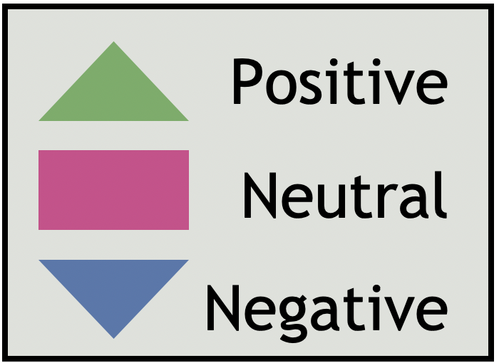
Hammersmith & Fulham Q2 | 2021/22
Network Area GP Reviews
North H&F PCN |  |  |  |  |  | Ease of gaining appointment | Convenience of appointment | Cleanliness | Staff Attitude | Waiting Time | Treatment Explanation | Quality of care | Generally how easy it is to get through ot someone on the phone?
Hammersmith & Fulham Centres for Healt |  |  |  |  |  | - | - | - | - | - | - | - | -
The Westway Surgery, Dr Dasgupta & partners |  |  |  |  |  | 4 | 4 | 5 | 4 | 4 | 4 | 4 | 4
Parkview Practice |  |  |  |  |  | 3 | 3 | 4 | 4 | 3 | 4 | 4 | 3
Canberra Old Oak Surgery |  |  |  |  |  | 4 | 4 | 4 | 4 | 4 | 4 | 4 | 4
Dr Uppal and Partners |  |  |  |  |  | 3 | 3 | 4 | 4 | 3 | 5 | 4 | 3
Parkview Medical Centre, Dr Kukar |  |  |  |  |  | - | - | - | - | - | - | - | -
The Medical Centre Dr Kukar |  |  |  |  |  | - | - | - | - | - | - | - | -
The New Surgery, Dr Dassanayake & Partners |  |  |  |  |  | 4 | 4 | 4 | 4 | 4 | 4 | 4 | 4
Shepherds Bush Medical Centre |  |  |  |  |  | 3 | 3 | 3 | 3 | 3 | 3 | 3 | 3
Number of reviews

Slide 37
Hammersmith & Fulham Q2 | 2021/22
Network Area GP Reviews
H&F Partnership |  |  |  |  |  | Ease of gaining appointment | Convenience of appointment | Cleanliness | Staff Attitude | Waiting Time | Treatment Explanation | Quality of care | Generally how easy it is to get through ot someone on the phone?
Park Medical Centre |  |  |  |  |  | 4 | 4 | 4 | 4 | 4 | 4 | 4 | 4
Richford Gate Medical Practice |  |  |  |  |  | 3 | 3 | 4 | 3.5 | 3 | 4 | 4 | 3
The Bush Doctors (HFP Medical) |  |  |  |  |  | 4 | 4 | 4 | 4 | 3.5 | 4 | 4 | 4
Brook Green Medical Centre (HFP Medical) |  |  |  |  |  | 3 | 3 | 3 | 4 | 3 | 3 | 3 | 3.5
North End Medical Centre (HFP Medical) |  |  |  |  |  | 3 | 3.5 | 4 | 4 | 3.5 | 4 | 3.5 | 3
Number of reviews

Slide 38
Hammersmith & Fulham Q2 | 2021/22
Network Area GP Reviews
H&F Central PCN |  |  |  |  |  | Ease of gaining appointment | Convenience of appointment | Cleanliness | Staff Attitude | Waiting Time | Treatment Explanation | Quality of care | Generally how easy it is to get through ot someone on the phone?
The Ashchurch Medical Centre |  |  |  |  |  | - | - | - | - | - | - | - | -
Sterndale Surgery |  |  |  |  |  | - | - | - | - | - | - | - | -
Brook Green Surgery |  |  |  |  |  | - | - | - | - | - | - | - | -
Hammersmith Surgery |  |  |  |  |  | - | - | - | - | - | - | - | -
North Fulham Surgery |  |  |  |  |  | 4 | 4 | 4 | 4 | 4 | 4 | 4 | 4
Number of reviews

Slide 39
Hammersmith & Fulham Q2 | 2021/22
Network Area GP Reviews
Babylon GP at Hand |  |  |  |  |  | Ease of gaining appointment | Convenience of appointment | Cleanliness | Staff Attitude | Waiting Time | Treatment Explanation | Quality of care | Generally how easy it is to get through ot someone on the phone?
Babylon GP at Hand, The Medical Centre, Dr. S Jefferies and partners |  |  |  |  |  | 3 | 4 | 4 | 4 | 3 | 4 | 4 | 3
Babylon GP at Hand, Dr. S Jefferies and partners |  |  |  |  |  | 3 | 3 | 4 | 2 | 2 | 1 | 2 | 2
Number of reviews

Slide 40
Hammersmith & Fulham Q2 | 2021/22
Network Area GP Reviews
South Fulham PCN |  |  |  |  |  | Ease of gaining appointment | Convenience of appointment | Cleanliness | Staff Attitude | Waiting Time | Treatment Explanation | Quality of care | Generally how easy it is to get through ot someone on the phone?
Fulham Cross Medical Centre |  |  |  |  |  | 4 | 4 | 4 | 4 | 4 | 4 | 4 | 3.5
The Salisbury Surgery, Dr Ravindrasena |  |  |  |  |  | - | - | - | - | - | - | - | -
The Palace Surgery, Dr Mangwana and Partners |  |  |  |  |  | - | - | - | - | - | - | - | -
Cassidy Medical Centre (West London Group Practices) |  |  |  |  |  | 4 | 4 | 4 | 4 | 4 | 4 | 4 | 4
Lilyville Surgery @ Parsons Green |  |  |  |  |  | 3.5 | 4 | 4 | 4 | 3 | 4 | 4 | 3
Ashville Surgery |  |  |  |  |  | 4 | 4 | 4 | 4 | 4 | 4 | 4 | 4
Fulham Medical Centre |  |  |  |  |  | 3 | 3 | 4 | 4 | 3 | 4 | 4 | 3
Sands End Health Clinic |  |  |  |  |  | 3.5 | 3.5 | 4 | 3.5 | 3.5 | 4 | 4 | 3
Number of reviews

Slide 41
Hammersmith & Fulham Q2 | 2021/22
Themes for primary Network Area
During Q2, we were able to capture reviews across all 5 PCN areas. The following pages show the top themes for each PCN, based on the qualitative analysis of comments received and the application of themes thereafter. For this report, theme counts below 20 were deemed as too low to draw any firm conclusions from. Themes and sentiments will be monitored over the coming quarters to identify any emerging trends. We can only show the main themes for each Primary Care Network (PCN) where we received a significant number of reviews.
In Q2, the PCNs which received a significant number of reviews and were thereby subject to thematic analysis were: North H&F PCN, H&F Partnership, H&F Central PCN, Babylon GP at Hand and South Fulham PCN.
After patients give their overall star rating for the service, there is a section that states "tell us more about your experience". Each comment is uploaded to our Online Feedback Centre where up to five themes and sub-themes may be applied to the comment (see appendix 3 p59-61; for a full list). For this reason, the total numbers of themes-counts will differ from the total number of reviews for each service area. For each theme applied to a review, a positive, negative or neutral 'sentiment' is given. The application of themes, sub-themes and sentiment is a manual process.

Slide 42
Themes for North H&F PCN Network
Hammersmith & Fulham Q2 | 2021/22
This quarter, Healthwatch H&F collected 168 reviews for North H&F PCN, of which 70% (n.118) were positive, 8% (n.13) were neutral and 22% (n.37) were negative. The chart below shows the top four themes for North H&F PCN. The Administration, Staff, Access to service and Treatment and Care themes have, by far, been the most regularly identified themes in the reviews for the surgeries within the North H&F PCN.
Patient feedback relating to the Staff and Treatment Care themes were mostly positive in sentiment (86%) and (88%). However, the reviews belonging to the Administration theme were mostly negative in sentiment, 53% (n.86). The main issues identified were around appointment availability and booking an appointment. ON a positive note, 40% of the reviews mentioning Administration theme were positive. In addition the patients’ feedback relating to the Access to service were negative in sentiment (71% n.36). Patients mentioned that they had to wait longer for their appointment or waiting longer on the phone before speaking to receptionists.
Positive reviews
“Since I moved to this surgery it has been great. Compared to my old surgery, here whenever I need an appointment they offer me one. I can also book my appointment online.”
GP Surgery
“I don't have any complains. I get everything I need when I need it. Very easy to book an appointment, it's done over the phone. I use the online system only for prescription, which is very good..”
GP Surgery
Themes
Negative / Neutral reviews
“Impossible to speak to staff, they do not pick up the phone. have been trying to book an appointment but I have been able to get through.”
GP Surgery
“It's impossible to book an appointment, the receptionists never answer the phone.”
GP Surgery
Number of reviews

Slide 43
Themes for H&F Partnership Network
Hammersmith & Fulham Q2 | 2021/22
This quarter, Healthwatch H&F collected 166 reviews for H&F Partnership of which 54% (n.90) were positive, 20% (n.33) were neutral and 26% (n.43) were negative. The chart below shows the top four themes for the H&F Partnership Network. During this quarter, the number of negative reviews for GP surgeries in the H&F Partnership have increased, compared last quarter.
Administration, Treatment and Care, Access to Service and Staff were the most common themes identified this quarter. The patient feedback related to the Staff theme was mostly positive with 72% (n.50) being positive in sentiment, whereas the majority of reviews belonging to the Administration theme received a negative sentiment – 65%, n.84. This shows an increased of 10& compared to last quarter.
One factor which may contribute to the negative sentiment fed back by some services users is the inability to book an appointment with their GP due to being unable to get through to an administrator on the phone and subsequently having to wait a long time for their next GP appointment. Lastly, the Access to Service theme received primarily negative sentiment reviews with 26 out 40 (65%).
Positive reviews
“They are great with babies! My 3 month old baby is getting all the proper care here during covid, with no health visitor around they are doing the check-ups.”
GP Surgery
“It's been a pleasure dealing with the staff of North End Medical Centre. Many thanks to Mr P at the reception for a quick and professional response to my query.”
GP Surgery
Themes
Negative /Neutral reviews
“Very unprofessional and the worst experience ever. I waited for 1h and 30. The doctor was unable even to advise on basic treatment or to help with my condition”
GP Surgery
“The phone is busy all day, why don't you have another number?”
GP Surgery
Number of reviews

Slide 44
Themes for H&F Central PCN Network
Hammersmith & Fulham Q2 | 2021/22
This quarter, Healthwatch H&F collected 34reviews for H&F Central PCN of which 56% (n.19) were positive, 12% (n.4) were neutral and 32% (n.11) were negative.
The chart below shows the top three themes for H&F Central PCN.
The Administration theme and the Staff theme have been, the most common themes identified in the reviews for H&F Central PCN.
The patient feedback relating to Administration theme was negative, with positive 60% reviews being positive in sentiment. However, 40% of the reviews that mentioned Administration theme were negative. Once again, this shows that patients/service users are struggling to obtain an appointment or get through to the administrative team on the telephone at their respective GP surgeries. Treatment and Care theme received a more balance between positive and negative sentiment. In term of the staff theme 50% of the reviews were negative in sentiment, which suggest patients/service users are not happy with staff attitude.
Positive reviews
“The receptionists are very good. I have been with the surgery for 39 years and I have always been happy with the service.”
GP Surgery
“They are consistent, friendly and attentive and caring doctors.”
GP Surgery
Themes
Negative /Neutral reviews
“Left after many years due to poor customer service, poor reception team and a few horror stories1.”
GP Surgery
“I have multiple health issues and am on numerous drugs. Despite this I haven t seen a GP in 18 months and they don't return calls.”
GP Surgery
Number of reviews

Slide 45
Themes for Babylon GP at Hand
Hammersmith & Fulham Q2 | 2021/22
This quarter, Healthwatch H&F collected 46 reviews for Babylon GP at Hand PCN. Of these reviews, 52% (n.24) were positive, 17% (n.8) were neutral and 30% (n.14) were negative. This chart shows the top two themes for Babylon GP at Hand.
Administration was, once again, the most common theme identified in the reviews for this PCN, with 29% (n.13) being positive in sentiment. However, 64% (n.29) of the reviews belonging to this theme were negative in sentiment, which seemed to be largely caused by patients not being able to get through to a receptionist on the telephone to book an appointment. The Staff theme was largely positive this quarter (56%), with patients praising the staff members' attitudes at their respective surgeries.
Positive reviews
“Since COVID-19, I have not had any face to face appointments which is fine for me. The receptionists are very nice and helpful.”
GP Surgery
“The staff are very good, They offer me an appointment when I need to. The doctors are very good and the receptionist are very nice and helpful.”
GP Surgery
Themes
Negative / Neutral reviews
“I have been calling Babylon GP at Hand for over a week on a simple admin task and it still hasn't been processed and I've had no explanation or apology!.”
GP Surgery
“The place is an absolute shambles. They have no idea as to what's going on with their own patients nor are they willing to help even when the fault is their own.”
GP Surgery
Number of reviews

Slide 46
Themes for South Fulham PCN
Hammersmith & Fulham Q2 | 2021/22
This quarter, Healthwatch H&F collected 191 reviews for South Fulham PCN. Of these, 72% (n.138) were positive, 10% (n.19) were neutral and 18% (n.34) were negative. The chart below shows the top four themes for South Fulham PCN.
Staff and Administration were by far most common themes identified. Patient feedback relating to Staff was very positive, making up 86% of the total number of these reviews. On the other hand, over half of the reviews referencing the Administration theme were negative, with 56% (n.105) being negative in sentiment. Reviews that were related to the Access to services were largely negative in sentiment, making up 58% (n.45) of the total number of reviews. Lastly, whilst the Treatment and Care theme was identified less frequently than the two leading themes, the reviews were mostly positive (89%).
Positive reviews
"I am so happy with the service I received from admin member at Cassidy, I processed an online consultation on my mother’s behalf as she does not speak English.”
GP Surgery
‘‘I just joined the surgery and it was easy to register, I sent them an email and it was all done. Very straightforward. I had my first visit to the surgery and it was great. I was seen on time.”
GP Surgery
Themes
Negative / Neutral reviews
“Can't get through on the phone my 82-year-old dad has to wait 3 weeks for a doctor to ring him with the results.”
GP Surgery
“Awfully rude receptionist (Stephanie). I've been going to this surgery for a decade and the regular challenge is to get past the rudeness, misinformation, and angry nature of the receptionist to get through to decent NHS healthcare beyond.”
GP Surgery
Number of reviews

Slide 47
Demographic Information
Hammersmith & Fulham Q2 | 2021/22
The pie chart below shows the breakdown of participants by religion. A large proportion of people leave this question blank or chose not to identify their religion. Out of the total number of participants this quarter, 26% (n.316) identified as being Christian, 8% (n.103) practice Islam and 4% (n.43) identified as Hindu. 10% (n.117) identified as having no religion. We will seek to improve the completion of monitoring data through our face to face engagement.
The pie chart below shows the breakdown of participants by age group. Aside from the majority of participants who left this question blank (n.625), the age group to provide the most feedback was the 35-44 at approximately 12% (n.146). This was followed by the 45-54 age group at approximately 10% (n.125), and the 25-34 age group accounting for 9% (n.107) of the population sample. Although there is representation in the lower age groups, given the boroughs profile, further work will be done to increase feedback from these groups and subsequently produce more robust conclusions about their interactions with services.
Religion of Patients
Age of Patients

Slide 48
Demographic Information
Hammersmith & Fulham Q2 | 2021/22
In terms of ethnicity, aside from the 51% (n.614) who did not complete this section, the largest proportion of feedback received this quarter was from people who identified as ‘White British’ (18%, n.218), a decrease of 12% from last quarter. The next highest category was from people who identify as ‘White - Any other White background’ at 9% (n.107) and followed by ‘Black British - Caribbean’ at 6% (n.71). Further monitoring of ethnicity data will take place to help direct targeted engagement work in the future.
The pie chart below shows the number of reviews received by gender. When comparing the number of individuals who identified as either Male or Female, the majority of the reviews received this quarter are from Females with 34% (n.414) of the total population sample – an increase of 1% compared to last quarter. Males made up 15% (n.180) of the sample population this quarter, representing a decrease of 1% compared to last quarter. As we have noticed that women are more willing to share their experiences, further work will be undertaken to gather feedback from men in the future.
Ethnicity of Patients
Gender of Patients

Slide 49
Demographic Information
Hammersmith & Fulham Q2 | 2021/22
During our direct telephone and face to face engagement, we have spoken to residents living in 16 different areas across the borough of Hammersmith & Fulham. The highest number of the reviews received was from residents in the Wormholt and White City (9%, n.107), the Parsons Green and Waltham Ward (6%, n.74) and the North End Ward (5%, n.59). The least number of reviews received was from the Fulham Reach Ward (1%, n.8). Compared to last quarter, we have seen an increase in reviews for some areas whilst others have decreased. In Quarter 3, we will continue to try and reach more people in the areas where we have received the fewest reviews, through face to face engagement.
Patient area of residence | Number of reviews | Percentage
Wormholt and White City | 107 | 9%
Parsons Green and Walham Ward | 74 | 6%
North End Ward | 59 | 5%
Hammersmith Broadway Ward | 58 | 5%
Avonmore & Brook Green Ward | 53 | 4%
Askew Ward | 38 | 3%
Munster Ward | 35 | 3%
Shepherds Bush Green Ward | 28 | 2%
College Park and Old Oak Ward | 22 | 2%
Fulham Broadway Ward | 22 | 2%
Sands End Ward | 20 | 2%
Revenscourt Park Ward | 19 | 2%
Town Ward | 19 | 2%
Fulham Reach Ward | 8 | 1%
Palace Riverside Ward | 11 | 1%
Out of the Borough | 2 | 0%
Blank | 617 | 52%
Patient area of residence

Slide 50
Hammersmith & Fulham Q2 | 2021/22
Conclusion
Our Patient Experience model has developed significantly from Q4 2020/2021 to Q2 2021/2022. Most importantly, we are now incorporating a degree of face to face Engagement, allowing us to gather feedback from individuals in person and rely less on online reviews and direct telephone engagement as our primary sources of feedback. We will continue to take a stepped approach to our face to face engagement work to ensure the safety of the public and our Patient Experience team remain a priority. As an example of the impact that this shift back to our preferred model of engagement has had on our work, we have seen an increase and more balanced response this quarter in the number of reviews that we received for GP surgeries. We hope to continue this work with GP surgeries in the borough during the coming quarters.
For this quarter, we collected a total of 1213 reviews. There were 898 (74%) positive reviews with a star rating 4-5, 130 (11%) neutral reviews with a star rating of 3 and 185 (15%) negative reviews with a star rating 1-2. As we saw in Q1 (April – June 2021), positive patient experiences far outweigh the negative experiences, overall. Unfortunately, a trend that we see continuing on from Q3 and Q1 of 2020/2021 is the high proportion of 1-star ratings. This is a trend that is not as prominent in neighbouring boroughs and therefore will be an area that we continue to monitor and feedback on, providing evidence for how we can address the prominent issues. During this quarter, one contributing factor to these 1-star reviews may be due in part to the continuing impact of the pandemic on experiences and may also be due to online reviews still being a feature of our data.
In comparison to the previous three quarterly reports, the rate at which we have received demographic information from patients/service users has increased. One factor which may have contributed to this increased was the return to face to face engagement and we would therefore expect this upward trajectory for demographic information to continue in future quarters.
If we look beyond the broader picture and at specific service categories, our findings indicate the following:
GP services
Positive feedback remains high around the Treatment and Care theme (77%) and Staff theme (79%), as well as associated sub-themes (Experience, Quality of Care and Staff Attitudes). The Access to Services theme received a significant amount of negative feedback (65%), as did Waiting Times (61%). Looking at previews quarter alongside this evidence, the Access to Services theme has consistently received the highest, or one of the highest, proportions of negative sentiment compared to other themes. The Administration theme received a significant amount of negative reviews similar to last quarter (40% positive, 55% negative and 5% Neutral). The main issues were with the sub-themes Booking Appointment (48% negative), Appointment availability (69% negative) and Getting through to someone on the telephone (77% negative).

Slide 51
Hammersmith & Fulham Q2 | 2021/22
Conclusion Cont.
Hospital Services (Imperial College NHS Trust)
Our findings indicate that the area in which the Imperial College NHS Trust can further improve is by reducing the length of time that individuals have to wait for their hospital appointment, as 63% of the reviews relating to the Waiting Times theme this quarter were negative in sentiment. Similarly to the previous 3 quarters, the theme Access to services and the sub-theme Waiting Times received the lowest number of positive reviews compared to other themes and sub-themes for Imperial College NHS Trust Hospitals. On the other hand, areas of good practice can be found in the overall Treatment and Care Quality of Care (84% positive) for patients and an overwhelming number of positive reviews (77%) for the members of staff at the Trust's hospitals, highlighting the incredible efforts of the staff to deliver their duties to the highest standard.
Hospital Services (Chelsea and Westminster NHS Foundation Trust)
During this quarter, we were only able to obtain a significant amount of feedback for the Staff theme for Chelsea and Westminster NHS Foundation Trust Hospitals. In total 70% of the reviews referencing the Staff theme were positive, with 60% of the reviews referencing the Staff Attitude sub-theme being positive in sentiment. Similarly to quarter 4 of last year, the reviews belonging to Chelsea and Westminster NHS Trust are more positive than negative, overall.
Pharmacy Services
Overall, H&F patients/service users are satisfied with the Staff Attitudes at their respective pharmacies and are happy with the way that the service, and concurrently their prescriptions, are being managed. However, it seems that there are some issues around the Waiting Times sub-theme as patients/service user have to wait longer than desired for their prescriptions.
PCN specific Network
If we look at the individual PCN areas on pages 40-45, we see that for the majority of PCN's there are issues around Administration, Booking Appointments, Getting through to someone on the telephone, Appointment Availability and Waiting Times. The feedback referencing the Treatment and Care and Staff themes were generally positive. The PCN that had the most negative reviews was the H&F Central PCN (56% positive, 12% neutral and 32% negative). Similarly to quarter 4, we can see that the number of negative reviews have increased, and this is most likely due to patients/service users struggling to get through on the telephone to book an appointment or unable to speak to a receptionist. This may also be a result of some of the GPs not allowing appointments to be booked over the phone. This has been an issue since quarter 2 of the 2020/21 financial year which has been a source of frustration for many individuals that we have spoken to.

Slide 52
Hammersmith & Fulham Q2 | 2021/22
Action, impact and next steps cont.
We will continue to identify opportunities for sharing our findings at different forums and settings within the Borough to influence change and inform our own work priorities and research studies for Q3 2021/22. This includes the POPS Forum, SUCE, The Practice Manager forum, the CCG communications and engagement Group and the CQC. We will continue to work closely with these organisations and individuals to ensure that the reach of our Patient Experience program grows and that in turn, the evidence that we present is utilised in the most effective ways. We will also:
Produce an in-depth analysis on the level of access to GP services during the last year and a half. This analysis of previous patient experience data will allow us to identify the key areas in which service delviery can be improved in the borough as well as highlighting the areas in which GP surgeries are doing particularly well, to ensure that best practices are shared.
Prioritise the feedback gathering process for Mental Health Support Services. To identify how Mental Health support services in the borough have been providing care our Patient Experience team have created a shortened version of the Patient Experience feedback form (see appendices). We will work with the West London NHS trust to promote this survey and gather user feedback of mental health services in Hammersmith and Fulham.
Further analysis into our Patient Experience demographic data. Through analysing our Patient Experience data, Healthwatch H&F will work with YVHSC to explore whether there are any significant differences in the level of access and care that different ethnicities have experienced, throughout the Pandemic. The findings from this report can subsequently inform our own internal workplans and indeed the local and regional inequalities agendas.
Continue to build relationships with Imperial College NHS Trust. In addition to the primary care services, Healthwatch H&F will work with the Trust to understand how we can best channel our reports and recommendations through their governance structure and collaboratively create a plan for our Patient Experience outreach at the Trust's sites ,when they are able to safely welcome back our team.
Comparative Analysis with other NWL Healthwatch This work would build on our review of GP surgeries over the last year and a half. We will explore whether parallels can be drawn between the feedback we receive from Hammersmith and Fulham residents and that which our neighbouring Healthwatch organisations receive.

Slide 53
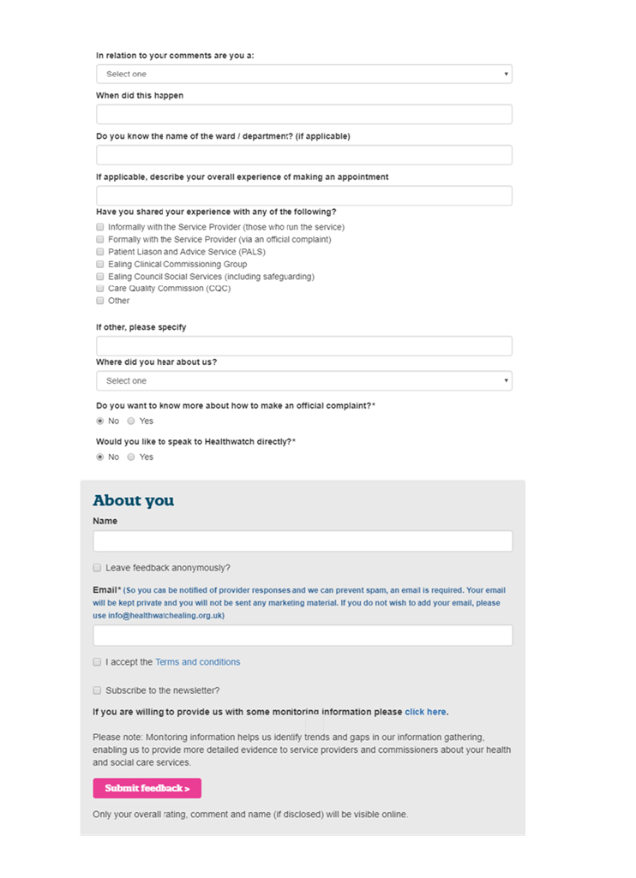
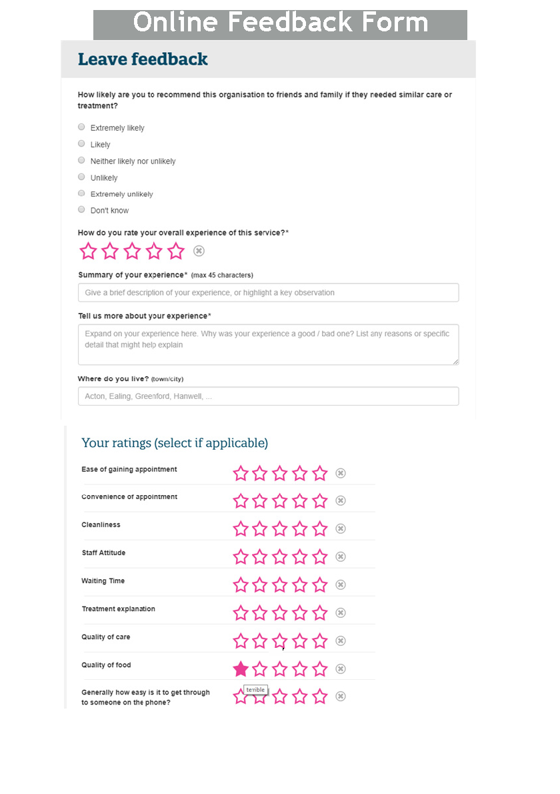

Slide 54
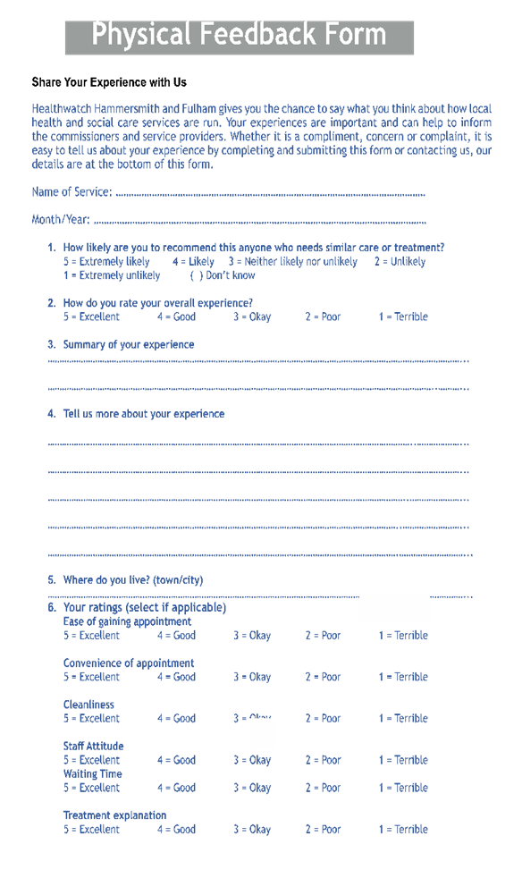
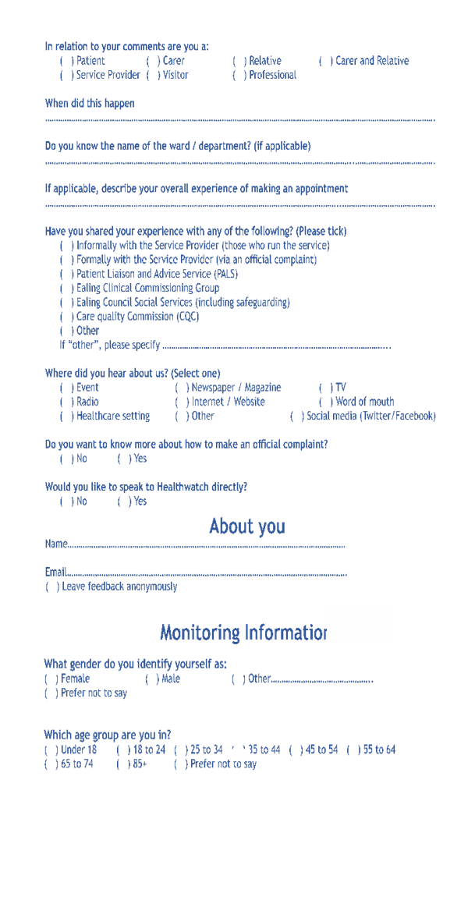

Slide 55
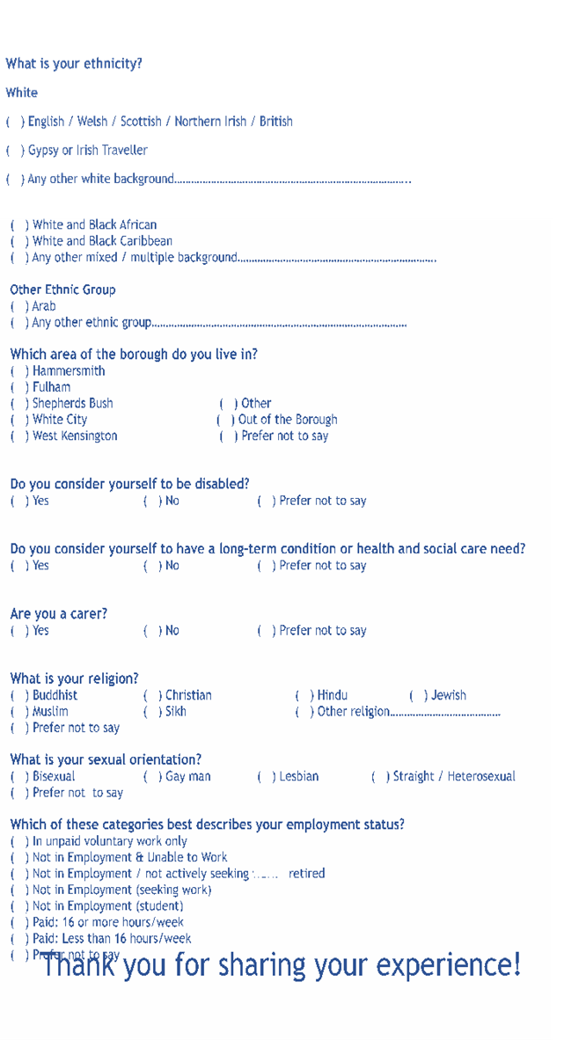
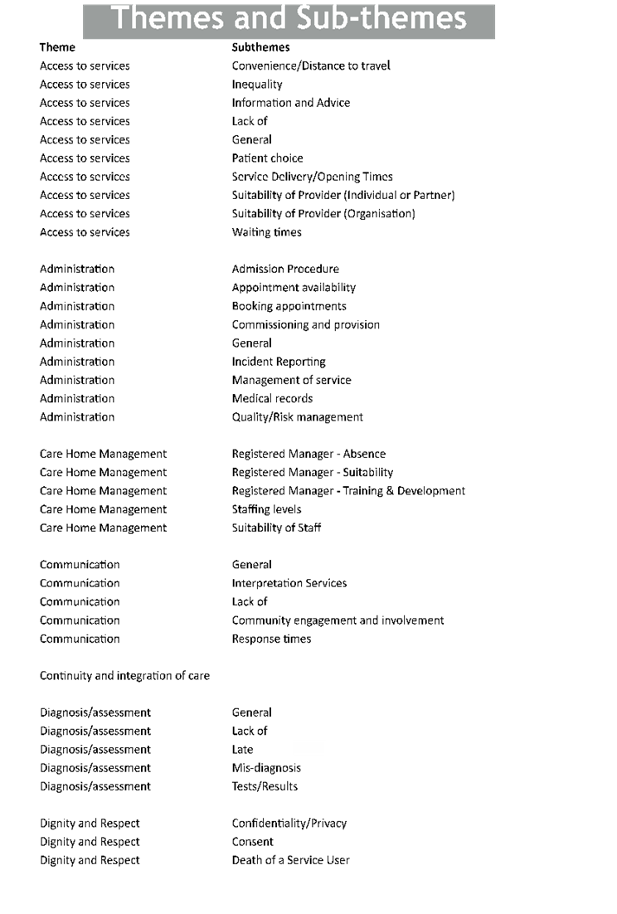

Slide 56
