Slide 1
PATIENT EXPERIENCE
REPORT 2021/2022
QUARTER 3
October-December

Slide 2
Contents
Hammersmith & Fulham Q3 | 2021/22
Introduction & Executive Summary
2
Our data explained
4
Overall Star Rating
5
Total Reviews per Service Category
8
Distribution of Positive, Neutral & Negative
9
Themes: GP, Hospital and Pharmacies
10
Other Positive Reviews
29
Other Negative and neutral reviews
32
Themes for Primary Care Network Area
36
9
Demographic Information
48
Conclusion
51
53
Action, impact and next steps
Appendix
54

Slide 3
Introduction & Executive Summary
Hammersmith & Fulham Q3 | 2021/22
Healthwatch was created by the health and social care reforms of 2012 with a powerful ambition of putting people at the centre of health and social care. To help realise that ambition Healthwatch Hammersmith & Fulham delivers a number of services to gather and represent the views of patients and service users of health and social care in the Hammersmith & Fulham borough. One of the ways we do this is through a comprehensive Patient Experience data collection programme. The successful implementation of this programme, including the use of our Digital Feedback Centre, will yield a minimum of 4,800 patient experiences per annum, all of which will be presented as they are received and considered as a valid community opinion. Your Voice in Health and Social Care (YVHSC) took over the provision of Healthwatch Hammersmith & Fulham in April 2020. In April 2020, the Digital Feedback Centre which is integral to the Patient Experience programme was launched together with the Healthwatch Hammersmith & Fulham website.
Our Patient Experience Officer, supported by a team of volunteers, will visit health and social care services to talk to and hear from patients, service users, carers, and relatives about their experiences of local services. The Healthwatch Team captures this information using our standardised Patient Experience Form (see appendices) that they fill in with the individual. This form includes questions for individuals to provide their overall ratings for the service, ratings for specific aspects of the service; such as ease of booking appointments and staff attitudes, and the opportunity to provide further detail about their experience in a free text box, should they see fit. This engagement method is supplemented by independent feedback that individuals are able to provide for the service in question, by visiting our website and filling out the exact same Patient Experience Form online through the Digital Feedback Centre. People can choose to leave their name or comment anonymously. At the end of each service visit, the Patient Experience Officer will relay any urgent matters requiring attention to the Operations Manager of Healthwatch Hammersmith & Fulham.
In May of 2021 we were able to restart our face-to-face engagement in GP surgeries in a limited capacity. Healthwatch H&F is taking a stepped-approach to moving back to our traditional model of face-to-face engagement for the Patient Experience programme to prioritise the safety of patients and Healthwatch staff and volunteers as well as ensuring that we do not interfere with GP surgery operations. During this quarter, we therefore implemented both our new and pre-pandemic model of engagement, combining in-person GP surgery visits with direct engagement over the telephone, the collection of feedback via the NEXTDOOR APP and collecting and collating existing online reviews from relevant platforms such as NHS.uk and Google reviews. This new 'digital' model that we have implemented throughout the pandemic has benefited residents by providing additional information and signposting and a level of befriending for many of those contacted over the telephone.

Slide 4
Introduction & Executive Summary cont.
Hammersmith & Fulham Q3 | 2021/22
Of course, these new methods of feedback collection bring their own limitations. First, although every effort is made to ensure
participant diversity, there is less opportunity through telephone and online contact, to speak to the diverse range of residents
that Patient Experience Officers would usually speak to in Primary and Secondary Care settings. A second limitation of collecting
online reviews is that there is the potential for a Selection Bias regarding the sentiment of feedback - individuals are more likely to
input a negative experience online than a positive one. Both these limitations, the general context of the COVID-19 pandemic and
indeed the strain that it is putting on healthcare services and patients' own wellbeing, must be taken into account when reviewing the
findings of these reports.
This quarter we focused on hearing more from people using mental health services and were able to collect 28 reviews, this is an improvement compared to previous quarters. This number is still low, however, it’s a step forward to understand the issue people using mental health services are facing. For Quarter 4 2021-2022, we hope to achieve between 100 and 200 reviews once we have access to the service.
This report covers the period of Quarter 3, from October to December, 2021. In ordinary circumstances, face-to-face community outreach
yields a minimum of 1,200 patient experience feedbacks, per quarter. In spite of being in this time of adapted engagement, we were
able to gather a total of 1219, achieving our quarterly target of 1200.
Out of the total number of patients experiences received:
882 (72%) were positive with a star rating of 4-5,
95 (8%) were neutral with a star rating of 3, and;
242 (20%) were negative with a star rating 1-2 (this is based on the overall star rating provided by patients - see page 4 for further detail).
In addition, we have worked extensively to promote our new service across the borough, driving direct reviews to our website for those with internet access. We have distributed our poster and leaflet in each of the GP surgeries that we have visited this quarter.
We also continue to make use of the Healthwatch Hammersmith and Fulham Widget which is currently used in thirteen GP surgeries, Imperial Healthcare NHS Trust and other community and voluntary sector organisation websites. We would like to thank all of these service providers for their ongoing support. As our service becomes further embedded across the borough, we expect greater awareness of our service and a subsequent increase in the number of reviews made directly through our website or by calling our office.

Slide 5
Our data explained
Hammersmith & Fulham Q3 | 2021/22
Healthwatch Hammersmith & Fulham uses a Digital Feedback Centre (on our website) and Informatics system (software behind the Digital Feedback Centre) to capture and analyse patient experience feedback.
The Informatics system is currently used by approximately 1/3 of the Healthwatch Network across England and it captures feedback in a number of ways:
It asks for an overall star rating of the service, (between 1-5).
It provides a free text box for comments
It asks for a star rating against specific domain areas, (between 1-5).
The above provides Healthwatch with several data sets.
Star ratings provide a simple snapshot average, both overall and against specific domain areas. The free text comment box is analysed in two different ways, with two different data set results:
In the first instance, free text comments are broken down and analysed for themes and sub themes. Where relevant, up to 5 themes and sub themes can be applied to any one patient experience comment. Upon each application of a theme or sub theme, a positive, negative or neutral sentiment is also applied. This is a manual process undertaken by trained staff and specially trained volunteers. The process is overseen by the Patient Experience Officer and regularly audited in order to ensure consistency. Where themes and related sentiments are discussed in the report, it relates to this aspect of the process.
Each of the areas described above provides an independent set of results which can be viewed separately or in conjunction with one another in order to gain an insight into a service or service area. It is important to note that correlation between different data sets may not be apparent, for example, a service may have an overall star rating of 4/5 but much lower ratings against individual domain areas.

Slide 6
Overall Star Ratings
Hammersmith & Fulham Q3 | 2021/22
The table below shows a breakdown of the negative, neutral, and positive patient reviews (see the appendices for examples of our physical and online questionnaires). Each patient is asked to give an overall rating out of 5 stars for a service. Star ratings of 1 and 2 indicate a negative response, a star rating of 3 indicates a neutral response and star ratings of 4 and 5 indicate a positive response.
It is important to note that our experience has shown that people are very reluctant to give a negative rating of their care provider. When the 3* 'neutral' ratings are analysed in more detail we have traditionally found these to outline negative feedback. Therefore, where a significant number of 3* ratings are found, our experience tells us these areas are worthy of further attention to help identify areas for improvement. This quarter 882 positive responses, 242 negative responses and 95 neutral responses have been recorded.
Month | 1 – 2 Star Reviews (Negative) ★ ★ ☆ ☆ ☆ | 3 Star Reviews (Neutral) ★ ★ ★ ☆ ☆ | 4 - 5 Star Reviews (Positive) ★ ★ ★ ★ ★
October | 66 | 29 | 309
November | 64 | 34 | 313
December | 112 | 32 | 260
Total | 242 | 95 | 882

Slide 7
Overall Star Ratings
Hammersmith & Fulham Q3 | 2021/22
This chart provides a breakdown of negative, neutral, positive and total reviews for each month, based on the overall star rating provided.

Slide 8
Overall Star Ratings
Hammersmith & Fulham Q3 | 2021/22
Individuals are asked to provide an overall star rating for the service that they are reviewing. With five stars being the highest and one star being the lowest. These pie charts show the breakdown of star ratings for each month and for the whole quarter.
In each month, the 5-star rating received the highest proportion of reviews, followed by the 4-star rating and 1-star rating. In October and November, the 5-star rating received over half of the reviews (n.221) and (n.216) of the reviews with a 5-star rating. However, in December the number of 5-star ratings has reduced to 42% (n.171).
We have noticed an increase in the number of negative reviews compared to previous quarters. One contributory factor could be the increased numbers of mental health reviews of which majorities of the reviews are negative.
Another factor could be the fact that in December we had to rely more on online reviews compare to the previews quarter. The overall star ratings for services tell us that people are satisfied.

Slide 9
Total Reviews per Service Category
Hammersmith & Fulham Q3 | 2021/22
The patient reviews recorded for this quarter cover eight service categories, as seen in this chart.
The category with the highest number of reviews recorded was for GPs (n.550), followed by Pharmacies (n.204), Dentists (n.195) and then Hospitals (n.148).
Compared to quarter 2 of this financial year (July-August 2021), the number of reviews for GP surgeries has decreased, because this quarter we focused more on collecting feedback from mental health services. However, looking at previews quarters the number of reviews for GPs were low.
Since the 17th of May we have restarted our face-to-face engagement work in the community. This factor likely contributed to the increase in GP reviews this quarter.
Type of services
Number of reviews

Slide 10
Distribution of Positive, Neutral & Negative
Hammersmith & Fulham Q3 | 2021/22
The bar chart compares the number of positive, neutral and negative reviews for each service category. This is based on the overall star rating.
45% of the reviews were about people's experiences of GP services. This shows a decrease of 5% from last quarter.
17% of the reviews were about people's experiences with Pharmacies. An increase of 4% from last quarter.
16% of the reviews were about people's experiences of Dentists. This shows a decrease of 1% from last quarter.
12% of the reviews were about people’s experiences with Hospitals. A decrease of 1% from last quarter.
Other comments were about Opticians, COVID-19 Services, Community Health Services and Mental Health Services.
Of these services:
Dentists received the highest proportion of positive reviews at 89%, followed by Pharmacies with 81%, Hospitals with 66% and GPs with 65%. This quarter there is a decrease in the proportion of positive reviews for Dentists 3%, Pharmacies 7% and GPs 3% compared to last quarter. However, there is an increase in the proportion of positive reviews for hospital 7% this quarter.
Type of service
Number of reviews

Slide 11
Themes and Sub-Themes
Hammersmith & Fulham Q3 | 2021/22
After asking patients for an overall star rating of the service we encourage them to "tell us more about your experience" (see the appendices for examples of our physical and online questionnaires). Qualitative analysis is conducted on individuals' comments to identify emerging or trending themes and sub-themes. To do this each comment is uploaded to our Online Feedback Centre where up to five themes and sub-themes may be applied to the comment (see appendix 3 p56-57 for a full list). For this reason, the total number of theme-counts will differ from the total number of reviews for each service area. For each theme applied to a review, a positive, negative, or neutral 'sentiment' is given.
The application of themes, sub-themes and sentiments is a manual process undertaken by trained staff and differs from the star rating patients provide.
This section shows a breakdown of the main themes and sub-themes for those service areas where we received a significant number of reviews.
In Q3 these areas are:
GP surgeries;
Hospitals and their Trusts;
Pharmacies

Slide 12
GP Themes and Sub-Themes
Hammersmith & Fulham Q3 | 2021/22
Administration, remains one of most applied themes for GPs this quarter. The theme was applied on 481 counts, with 43% (n.207) of these being positive, 8% (n.38) being neutral and 49% (n.236) were negative.
Booking an Appointment, was one of the most applied sub-themes within this service category, identified in 189 responses. Of these responses, 51% (n.97) were positive, 8% (n.16) neutral and 40% (n.76) were negative, with the negative reviews largely caused by patients being unable to book an appointment. This quarter there is a balance between positive and negative sentiment. Patients/service users continue to have issues accessing their GPs due to the pandemic. This quarter the reviews belonging to the sub-theme Management of Service were largely negative in sentiment compared to previous quarter.
For the Appointment Availability sub-theme, there were 106 counts, of which, 37% (n.39) were positive, 7% (n.8) neutral and 56% (n.59) were negative. Patients\service uses are struggling to obtain a suitable appointment. Many of the reviews relating to the sub-theme, Getting through on the telephone, were negative in sentiment with 61% (n.59) being negative. This was due to unanswered calls, long waiting times and patients unable to speak to the receptionist on the phone when trying to book an appointment or ask for advice. This issue has been identified as an ongoing trend in GP surgery reviews since quarter 2 2020/2021.
Positive reviews
“It is fairly easy to book an appointment and it's quite a short wait (around 4 days) till the day of the appointment.”
GP Surgery
“It's easy to book an appointment, both online and on the phone.”
GP surgery
Sub-themes
Negative reviews
“It's hard to get through the phone as there is a long wait. Once you get through, you can book an appointment.”
GP surgery
“Getting an appointment can sometime be hard. You are on the phone for very long and when you get through, they tell you there is not more appointment.”
GP surgery
Number of reviews

Slide 13
GP Themes and Sub-Themes
Hammersmith & Fulham Q3 | 2021/22
In this quarter, Staff, was the second most applied theme for GPs. It applied to 378 reviews, of which 71% (n.268) were positive, 5% (n.19) were neutral and 24% (n.91) were negative.
The chart below presents a more detailed breakdown, featuring the top three sub-themes for the Staff theme.
The majority of reviews focused on the sub-theme Attitude, where 69% (n.144) of the reviews were positive in sentiment. Taken together with the positivity regarding the sub-themes Staff General, this strongly suggests that the majority of patients/service users were satisfied with the professionalism provided by the administrative and clinical teams at their respective GP surgeries.
Positive reviews
“The staff is very good, easy to talk to and helpful. The GP is fine.”
GP surgery
“The staff are very friendly, when I need to have a check up, the reception sent me a text to book my appointment.”
GP surgery
Sub-themes
Negative / Neutral reviews
“The staff are very rude and impolite especially the receptionist. The Doctors are awful and unhelpful.”
GP surgery
“The receptionists are so rude that it actually makes you feel like a burden when calling. Abrupt, rude and a dismissive manner is just what you want to hear when you don't feel great.”
GP surgery
Number of reviews

Slide 14
GP Themes and Sub-Themes
Hammersmith & Fulham Q3 | 2021/22
On this occasion, Access to Services was our third most identified theme, with 213 patient reviews focusing on this area. Out of the total number of times this theme was identified, 38% (n.81) were positive, 8% (n.17) were neutral and 54% (n.115) were negative. Following on from the last four quarters this demonstrates that the sentiment around, Access to Services is largely negative.
The chart below presents a more detailed breakdown of the top sub-theme for Access to Services.
Unsurprisingly, the sub-theme related to Waiting Times was most frequently identified with two third of reviews (n.142) of all Access to Services issues focusing on this topic. In addition, the sentiment around this sub-theme was negative in the majority of these reviews (58%). This indicates that patients are having to wait longer then they would like, to get the necessary service they need. On a more encouraging note 32% of the reviews belonging to this sub-theme were identified as positive. The reviews belonging to the Information and Advice sub-theme received a positive sentiment, this indicate patients are satisfied with the advice their receive from the staff are their respective surgery.
Positive reviews
‘‘The service is great; the staff are helpful and understanding. The doctor are excellent. easy to book an appointment over the phone. You don’t need to wait long for the appointment.”
GP surgery
‘‘Great service, fast and friendly. I needed a consult on a medical issue, and it was great to speak to someone knowledgeable the next day when I booked - no waiting time with NHS appointments.”
GP surgery
Sub-themes
Negative / Neutral reviews
‘‘Impossible to get an appointment within half a week to a week, have to wait on the phone for 20min every time on hold when calling them. Disgraceful service.”
GP surgery
‘‘I have given them 3 stars because of the waiting times at the premisses, quiet a long waiting.”
GP surgery
Number of reviews

Slide 15
GP Themes and Sub-Themes
Hammersmith & Fulham Q3 | 2021/22
Treatment of Care, was the fourth most applied theme for GPs this quarter. It received 147 reviews. Of the total count 76% (n.112) were positive, 3% (n.4) were neutral and 21% (n.31) were negative. The chart below shows the breakdown for the Treatment and Care theme into the top four sub-themes.
Experience of Care was the most applied sub-theme this quarter. This sub-theme was identified as largely positive in sentiment; 82% (n.75). The second highest identified sub-theme was Quality of care, with 70% (n.21) of these reviews being positive in sentiment.
The Treatment Explanation sub-theme was positive in sentiment.
Positive reviews
“I joined this practice a couple of months ago and have been impressed with everything so far. I have type 1 diabetes and they have been amazing, firstly from speaking with me, getting prescriptions and doing a review. The doctors are very caring and want to help.”
GP surgery
“I have a good experience here and I like how easy it is to get an appointment.”
GP surgery
Sub-themes
Negative/ Neutral reviews
“I don’t like the fact that when I see the doctor they speak very quickly and you don't have the time to explain yourself. Once I was with the doctor and he told me I have 10 minutes, so I should book another appointment.”
GP surgery
“The doctors do not listen to your issues. I do not believe I m getting any better.”
GP surgery
Number of reviews

Slide 16
Positive, Negative, Neutral and Total reviews for each Hospital
Hammersmith & Fulham Q3 | 2021/22
This section shows a breakdown of the main themes and sub-themes identified in the reviews that Healthwatch received for the hospitals under the Imperial College Healthcare NHS Trust and Chelsea and Westminster Hospital NHS Foundation Trusts. These hospitals are:
Charing Cross Hospital: Out of the total reviews for the quarter (n.44), 41% (n.18) were positive, 32% (n.14) neutral and 27% (n.12) negative
Hammersmith Hospital: Out of the total reviews for the quarter (n.15), 47% (n.7) were positive, 27% (n.4) neutral and 27% (n.4) negative
St Mary’s Hospital: Out of the total reviews for the quarter (n.17), 82% (n.14) were positive, 6% (n.1) neutral and 12% (n.2) negative
Queen Charlottes and Chelsea Hospital: Out of the total reviews for the quarter (n.16) , 56% (n.9) were positive, and 44% (n.7) negative
Western Eye Hospital: Only 3 reviews were collected for this hospital during this quarter.
We have also looked at surrounding hospitals that most of our residents attend which are part of the Chelsea and Westminster Hospital NHS Foundation Trust. These hospitals are:
Chelsea & Westminster Hospital: Out of the total reviews for the quarter (n.43), 58% (n.25) were positive, 12% (n.5) neutral and 30% (n.13) negative
West Middlesex University Hospital: No reviews were collected for this hospital during this quarter
Other hospitals:
The Royal Marsden: Only 3 review was collected for this hospital during this quarter
Royal Brompton Hospital: Only 7 reviews were collected for this hospital during this quarter
In the next section we identify leading positive and negative themes at individual hospital sites and look in more detail at the overall themes and sub-themes for each Trust. For this quarter these are Imperial College Healthcare NHS Trust and Chelsea and Westminster Hospital NHS Foundation Trust.

Slide 17
Summary of themes for each hospital
Hammersmith & Fulham Q3 | 2021/22
Charing Cross Hospital:
The Treatment and Care (75%) and Staff (69%) themes were regularly identified as positive. This suggests that staff's general professionalism, bedside manner and ability to meet the needs of their patients is a consistent feature of care at Charing Cross Hospital. However, there is also a few people who were not satisfy with the care their received and the attitude of staff members with (21% and 23%) of the reviews being negative in sentiment.
Out of the 17 reviews in which the theme Access to Services was identified, 53% (n.9) were negative in sentiment. The main issues remain around the sub-theme Waiting Times. Some patients report longer waiting times whilst others mention that their appointments have been postponed or cancelled, altogether.
Out of the 9 reviews in which mentioned Administration theme 89% (n.8) were negative in sentiment. The main issues remain around the sub-themes Booking appointment and Appointment availability. This indicates that patients struggled to obtain an appointment at the hospital during this quarter.
Themes
Number of reviews
Themes
Hammersmith Hospital:
The reviews relating to the themes Staff (73%) identified were positive in sentiment. These findings indicate that patients are happy with the service provided by healthcare professionals at Hammersmith Hospital and happy with the manner in which members of staff provide them. Compare to last quarter there is a 16% decreases in the proportion of positive reviews for the staff theme.
Number of reviews

Slide 18
Summary of themes for each hospitals
Hammersmith & Fulham Q3 | 2021/22
St Mary’s Hospital:
The reviews belonging to St Mary's Hospital have been largely positive this quarter. The highest proportion of feedback was identified as relating to the Staff theme with the majority of reviews being positive in sentiment (92%). However, 30% of the reviews belonging to the Treatment and Care theme were negative in sentiment and 20% were neutral, suggesting that some patients are not satisfied with the care their receive at St Mary’s Hospital.
On a positive note, 50% of the reviews relating to the Treatment and Care theme were positive in sentiment.
Sub-themes
Number of reviews
Queen Charlottes and Chelsea Hospital:
This quarter the proportion of positive review for Queen Charlottes Hospital have decreased compare to last quarter. The reviews belonging to the Staff themes were equally split between positive and negative sentiment. In addition, 64% (n.7) of the reviews mentioning the Treatment and Care theme were negative in sentiment. This evidence suggests that patients at Queen Charlotte’s and Chelsea Hospital were no happy with how their needs were not met and how the staff cared for them during their time in the hospital.
Sub-themes
Number of reviews

Slide 19
Summary of themes for each hospital
Hammersmith & Fulham Q3 | 2021/22
Chelsea and Westminster Hospital:
Compared to last quarter, the total number of positive reviews for this hospital have increased.
67% (n.18) of the reviews relating to the theme Treatment and Care were positive. This indicates that most patients/service users were satisfied with the quality of treatment that they received at the hospital. However, 30% (n.8) of the reviews were negative. This indicate that patients are not satisfied with the treatment they currently receive from Chelsea and Westminster hospital.
The majority of the reviews relating to the theme Staff were positive (71%). This suggest that, most patients are happy with the manner in which care is provided by healthcare professionals at Chelsea and Westminster Hospital. 22% (n.9) of the reviews negative.
In comparison to the two top themes mentioned for Chelsea and Westminster hospital, the reviews belonging to the Access to Services theme were negative in sentiment with 69% (n.11).
Sub-themes
Number of reviews

Slide 20
Themes and Sub-Themes for Imperial College NHS Trust
Hammersmith & Fulham Q3 | 2021/22
Staff was one of the leading themes identified for Imperial College NHS Trust this quarter, with 68 patient reviews being identified to this theme. In total, 69% (n.47) were positive, 4% (n.3) were neutral and 26% (n.18) were negative. It also had the highest proportion of positive reviews out of all the main themes relating to hospital services. This suggests that the professionalism and manner of care from Imperial College NHS Trust staff is exemplary.
The chart below presents a breakdown of the top tow sub-themes for Staff. Attitudes was the most regularly identified sub-theme, with (51%) of the reviews (n.35) within the Staff theme referencing this sub-theme. Out of the total number of these reviews, 63% were positive in sentiment, providing strong evidence that patient-facing staff at the Imperial College NHS Trust are delivering care to a very high standard. However, 37% of the reviews mentioning the Staff theme were negative in sentiment.
Positive reviews
“The staff are attentive and friendly.
Always seems to be someone to point you in the right direction.”
Outpatient department
“The staff are highly skilled and professional and always treat their patients as individuals and with respect.”
Outpatient department
Sub-themes
Negative / Neutral reviews
“Worse Hospital in South West, very rude doctor you have to see for sorting out your problem.”
Outpatient department
“The staff at the antenatal are extremely rude, they don't even say hello, it's appalling to see the way they treat a pregnant woman.”
Maternity department
Number of reviews

Slide 21
Themes and Sub-Themes for Imperial College NHS Trust
Hammersmith & Fulham Q3 | 2021/22
Treatment and Care was our second most popular theme identified for Imperial College NHS Trust this quarter, with 52 comments highlighting this area. These reviews have been positive, as 62% (n.32) of patients/service users expressed their satisfaction, whilst 33% (n.17) were negative in sentiment and 4% were neutral. The chart below shows the breakdown for the Treatment and Care theme into the top three sub-themes.
The sub-theme experience was the most regularly theme identified with 63% (n.19) of the feedback relating to this sub-theme being positive in sentiment. In addition, 100% (n.6) of the reviews that made reference to the sub-theme, Quality of care were positive in sentiment. Overall, these findings indicate that patients are happy with the quality of care being received. However, there remains room for improvement to ensure that patients overall experience of care at the Trust's hospitals are positive in nature.
Positive reviews
“I had my baby girl there and it was the best experience staff were very nice and professional.”
Maternity department
“I Had an infection could not get an appointment at my GP so went to the A&E and I was offered antibiotics which did help. They were very helpful.”
A&E department
Negative reviews
“I was seen by a surgeon called Miss P and she was so rude, she didn't help me at all with making me feel comfortable about my situation! She essentially made me feel like I was wasting her time and shouldn't be there! Had to leave without any help and was very upset.”
Outpatient department
“Such unprofessional and rude doctors and staff. My partner has been left at Emergency for 4 hours waiting in pain. No one did come to see him. My partner was in a life-threatening condition. They gave him paracetamol and sent him back home. ”
A&E department
Sub-themes
Number of reviews

Slide 22
Themes and Sub-Themes for Imperial College NHS Trust
Hammersmith & Fulham Q3 | 2021/22
On this occasion, Access to Services was our third most identified theme, with 28 patient reviews focusing on this area. Out of the total number of times this theme was identified, 36% (n.10) were positive, 11% (n.3) were neutral and 54% (n.15) were negative. Following on from the last four quarters this demonstrates that the sentiment around, Access to Services is largely negative.
The chart below presents a more detailed breakdown of the top sub-theme for Access to Services.
Unsurprisingly, the sub-theme related to Waiting Times was most frequently identified with half of reviews (n.14) of all Access to Services issues focusing on this topic. In addition, the sentiment around this sub-theme was negative in the majority of these reviews (50%). This indicates that patients are having to wait longer then they would like, to get the necessary service they need. On a more encouraging note 36% of the reviews belonging to this sub-theme were identified as positive.
Positive reviews
“It was very quick, I had to wait for 2 to 3 weeks for the appointment, on the day I did not wait. I was seen on time. The staff were lovely and helpful.”
Outpatient department
“I was there for a chest x-ray. There was no queue I waited 5 mins to be called. It took about 10mins for the x-ray to be done then I was allowed to go home.”
X-Ray department
Sub-themes
Negative reviews
“I went to the A&E it was great apart from the waiting which is expecting I was happy with the service. I received the right treatment.”
A&E department
“Great service, great advice and support from the staff. Sometime I had to wait a bit longer for my appointment but it's okay.”
Maternity department
Number of reviews

Slide 23
Themes and Sub-Themes for Chelsea and Westminster NHS Foundation Trust
Hammersmith & Fulham Q3 | 2021/22
Staff was the leading theme for Chelsea and Westminster NHS Foundation Trust Hospitals this quarter (n.41). A total of 71% (n.29) of the reviews relating to this theme were positive whilst 22% (n.6) were negative and 7% (n.3) were neutral.
The chart below presents a breakdown of the top two sub-themes for the Staff theme.
Attitudes was by far the most frequently mentioned sub-theme, with 37% reviews (n.15) within the Staff theme focusing on this area. The Attitude sub-theme received positive comments, as 73% of reviews relating to this theme were left by patients commending the attitude and professionalism of staff at Chelsea and Westminster NHS Foundation Trust Hospitals. However, 27% of the reviews commenting the Staff theme were negative, suggesting that some patients are not happy with the staff behaviour at Chelsea and Westminster NHS Foundation Trust.
Positive reviews
“In February I got COVID-19 and was in the hospital for 2 weeks the staff were amazing they were compassionate and helpful, they saved me.”
ICU department
“I had my baby there it was my first pregnancy and everything was of high level standards! The staff were amazing throughout the pregnancy and even more during my labour experience, special mention to Miss P who was the midwife who delivered my baby girl.
Maternity department
Sub-themes
Negative / Neutral reviews
“It was very bad experience and the nurses in children's A&E are very rude and they are dealing with the patients depending on their nationality.”
A&E department
“Terrible maternity services and the slowest, most irresponsible, unprofessional A&E. Avoid if you can.”
A&E department
Number of reviews

Slide 24
Themes and Sub-Themes for Chelsea and Westminster NHS Foundation Trust
Hammersmith & Fulham Q3 | 2021/22
Treatment and Care was our second most popular theme identified for Chelsea and Westminster NHS Foundation Trust this quarter, with 27 comments highlighting this area. These reviews have been positive, as 67% (n.18) of patients/service users expressed their satisfaction, whilst 30% (n.8) were negative in sentiment and 3% were neutral. The chart below shows the breakdown for the Treatment and Care theme into the top three sub-themes.
The sub-theme Experience received a more balance between positive and negative sentiment with 58% (n.7) being positive and 42% (n.5) being negative. On a positive note, the reviews belonging to the sub-theme Quality of care were mainly positive in sentiment. Overall, these findings indicate that patients are happy with the quality of care being received. However, there remains room for improvement to ensure that patients overall experience of care at the Trust's hospitals are positive in nature.
Positive reviews
“Popped in with my son early this morning to urgent care for a hand injury assessment. Staff all incredibly attentive and he received a diagnosis within the hour. Top job..”
A&E department
“Very big thanks to all the A&E staff. Starting from receptions to all the team that helped me stay alive. They were very fast to treat me with my heart condition.”
A&E department
Sub-themes
Negative / Neutral reviews
“Use another hospital for maternity care. I had an induction, and they had me at pre-birth care for more than 24 hours because of lack of staff.”
Maternity department
“Abysmal consultants. Poor knowledge. Don't listen to patients.. ”
Outpatient department
Number of reviews

Slide 25
Pharmacies: Themes & Sub-Themes
Hammersmith & Fulham Q3 | 2021/22
For Pharmacies in Hammersmith & Fulham, during this quarter the Staff theme was the most identified theme with 132 reviews focusing on this area, with 78% (n.103) being positive, 6% (n.8) neutral and 16% (n.21) negative.
The chart below presents a more detailed breakdown of the top three sub-themes for Staff.
Unsurprisingly, the sub-theme related to Attitudes was most frequently mentioned here, with 86% (n.64) being positive, 2% (n.1) neutral and 12% (n.9) negative. In addition the reviews belonging to the sub-theme Staff General were positive in sentiment. Patients are, therefore, generally happy with staff members' attitudes toward them at their respective pharmacies.
Positive reviews
“There is a guy there is very helpful, I have never seen a guy like him he is always happy to help.”
Pharmacy
‘‘Great customer service and friendly staff.”
Pharmacy
Sub-themes
Negative / Neutral reviews
“Very rude service. They are cheeky, they laugh and shout at people.”
Pharmacy
“The staff are incredibly rude and unhelpful.”
Pharmacy
Number of reviews

Slide 26
Pharmacies: Themes & Sub-Themes
Hammersmith & Fulham Q3 | 2021/22
Access to Services was the second most applied theme for pharmacy services this quarter with 74 counts - 38% (n.28) being positive, 23% (n.17) neutral and 39% (n.29) negative.
The chart below shows that the main sub-themes for Access to Services theme is Waiting Times.
It received 32 reviews with 13% (n.4) being positive, 63% (n.20) being negative and 24% (n.8) being neutral. This indicates that most patients had to wait longer than they would have liked to receive their prescription, understandably causing frustration amongst service users. However, these findings must be viewed and noted within the context of the current COVID-19 pandemic. On a positive note the reviews related to the sub-theme Access to Services General were positive in sentiment with 64% (n.16) being positive.
Positive reviews
“ Waiting times is not long and the staff are friendly.”
Pharmacy
“They are great, they manage my prescription so well. I have to take so many medications and they always have it ready for me.”
Pharmacy
Sub-themes
Negative / Neutral reviews
“They are okay, prescription is fine. a bit of wait sometimes.”
Pharmacy
“They are okay, long waiting.”
Pharmacy
“They are okay, long waiting time when picking up your prescription..”
Pharmacy
Number of reviews

Slide 27
Pharmacies: Themes & Sub-Themes
Hammersmith & Fulham Q3 | 2021/22
For Pharmacies in Hammersmith & Fulham, during this quarter the Administration theme was the third most identified theme with 44 reviews focusing on this area, with 68% (n.30) being positive, 7% (n.3) neutral and 25% (n.11) negative.
The chart below presents a more detailed breakdown of the top three sub-themes for Administration.
The sub-theme related to Management of service was most frequently mentioned here, with 76% (n.13) being positive and 24% (n.4) negative. Patients are, therefore, generally happy with how their respective pharmacy is managed.
Positive reviews
“Wonderful, really well organised, friendly and compared to some of the other pharmacies in the area a dream come true. Really get the feeling they care and know what they are doing.”
Pharmacy
‘‘They are great, I have a repeat prescription and they always manage it well.”
Pharmacy
Sub-themes
Negative / Neutral reviews
“Good variety yet needs proper arrangement.”
Pharmacy
“It was fine, but it was not well organised, there was a queue.”
Pharmacy
Number of reviews

Slide 28
Pharmacies: Themes & Sub-Themes
Hammersmith & Fulham Q3 | 2021/22
During this quarter, Treatment and Care was frequently discussed, with 40 reviews mentioning this theme. Out of these reviews, 90% (n. 36) were positive and 10% (n. 4) were negative.
The chart below illustrates a breakdown of the top two sub-themes for Treatment and Care.
The sub-theme relating to Experience was most frequently mentioned. It was applied 27 times, 85% (n.23) being positive, and 15% (n.4) neutral. Overall, this shows that patients are happy with the care their receive at their respective pharmacy.
Positive reviews
“I always get great advise here.”
Pharmacy
“This is a great pharmacy - nothing is too much for them. Super helpful and knowledgeable.”
Pharmacy
Sub-themes
Negative / Neutral reviews
“They do not give original drugs, only substitute them, and they make mistakes with dispensing drugs.”
Pharmacy
“Awful. The chemist didn't wear a mask whilst entering or leaving the customer space.”
Pharmacy
Number of reviews

Slide 29
Pharmacies: Themes & Sub-Themes
Hammersmith & Fulham Q3 | 2021/22
During this quarter, Medication was frequently discussed, with 36 reviews mentioning this theme. Out of these reviews, 67% (n. 24) were positive 14% (n.5) neutral and 19% (n. 7) were negative.
The chart below illustrates a breakdown of the top two sub-themes for Medication.
The sub-theme relating to Pharmacy Repeat Prescription was most frequently mentioned. It was applied 25 times, 68% (n.17) being positive, 12% (n.3) neutral and 20% (n.5) negative. There is a decreased of 15% in the positive sentiment compared to last quarter. Overall, this shows that patients are happy with their ability to access their medication. In addition, the sub-theme Medicines Management received a positive.
Positive reviews
“Very happy with the service, I always get the prescription on time.”
Pharmacy
“Very good, very fast ,never issue with my medication when you go there it's ready.”
Pharmacy
Sub-themes
Negative / Neutral reviews
“They are always busy, and they never have my medication ready.”
Pharmacy
“It looks like there is a new owner because they keep giving different medicine to the one the GP prescribed.”
Pharmacy
Number of reviews

Slide 30
Other Positive Reviews
Hammersmith & Fulham Q3 | 2021/22
Looking at the positive reviews we have received allows us to highlight areas where a service is doing well and deserving of praise. This section provides an overview of the number of positive reviews by service category and goes on to give some examples of the comments received, during this quarter.
Type of Services
Positive Reviews

Slide 31
Dentist Services
“Had an emergency appointment here today through NHS 111 saw a lovely dentist and nurse who really made me feel at ease. Excellent service from both reception staff and dental thank you.”
Dentist Services
“Amazing practice, all fitted with modern equipment. Saw Dr P who is really gentle, friendly and has a very good attention to detail! Staff very friendly and helpful.”
Dentist Services
“Million thanks for your professional service and care! I loved the way you explained to me my teeth situation and the best way to sort the problem and control it. Super happy! Polite team, and no delays just perfect!”
Dentist Services
Opticians Services
“My whole family has been using Karen for many years. The service is of very high quality and the professional skills excellent.”
Opticians Services
“Outstanding service! My daughter and I have been costumers for many years and the staff have always been amazing. They are very helpful.”
Opticians Services
“This was a great experience, the eye test was very thorough and I got a lot of help choosing glasses! I can see so much better with my new glasses and it's made such a difference. Thank you!”
Opticians Services

Slide 32
Covid-19 services
“They are great, easy to book the appointment and well organised. Was seen on time.”
Covid-19 service
“I was able to book my appointment for my booster via a link, I came in today I did not have to wait. The gentleman was nice and helpful.”
Covid-19 service
“ It was quick got a text message that I needed to book an appointment and did. On the day it was well organise.”
Covid-19 service
Mental Health Services
“My therapist was amazing. Extend the course, give them more funding. Provide more funding to the services, more specialised therapists.”
Mental Health Service
“Incredible and a lifesaver. Free therapy from NHS was able to get help because I could afford it and it shouldn't be like that. This system will help make the divide between the haves and have nots bigger and will grow inequality exponentially because the people who are already being marginalised are unable to get the help they need to be healthy and to improve the situation.”
Mental Health Service

Slide 33
Other Negative & Neutral Reviews
Hammersmith & Fulham Q3 | 2021/22
By looking at the negative and neutral reviews we have received from patients/service users from Hammersmith and Fulham each month, we can better understand where a service needs to improve in order to provide an all-round positive experience. This section provides an overview of the number of negative and neutral reviews by service category and goes on to give some examples of comments received. We include those reviews where we have classified the comment as being of ''neutral'' sentiment as experience tell us that these can generally highlight where improvements could be made.
Type of Services
Negative & Neutral Reviews

Slide 34
Dentist reviews
“This Dental practice is awful!!
I have been with them for 5 years and I can't say a single good thing.
Rude receptionist, never any available appointments in the near future, no emergency appointments unless you want to pay them cash, the list goes on.”
Dentist Services
“Got a filling done privately, the dentist took 3 times to fit it, it came off 4 months later. Got a cancellation slot, told to come in on Thursday at 9:30am, got there, was told they booked it's for Fri instead. Completely dismissive receptionist refusing to even apologise for the error.”
Dentist Services
“They haven’t been honest about treatment costs, not reliable people. Very weak customer service.”
Dentist Services
Covid-19 service
“At first, I was against taking the vaccine as I did not believe it, but a friend of mine got sick and I decided to take it. on the day It was well organised, I did not wait. I was able to get in and out.”
Covid-19 service

Slide 35
Opticians Services
“So disappointed, the staff should know all of us have different needs and faces, went back twice, and only on the second visit they "fixed" the problem, was even told that glasses were not meant to be worn the way I wear them.”
Opticians Services
“They draw you in with cheap prices.”
Opticians Services
“Very unprofessional, they count on their client's time.”
Opticians Services
Community Health Services
“This is the coldest place to be in. Receptionist very cold. No customer service. Staff passing by waiting patients seem don't care at all.... not even asking if they have been attended to already. People here seem don't like their job at all”
Community Health Service
“The lady at the reception was not helpful, I took my niece(who came to study here and not yet vaccinated) to get a covid vaccine and she said 'this country has stopped walk-in vaccinate, 'we have to register with a GP first, I think she was wrong.”
Community Health Service
“Rude customer service, I called to book an appointment as a new patient and she told me that they dont take people off the street.”
Community Health Services

Slide 36
Mental Health Services
“The woman I went to see was horrific. She asked questions about drugs and alcohol etc. from her attitude and facial expression I could feel she looked down on drinking. She is too judgmental to be working in this kind of work. I felt worse after seeing her and will never call mental health services as their attitude and judgment could push us to the edge.”
Mental Health Service
“Help does not exist. It's a shame. An empty cold hostility. The workers were in a daze. NOT interested.”
Mental Health Service
“Very difficult to talk to anyone on the telephone or in person. The service is overstretched and long term welfare is not fully considered..”
Mental Health Service

Slide 37
Hammersmith & Fulham Q3 | 2021/22
Themes for Primary Care Network Area
The tables on the following pages show the number of positive, negative and neutral reviews for each surgery based on the overall star ratings. The left side of the table indicates the number of the reviews received for each GP surgery and their sentiment.
The data displayed on the right-hand side reflects the average star rating given by patients regarding specific
aspects of the surgery, such as; Ease of gaining an appointment, Waiting times and Staff Attitudes.
It should be noted that the GP surgeries that received less than 10 reviews during this quarter (October – November) are not
included in the average ratings on the right-hand side. This is to avoid generalising the findings from smaller
samples sizes.
The London Borough of Hammersmith & Fulham is
divided into five Primary Care Network areas (PCNs):
North H&F PCN
H&F Partnership
H&F Central PCN
Babylon GP at Hand
South Fulham PCN
The bar chart below shows the number of reviews received in each network area.
The PCN that received the highest reviews this quarter are North H&F (34%, n.187), H&F Partnership (32%, n.174) and South Fulham (31%, n.91).
The PCN that received the highest positive sentiment this quarter is the South Fulham PCN with 70% of the reviews being positive. The PCN that received the highest negative sentiment are H&F Partnership and H&F Central PCN with 52% of the reviews being negative in sentiment.

Slide 38
Hammersmith & Fulham Q3 | 2021/22
Network Area GP Reviews
North H&F PCN |  |  |  |  |  | Ease of gaining appointment | Convenience of appointment | Cleanliness | Staff Attitude | Waiting Time | Treatment Explanation | Quality of care | Generally how easy it is to get through ot someone on the phone?
Hammersmith & Fulham Centres for Healt |  |  |  |  |  | 4 | 4 | 4 | 4 | 4 | 4 | 4 | 4
The Westway Surgery, Dr Dasgupta & partners |  |  |  |  |  | - | - | - | - | - | - | - | -
Parkview Practice |  |  |  |  |  | 4 | 4 | 4 | 4 | 4 | 4 | 4 | 4
Canberra Old Oak Surgery |  |  |  |  |  | 3.5 | 4 | 4 | 4 | 3 | 4 | 4 | 3.5
Dr Uppal and Partners |  |  |  |  |  | 4 | 4 | 4 | 4 | 4 | 4 | 4 | 4
Parkview Medical Centre, Dr Kukar |  |  |  |  |  | - | - | - | - | - | - | - | -
The Medical Centre Dr Kukar |  |  |  |  |  | - | - | - | - | - | - | - | -
The New Surgery, Dr Dassanayake & Partners |  |  |  |  |  | 4.5 | 4.5 | 4 | 4 | 4 | 4.5 | 4 | 4
Shepherds Bush Medical Centre |  |  |  |  |  | 1 | 1 | 1 | 1 | 1 | 3 | 3 | 1
Number of reviews

Slide 39
Hammersmith & Fulham Q3 | 2021/22
Network Area GP Reviews
H&F Partnership |  |  |  |  |  | Ease of gaining appointment | Convenience of appointment | Cleanliness | Staff Attitude | Waiting Time | Treatment Explanation | Quality of care | Generally how easy it is to get through ot someone on the phone?
Park Medical Centre |  |  |  |  |  | 4 | 4 | 4 | 4 | 4 | 4 | 4 | 4
Richford Gate Medical Practice |  |  |  |  |  | 4 | 4 | 4 | 4 | 4 | 4 | 4 | 4
The Bush Doctors (HFP Medical) |  |  |  |  |  | 2.5 | 2.5 | 4 | 2.5 | 2.5 | 2.5 | 2.5 | 3
Brook Green Medical Centre (HFP Medical) |  |  |  |  |  | 3 | 4 | 4 | 4 | 4 | 4 | 4 | 3
North End Medical Centre (HFP Medical) |  |  |  |  |  | 3.5 | 4 | 4 | 4 | 4 | 4 | 4 | 3
Number of reviews

Slide 40
Hammersmith & Fulham Q3 | 2021/22
Network Area GP Reviews
H&F Central PCN |  |  |  |  |  | Ease of gaining appointment | Convenience of appointment | Cleanliness | Staff Attitude | Waiting Time | Treatment Explanation | Quality of care | Generally how easy it is to get through ot someone on the phone?
The Ashchurch Medical Centre |  |  |  |  |  | - | - | - | - | - | - | - | -
Sterndale Surgery |  |  |  |  |  | - | - | - | - | - | - | - | -
Brook Green Surgery |  |  |  |  |  | - | - | - | - | - | - | - | -
Hammersmith Surgery |  |  |  |  |  | - | - | - | - | - | - | - | -
North Fulham Surgery |  |  |  |  |  | 3 | 3 | 4 | 3 | 3 | 4 | 4 | 3.5
Number of reviews

Slide 41
Hammersmith & Fulham Q3 | 2021/22
Network Area GP Reviews
Babylon GP at Hand |  |  |  |  |  | Ease of gaining appointment | Convenience of appointment | Cleanliness | Staff Attitude | Waiting Time | Treatment Explanation | Quality of care | Generally how easy it is to get through ot someone on the phone?
Babylon GP at Hand, The Medical Centre, Dr. S Jefferies and partners |  |  |  |  |  | 3 | 3.5 | 4 | 4 | 3.5 | 4 | 4 | 4
Babylon GP at Hand, Dr. S Jefferies and partners |  |  |  |  |  | - | - | - | - | - | - | - | -
Number of reviews

Slide 42
Hammersmith & Fulham Q3 | 2021/22
Network Area GP Reviews
South Fulham PCN |  |  |  |  |  | Ease of gaining appointment | Convenience of appointment | Cleanliness | Staff Attitude | Waiting Time | Treatment Explanation | Quality of care | Generally how easy it is to get through ot someone on the phone?
Fulham Cross Medical Centre |  |  |  |  |  | 4 |  |  | 4 | 4 | 3 | 5 | 3.5
The Salisbury Surgery, Dr Ravindrasena |  |  |  |  |  | - | - | - | - | - | - | - | -
The Palace Surgery, Dr Mangwana and Partners |  |  |  |  |  | - | - | - | - | - | - | - | -
Cassidy Medical Centre (West London Group Practices) |  |  |  |  |  | 4 | 4 | 4 | 4 | 4 | 4 | 4 | 3.5
Lilyville Surgery @ Parsons Green |  |  |  |  |  | 4 | 4 | 4 | 4 | 3.5 | 4 | 4.5 | 3.5
Ashville Surgery |  |  |  |  |  | 4 | 4 | 4 | 4 | 4 | 4 | 4 | 4
Fulham Medical Centre |  |  |  |  |  | 4 | - | - | 4.5 | 3.5 | - | 5 | 4
Sands End Health Clinic |  |  |  |  |  | 3 | 4 | 4 | 4 | 3 | 4 | 4 | 3
Number of reviews

Slide 43
Hammersmith & Fulham Q3 | 2021/22
Themes for primary Network Area
During Q3, we were able to capture reviews across all 5 PCN areas. The following pages show the top themes for each PCN, based on the qualitative analysis of comments received and the application of themes thereafter. For this report, theme counts below 20 were deemed as too low to draw any firm conclusions from. Themes and sentiments will be monitored over the coming quarters to identify any emerging trends. We can only show the main themes for each Primary Care Network (PCN) where we received a significant number of reviews.
In Q3, the PCNs which received a significant number of reviews and were thereby subject to thematic analysis were: North H&F PCN, H&F Partnership, H&F Central PCN, Babylon GP at Hand and South Fulham PCN.
After patients give their overall star rating for the service, there is a section that states "tell us more about your experience". Each comment is uploaded to our Online Feedback Centre where up to five themes and sub-themes may be applied to the comment (see appendix 3 p59-61; for a full list). For this reason, the total numbers of themes-counts will differ from the total number of reviews for each service area. For each theme applied to a review, a positive, negative or neutral 'sentiment' is given. The application of themes, sub-themes and sentiment is a manual process.

Slide 44
Themes for North H&F PCN Network
Hammersmith & Fulham Q3 | 2021/22
This quarter, Healthwatch H&F collected 187 reviews for North H&F PCN, of which 64% (n.120) were positive, 12% (n.22) were neutral and 24% (n.45) were negative. The chart below shows the top four themes for North H&F PCN. The Administration, Staff, Access to service and Treatment and Care themes have, by far, been the most regularly identified themes in the reviews for the surgeries within the North H&F PCN.
Patient feedback relating to the Staff and Treatment Care themes were mostly positive in sentiment (80%) and (88%). This strongly suggests that the majority of patients/service users were satisfied with the professionalism and care provided by the administrative team at their respective GP surgeries. However, the reviews belonging to the Administration theme received balance between positive and negative in sentiment, 46% (n.72) and 47% (n.74). The main issues identified were around Appointment availability, Booking an appointment and Getting through on the telephone. In addition the patients’ feedback relating to the Access to service were negative in sentiment (51% n.37). Patients mentioned that they had to wait longer for their appointment or waiting longer on the phone before speaking to receptionists. On a positive note, 36% of the reviews mentioning Administration theme were positive.
Positive reviews
“They have always been helpful, very friendly , very easy booking an appointment ,the reception are fantastic.”
GP Surgery
“They are very good, I called the receptionist then the doctor called me back and he asked me to come in. They are very thorough and follow up with referral, very nice staff.”
GP Surgery
Themes
Negative / Neutral reviews
“You ring the staff they never answer the phone. I went to get a prescription and I asked her if I could get an appointment to see the doctor and she told me to go home and call back. she was rude.”
GP Surgery
“Every time when I call I have to wait on the phone for 1 hour and when they cancel my appointment they don't tell me and I come here I have to find out. I am not happy with that.”
GP Surgery
Number of reviews

Slide 45
Themes for H&F Partnership Network
Hammersmith & Fulham Q3 | 2021/22
This quarter, Healthwatch H&F collected 174 reviews for H&F Partnership of which 57% (n.99) were positive, 13% (n.23) were neutral and 30% (n.52) were negative. The chart below shows the top four themes for the H&F Partnership Network. During this quarter, the number of negative reviews for GP surgeries in the H&F Partnership have decreased, compared to last quarter.
Administration, Treatment and Care, Access to Service and Staff were the most common themes identified this quarter. The patient feedback related to the Staff and Treatment and Care themes were mostly positive with 68% (n.90) and 73% (n. 24) being positive in sentiment, whereas the majority of reviews belonging to the Access to Service theme received a negative sentiment – 63%, n.50. The main issue was around the sub-theme Waiting times, patients/service users had to wait longer for their appointment or were unable to secure an appointment withing a week.
In addition, the Administration theme received a more balance between positive and negative sentiment, 44% (n.74) and 49% (n.82). One factor which may contribute to the negative sentiment fed back by some services users is the inability to book an appointment with their GP due to being unable to get through to an administrator on the phone and subsequently having to wait a long time for their next GP appointment.
Positive reviews
“The staff are very friendly, when I need to have a check up, the reception sent me a text to book my appointment. It is very easy to get through. I am happy with the treatment.”
GP Surgery
“No long wait and a fast appointment. It's easy to speak to someone on the phone. The GP is calm and explains everything clearly. The staff is good.”
GP Surgery
Themes
Negative /Neutral reviews
“Very long waiting here which I don't know the reason why.”
GP Surgery
“There is a long wait on the phone. Once you get through, you can book an appointment but they don't tell you when the GP will call back. ”
GP Surgery
Number of reviews

Slide 46
Themes for H&F Central PCN Network
Hammersmith & Fulham Q3 | 2021/22
This quarter, Healthwatch H&F collected 29 reviews for H&F Central PCN of which 38% (n.11) were positive, 10% (n.3) were neutral and 52% (n.15) were negative.
The chart below shows the top three themes for H&F Central PCN.
The Administration theme and the Staff theme have been, the most common themes identified in the reviews for H&F Central PCN.
The patient feedback relating to Administration theme was negative, with 43% reviews being positive in sentiment. However, 57% (n. 12) of the reviews that mentioned Administration theme were negative. Once again, this shows that patients/service users are struggling to obtain an appointment or get through to the administrative team on the telephone at their respective GP surgeries. Treatment and Care theme received a more balance between positive and negative sentiment. In term of the Staff theme 50% of the reviews were negative in sentiment, which suggest patients/service users are not happy with staff attitude.
Positive reviews
“Such a warm and friendly welcome as always from the nurse. She really takes time to listen to what's going on and ask meaningful questions. You never feel like she is rushing you.”
GP Surgery
“I received excellent, efficient treatment when I visited the practice today. I was seen promptly, I was put at ease and I was treated in a very friendly and understanding manner. .”
GP Surgery
Themes
Negative /Neutral reviews
“The receptionists are so rude that it actually makes you feel like a burden when calling. Abrupt, rude and a dismissive manner is just what you want to hear when you don't feel great.”
GP Surgery
“Impossible to get an appointment within half a week to a week, have to wait on the phone for 20min every time on hold when calling them.”
GP Surgery
Number of reviews

Slide 47
Themes for Babylon GP at Hand
Hammersmith & Fulham Q3 | 2021/22
This quarter, Healthwatch H&F collected 29 reviews for Babylon GP at Hand PCN. Of these reviews, 52% (n.15) were positive, 3% (n.1) were neutral and 45% (n.13) were negative. This chart shows the top two themes for Babylon GP at Hand.
Staff was, once again, the most common theme identified in the reviews for this PCN, with 42% (n.11) being positive in sentiment. However, 58% (n.29) of the reviews belonging to this theme were negative in sentiment, which seemed to be largely caused by patients not being happy with the attitude of staff at their respective GP surgeries. The Administration theme was largely negative this quarter 68%, with patients/service user not being able to get through to a receptionist on the telephone to book an appointment.
Positive reviews
“Fantastic service from reception through to medical staff. My doctors were kind, compassionate and understanding as were the reception team. Excellent service.”
GP Surgery
“I have a health issue so, I rarely book an appointment myself. They always book it for me. They are excellent.”
GP Surgery
Themes
Negative / Neutral reviews
“Everything was bad this made me sad. Think they like distressing people.”
GP Surgery
“Very rude and unhelpful.”
GP Surgery
“I have used this app for years now and it has declined rapidly. It used to be fantastic! You could book same-day appointments which I feel is an absolute necessity when you are unwell.”
GP Surgery
Number of reviews

Slide 48
Themes for South Fulham PCN
Hammersmith & Fulham Q3 | 2021/22
This quarter, Healthwatch H&F collected 131 reviews for South Fulham PCN. Of these, 70% (n.92) were positive, 13% (n.17) were neutral and 17% (n.22) were negative. The chart below shows the top four themes for South Fulham PCN. This quarter the reviews belonging to the South Fulham PCN have been positive compared to previous quarter.
Staff and Administration were by far most common themes identified. Patient feedback relating to Staff theme was positive, making up 79% of the total number of these reviews. On the other hand, the reviews referencing the Administration theme received a more balance between positive and negative , with 41% (n.48) being positive in sentiment and 47% (n.54) being negative in sentiment.
In addition, reviews that were related to the Access to services theme received a more balance between positive and negative sentiment. Lastly, whilst the Treatment and Care theme was identified less frequently than the two leading themes, the reviews were mostly positive (78%).
Positive reviews
"They always answer the phone, when booking an appointment the doctor will always call you back and they have been good with the kids.”
GP Surgery
‘‘It's easy to book an appointment and there is no long wait. The receptionists are very good and helpful. The GP is also very good and gives good advice.”
GP Surgery
Themes
Negative / Neutral reviews
“No one answers the phone has to listen to an ugly recorded voice for more than 30 min without speaking to a human.”
GP Surgery
“Getting an appointment is okay. I don't like the fact that I have to go through the telephone consultation first then come here.”
GP Surgery
Number of reviews

Slide 49
Demographic Information
Hammersmith & Fulham Q3 | 2021/22
The pie chart below shows the breakdown of participants by religion. A large proportion of people leave this question blank or chose not to identify their religion. Out of the total number of participants this quarter, 24% (n.295) identified as being Christian, 5% (n.64) practice Islam and 3% (n.36) identified as having other religion. 13% (n.161) identified as having no religion. We will seek to improve the completion of monitoring data through our face to face engagement.
The pie chart below shows the breakdown of participants by age group. Aside from the majority of participants who left this question blank (n.625), the age group to provide the most feedback was the 35-44 at approximately 10% (n.122). This was followed by the 55-64 age group at approximately 9% (n.109), and the 65-74 age group accounting for 9% (n.108) of the population sample. Although there is representation in the lower age groups, given the boroughs profile, further work will be done to increase feedback from these groups and subsequently produce more robust conclusions about their interactions with services.
Religion of Patients
Age of Patients

Slide 50
Demographic Information
Hammersmith & Fulham Q3 | 2021/22
In terms of ethnicity, aside from the 52% (n.631) who did not complete this section, the largest proportion of feedback received this quarter was from people who identified as ‘White British’ (21%, n.261), an increase of 3% from last quarter. The next highest category was from people who identify as ‘White - Any other White background’ at 12% (n.146) and followed by ‘Black British - Caribbean’ at 4% (n.48). Further monitoring of ethnicity data will take place to help direct targeted engagement work in the future.
The pie chart below shows the number of reviews received by gender. When comparing the number of individuals who identified as either Male or Female, the majority of the reviews received this quarter are from Females with 30% (n.368) of the total population sample – a decrease of 4% compared to last quarter. Males made up 18% (n.221) of the sample population this quarter, an increase of 3% compared to last quarter. As we have noticed that women are more willing to share their experiences, further work will be undertaken to gather feedback from men in the future.
Ethnicity of Patients
Gender of Patients

Slide 51
Demographic Information
Hammersmith & Fulham Q3 | 2021/22
During our direct telephone and face to face engagement, we have spoken to residents living in 16 different areas across the borough of Hammersmith & Fulham. The highest number of the reviews received was from residents in the Wormholt and White City (9%, n.107), the Parsons Green and Waltham Ward (6%, n.74) and the North End Ward (5%, n.59). The least number of reviews received was from the Fulham Reach Ward (1%, n.8). Compared to last quarter, we have seen an increase in reviews for some areas whilst others have decreased. In Quarter 3, we will continue to try and reach more people in the areas where we have received the fewest reviews, through face to face engagement.
Patient area of residence | Number of reviews | Percentage
Wormholt and White City | 131 | 11%
North End ward | 107 | 9%
Askew Ward | 63 | 5%
Avonmore & Brook Green Ward | 41 | 3%
Town ward | 42 | 3%
College Park and Old Oak Ward | 33 | 3%
Hammersmith Broadway ward | 32 | 3%
Sands End Ward | 31 | 3%
Revenscourt Park Ward | 25 | 2%
Fulham Broadway ward | 22 | 2%
Addison Ward | 17 | 1%
Parsons Green and Walham Ward | 13 | 1%
Munster Ward | 10 | 1%
Shepherd Bush Green ward | 9 | 1%
Palace Riverside ward | 1 | 0%
Prefer not to say | 642 | 53%
Patient area of residence

Slide 52
Hammersmith & Fulham Q3 | 2021/22
Conclusion
Our Patient Experience model has developed significantly from Q4 2020/2021 to Q3 2021/2022. Most importantly, we are now incorporating face to face Engagement, allowing us to gather feedback from individuals in person and rely less on online and direct telephone engagement as our primary sources of feedback. We will continue to take a stepped approach to our face to face engagement work to ensure the safety of the public, healthcare staff and our Patient Experience team remain a priority. As we shift back to our preferred model of engagement we see an increase and more positive response in the number of reviews that we receive for GP surgeries. We hope to continue this work with GP surgeries in the borough during the coming quarters.
For this quarter, we collected a total of 1219 reviews. There were 882 (72%) positive reviews with a star rating 4-5, 95 (8%) neutral reviews with a star rating of 3 and 242 (20%) negative reviews with a star rating 1-2. This follows the consistent trend in Hammersmith and Fulham that the positive experiences of patients significantly outweigh the negative. Unfortunately, a trend that we see continuing on from Q1 and Q2 of 2021/2022 is the high proportion of 1-star ratings. This is a trend that is not as prominent in neighbouring boroughs and therefore will be an area that we continue to monitor and feedback on, providing evidence for how we can address the issues. During this quarter, one contributing factor to the increase in 1-star reviews may be the continuing impact of the pandemic along with the added pressure of the new Omicron variant.
In comparison to the previous three quarterly reports, the rate at which we have received demographic information from patients/service users has increased. This increase is likely due to the return to face to face engagement and we would therefore expect this upward trajectory for demographic information to continue in future quarters.
If we look beyond the broader picture and at specific service categories, the findings from the thematic analysis within this
report outline several areas of service delivery that are worth celebrating as well as those that can be further developed.
GP services
The majority of negatively themed comments within a patient GP surgery this quarter related to difficulties in booking appointments and the length of time that they had to wait for their appointment to take place. Other, less referenced areas of negative feedback included patients feeling inadequately communicated with in their patient-staff interactions. Unsurprisingly, the evidence suggests that these areas of concern are
interlinked, with the inability or difficulty in booking a GP appointment likely acting as the root cause of most of this negative feedback. This maintains the trend for negative feedback for GP surgeries with the Administration theme receiving a significant amount of negative reviews (43% positive, 49% negative and 7% Neutral). .
On the other hand, during this quarter the feedback for GP staff shows a significant improvement. Positive feedback remains high around the Treatment and Care theme (76%) as well as associated sub-themes (Experience, Quality of Care and Staff Attitudes).

Slide 53
Hammersmith & Fulham Q3 | 2021/22
Conclusion Cont.
Hospital Services (Imperial College NHS Trust)
Our findings indicate that Imperial College NHS Trust can further improve by reducing the length of time that individuals have to wait for their hospital appointment, as 54% of the reviews relating to the Access to services theme this quarter were negative in sentiment. Similarly to the previous 3 quarters, the theme Access to services and the sub-theme Waiting Times received the lowest number of positive reviews compared to other themes and sub-themes for Imperial College NHS Trust Hospitals. Areas of good practice can be found in the overall Treatment and Experience of Care (63% positive) for patients and an overwhelming number of positive reviews (69%) for the members of staff at the Trust's hospitals, highlighting the incredible efforts of the staff to deliver their duties to the highest standard. However, this quarter we can see a reduction in the number of positive reviews for Imperial College NHS Trust compared to previous quarters.
Hospital Services (Chelsea and Westminster NHS Foundation Trust)
During this quarter, we were only able to obtain a significant amount of feedback for the Treatment and Care and Staff themes for Chelsea and Westminster NHS Foundation Trust Hospitals. In total 67% of the reviews referencing the Treatment and Care theme were positive, with 58% of the reviews referencing the Experience in Care sub-theme being positive in sentiment. Even though the reviews are positive this quarter, looking at the last previous quarters the number of positive reviews have reduced, this could be due to the lack of our presence at the hospital where we could collect the reviews directly rather relying on online reviews. The theme Staff also received a positive sentiment with 71% of the reviews being positive in sentiment.
Pharmacy Services
Overall, H&F patients/service users are satisfied with the Staff Attitudes at their respective pharmacies and are happy with the way that the service, and concurrently their prescriptions, are being managed. However, it seems that there are some issues around the Waiting Times sub-theme as patients/service user have to wait longer than desired for their prescriptions.
PCN specific Network
If we look at the individual PCN areas on pages 42-47, we see that for the majority of PCNs there are issues around Administration, Booking Appointments, Getting through to someone on the telephone, Appointment Availability and Waiting Times. The feedback referencing the Treatment and Care and Staff themes were generally positive. The PCN that had the most negative reviews were the H&F Central PCN (52% negative) and the H&F Partnership (52% negative) . Similarly to quarter 2, we can see that the number of negative reviews has increased, and this is most likely due to patients/service users struggling to get through on the telephone to book an appointment or being unable to speak to a receptionist. This may also be a result of some of the GPs only allowing appointments to be booked over the phone and no appointment available on the online service, which is forcing many people to use the telephone as the only source to speak to receptionists. This has been an issue since quarter 1 of the 2021/22 financial year which has been a source of frustration for many individuals that we have spoken to.

Slide 54
Hammersmith & Fulham Q3 | 2021/22
Actions and next steps
Actions Taken
Healthwatch Hammersmith and Fulham continues to develop our methods of outreach and improve the way in which we represent the voices of Hammersmith and Fulham communities in the borough’s decision-making processes. Since the publication of the Quarter 2 report, we have:
Strengthened our relationship with the LMC. We hope this will help to facilitate more direct responses to our quarterly findings for GP surgeries.
Produced a one-year data analysis on the three main areas of negative feedback for GP surgeries: Staff, Administration and Access the findings of which can now be shared with health partners and the NWL CCG to inform their improvement strategy for PCN/individual practices in the borough.
In collaboration with YVHSC and our neighbouring Healthwatch, continued to explore the ways in which we can develop the presentation of these quarterly findings to achieve the most impact.
Produced an organisation-wide action plan based on local Healthwatch quality frameworks, focusing on how we can continue to improve our reach and impact as an organisation.
Produced a two-year data comparative analysis with other NWL Healthwatch to review the three main areas of negative feedback for GP surgeries. This work builds on our one-year review of GP surgeries to explore whether parallels can be drawn between the feedback we receive from Hammersmith and Fulham residents and that which our neighbouring Healthwatch organisations receive.

Slide 55
Hammersmith & Fulham Q3 | 2021/22
Action and next steps cont.
Next Steps for Healthwatch Hammersmith and Fulham
Use the comparative Analysis with other NWL Healthwatch and our one-year review of GP surgeries to explore what issues are specific to Hammersmith and Fulham. Support practice managers and highlight areas of good practice in any subsequent improvements made.
Continue to improve Patient Experience representation
Organise a more direct line of communication with GP Practice Managers, directly sending all a copy of our
quarterly reports, prior to publication, to give them the opportunity to feed back on the findings.
Request feedback from Practice managers for areas of improvement so we can collaboratively make use of our patient experience data. Request their input for questions they would like to see included in the new patient experience form.
Recommendations for Health Partners
General Practice
Agree on whether customer service training and development for GP surgery staff should be pursued – taking into account the current climate, the
findings from our one-year review, the NWL Healthwatch comparative analysis, improvements outlined in this quarterly report, and other local intelligence.
West London NHS Trust
Support Healthwatch in our recent prioritisation of hearing from residents who have engaged with local mental health services. We would like to understand service users’ experiences in more detail to identify the areas of best practice and those that need further development to best support these individuals.
Imperial College NHS Trust
Support Healthwatch to conduct at least three visits to Charing cross Hospital next quarter to hear from patients and service users in person.
NWL CCG
Continue to supplement Primary Care improvement strategies and work with Healthwatch Hammersmith and Fulham to establish clear ways in which we can improve GP access and administration for Hammersmith and Fulham residents.

Slide 56
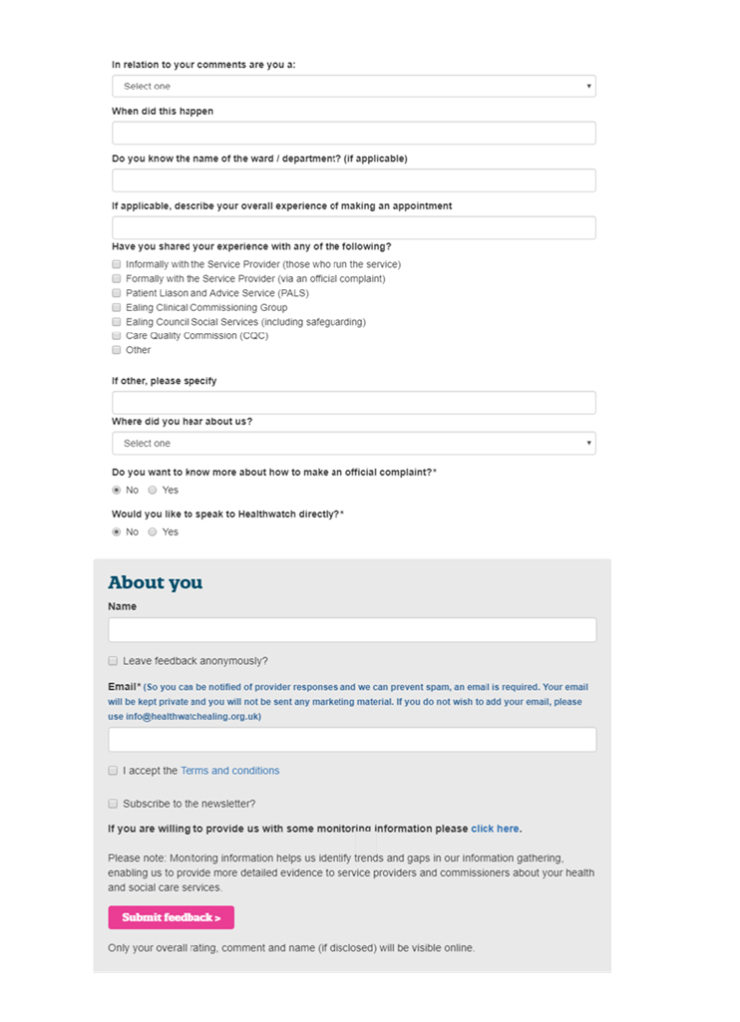
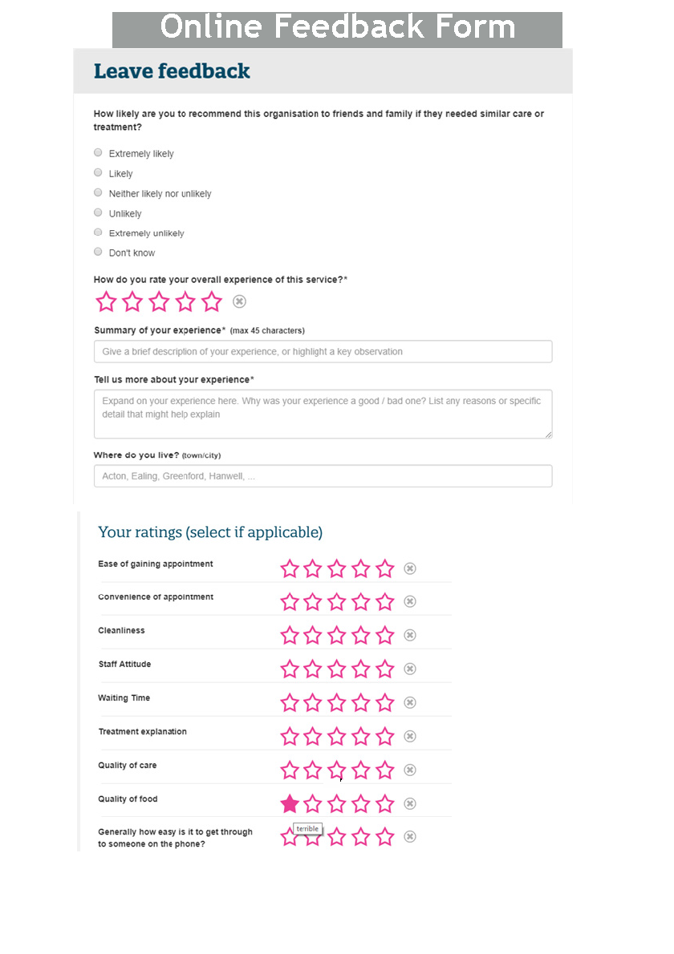

Slide 57
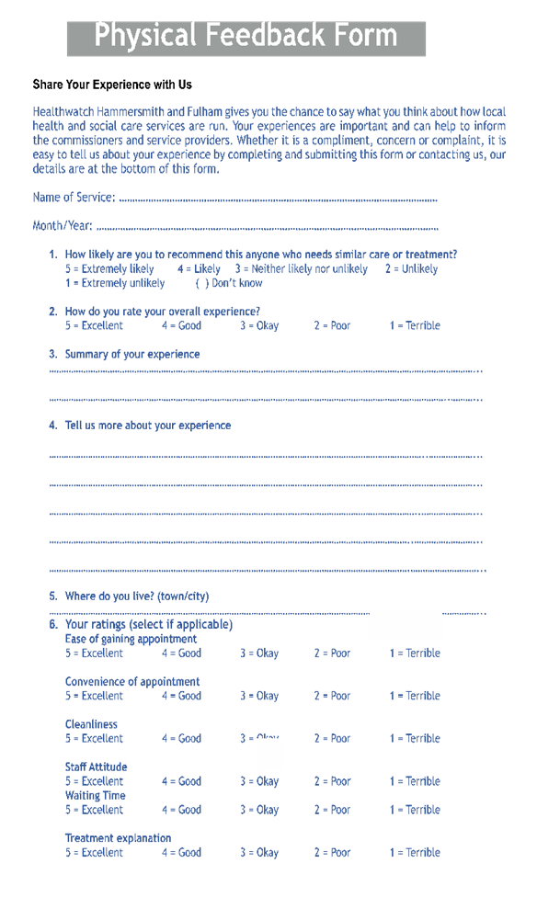
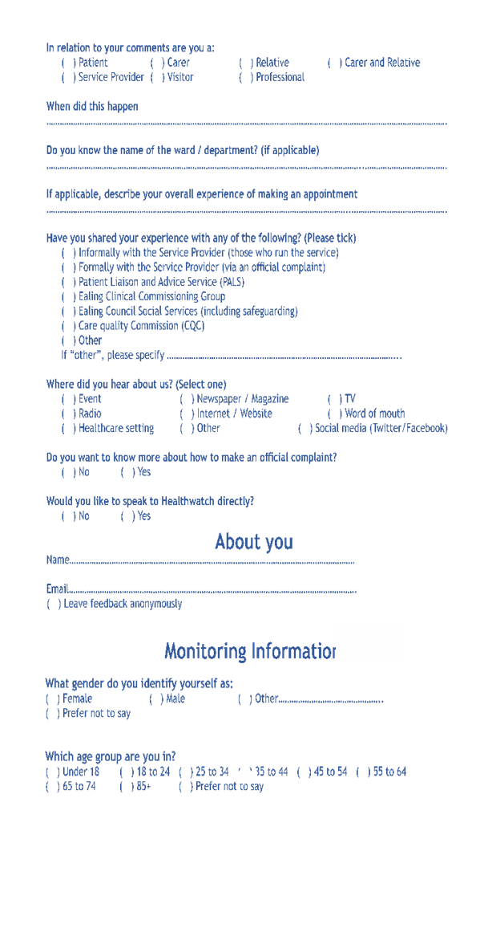

Slide 58
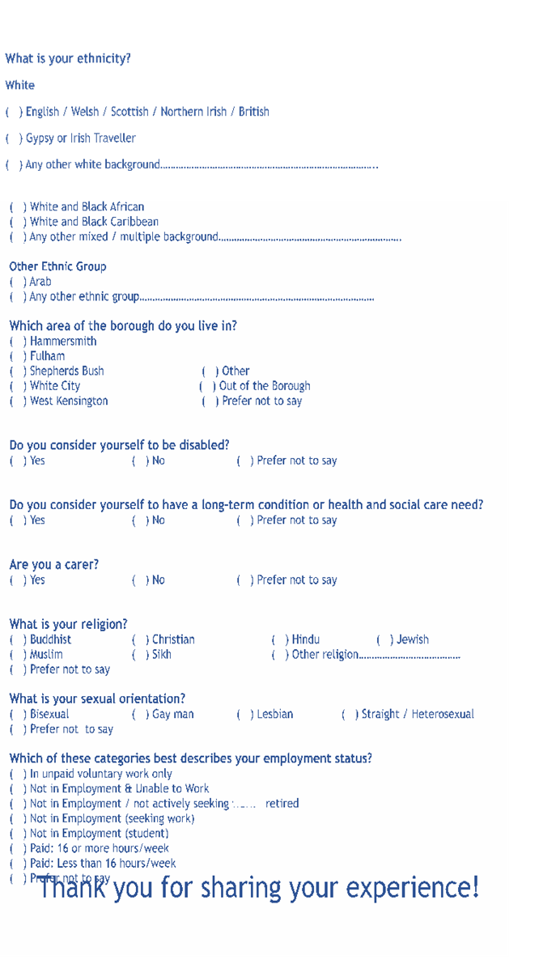
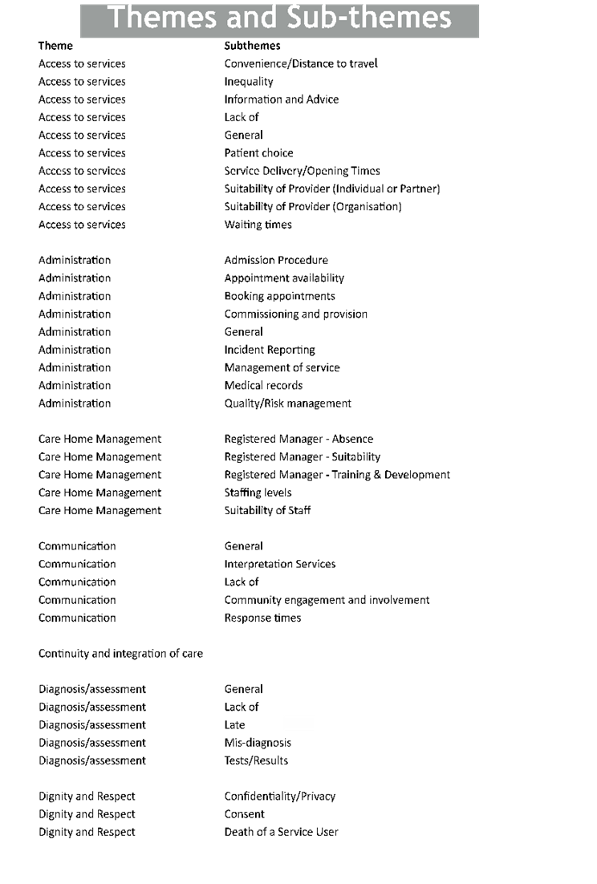

Slide 59
