Slide 1
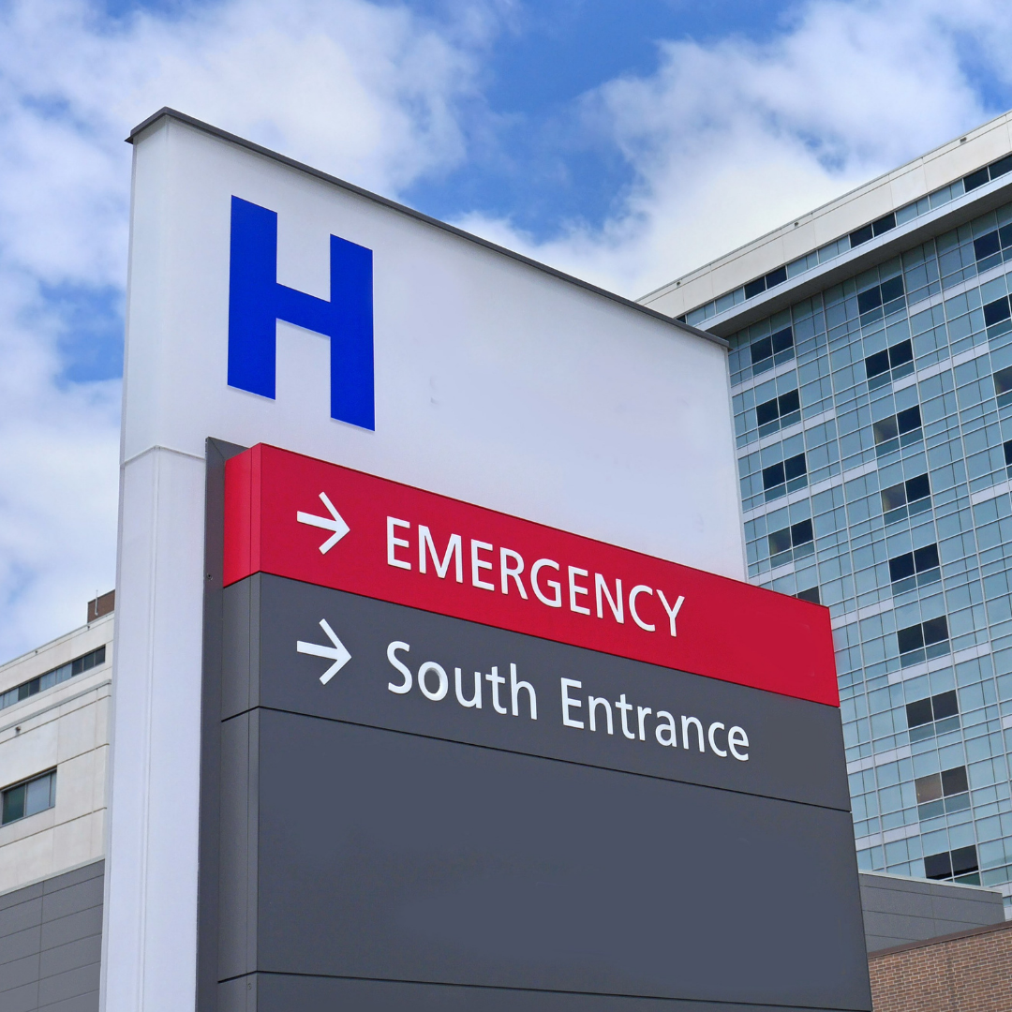
Black, Asian and Minority Ethnic Patient Experience Report Hospitals
April 2020 – March 2021

Slide 2
01.
INTRODUCTION
02.
DATA COLLECTION
03.
FINDINGS
04.
CONCLUSION & NEXT STEPS
Introduction to this report and a background to Healthwatch & Your Voice in Health and Social Care.
Methology used to collect and analyse data.
Overview and comparison of all the boroughs.
Final comments

Slide 3
01
INTRODUCTION

Slide 4
INTRODUCTION
This Black, Asian and Minority Ethnicities (BAME) Report for Healthwatch covers hospitals in six London boroughs for the period April 2020 – March 2021. Using reviews from our Diversity Monitoring Form and Patient Experience Data Collection Programme, we have analysed the data to help us understand hospital experiences from patients from different ethnic backgrounds.
About Healthwatch
Healthwatch was created by the health and social care reforms of 2012 with a powerful ambition of putting people at the centre of health and social care. To help realise this ambition Healthwatch has a number of duties around gathering and representing the views of patients and service users in local boroughs across the country.
About Your Voice in Health and Social Care
Your Voice in Health and Social Care (YVHSC) holds the contracts for the following Healthwatch services: Healthwatch Bromley, Healthwatch Ealing, Healthwatch Hammersmith & Fulham, Healthwatch Hounslow, Healthwatch Lewisham, and Healthwatch Waltham Forest.

Slide 5
02
DATA COLLECTION

Slide 6
DATA COLLECTION METHODS DURING COVID-19
DIRECT ENGAGEMENT
Normally, our Patient Experience Officers, supported by a team of volunteers, visit health and social care services daily to talk to and hear from patients, service users, carers and relatives about their experiences of local services. Due to COVID-19, we were unable to carry out our traditional face to face visits during this period.
A NEW APPROACH: ONLINE DIRECT ENGAGEMENT
In adapting to these challenging new circumstances we developed and introduced a new model for our Patient Experience Programme, involving the collection of feedback via our zoom engagement sessions and collating existing online reviews from relevant platforms, such as NHS.uk, Google reviews and Care Opinion. This report represents data gathered through these methods during the period of April 2020-March 2021.
Gathering data predominantly from online platforms has impacted our ability to collect equality monitoring information. The numbers in this report are therefore lower than we would traditionally anticipate.

Slide 7
DIVERSITY REPORTING
Unlike through our traditional face-to-face patient experience work, we are unable to collect equality monitoring data from patients who have left reviews on online websites such as Google reviews or NHS.uk.
Where we do have this data we can see that participation in filling the Diversity Monitoring Form was highest in Hounslow, Hammersmith and Fulham and Ealing during this period, although there is still considerable room for improvement.
In the interest of this being a summary report, the 24 different ethnic backgrounds identified have been consolidated into 5 main classifications listed on the right. We understand that these classifications can be too general but due to the small size of the data sets, in order to identify patterns and help with analysis, such grouping was required and may serve the purpose of prompting further investigation.
All our Patient Experience Officers have undergone Healthwatch England bespoke training around the importance of equality monitoring data and are utilising tips and techniques to improve uptake by patients that we speak to.
5 ‘Summary’ Ethnic Backgrounds for this report:
White Ethnic Background
Black Ethnic Background
Asian Ethnic Background
Mixed/Multiple Ethnic Background
Other Ethnic Background

Slide 8
EXPLAINING THE DATA
We use the Digital Feedback Centre (on our website) and Informatics system (software sitting behind the Digital Feedback Centre) to capture and analyse patient experience feedback. Each patients’ review has its own Reviewer ID code which was used to cross-reference the data with equality monitoring data.
The Informatics system is currently used by approximately 1/3 of the Healthwatch Network across England and it captures feedback in a number of ways:
1. It asks for an overall star rating of the service between 1 – 5 which represents Very Bad to Very Good.
2. It provides a free text box for comment
3. It asks for a star rating against specific domain areas, (between 1-5).
4. Patients are asked to complete a Diversity Monitoring Form.

Slide 9
03
FINDINGS

Slide 10
Overall Star Ratings

Slide 11
All Borough: Summary
Summary of Hospital Reviews
1,007 respondents over the year gave their feedback on hospital services and provided information on their ethnic background.
Lewisham had the largest proportion of BAME patients participating, while Bromley had the fewest.
Notes:
textbox
No alt text provided.
actionButton
No alt text provided.
Reviews by Ethnic Background
No alt text provided.
Overall Reviews by Borough and Ethnicity
No alt text provided.
Overall Reviews by Borough and Ethnic Background
No alt text provided.

Slide 12
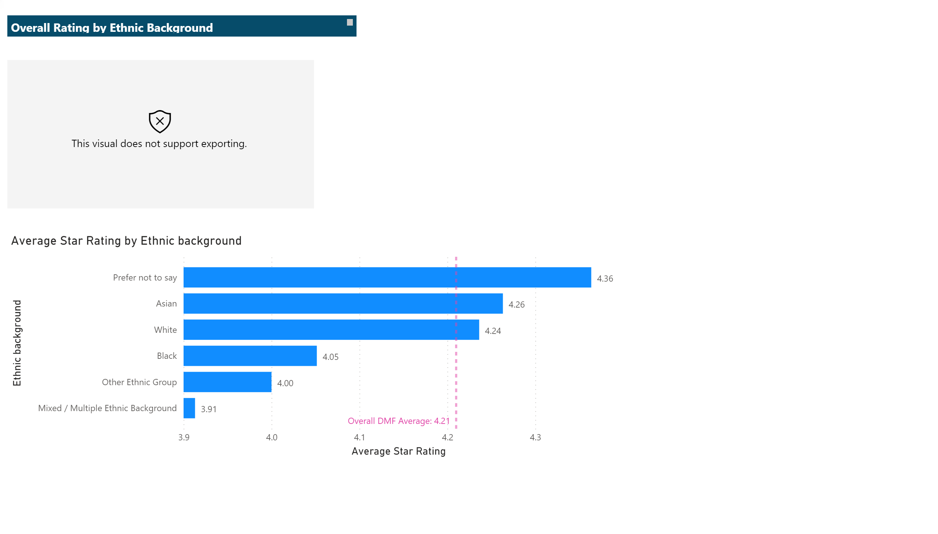
NEW Ethnicity Rating by Ethnicity
Patients were asked to rate their experience from Very Bad (1 star) to Very Good (5 stars). Overall, the average rating was 4.21 stars.
This report will focus on the data collected from patients who did complete the Equality/Diversity Monitoring Form (DMF), including those who marked the ‘Prefer not to say’ box.
This graph shows that across the boroughs, all the patients apart from those from Mixed/Multiple Ethnic Backgrounds rated the hospitals over 4 out of 5 stars.
Asian and White groups rated more positively than Black, Other and Mixed ethnic groups
‘Overall DMF Average’ means the overall average of patients who completed the Diversity Monitoring Form (DMF) across all boroughs.
Notes:
clusteredBarChart
No alt text provided.
textbox
No alt text provided.
ratingsvisual001
No alt text provided.

Slide 13
Duplicate of Duplicate of All Boroughs: Ethnicity
Overall satisfaction rating
This page provides a more detailed look at the individual star ratings by ethnic group with a 5 star rating being very good and 1 star rating being very bad.
The left-hand graph below shows on the whole, that patients from Black Ethnic Backgrounds were least likely to view the service as Very Good (5 stars) and those from the Asian group were most likely to rate the service as very good. Whilst lower star ratings are less in general across all ethnic groups Patients from Mixed / Multiple Ethnic Backgrounds were most likely to rate the service Very Bad (1 star). Patients from White Ethnic Backgrounds most commonly rated hospital services as good.
If we combine the star ratings into positive, negative and neutral the chart on the right shows variation in positive ratings ranging from 69% (Mixed/Multiple) to 83% (White).
Notes:
textbox
No alt text provided.
Patient Feedback
No alt text provided.

Slide 14
Duplicate of Duplicate of All Boroughs: Ethnicity
Overall star rating by ethnic background
These pie charts show the same data as the previous slide in pie chart form.
If we group ‘good’ (4 stars) and ‘very good’ (5 stars) ratings we find the following variation:
Asian – 79% positive
Black – 76% positive
Mixed – 69% positive
Other – 70% positive
White – 82% positive
-----------------------------------
BAME – 74% positive.
White – 82% positive
Notes:
textbox
No alt text provided.
Patient Feedback
No alt text provided.

Slide 15
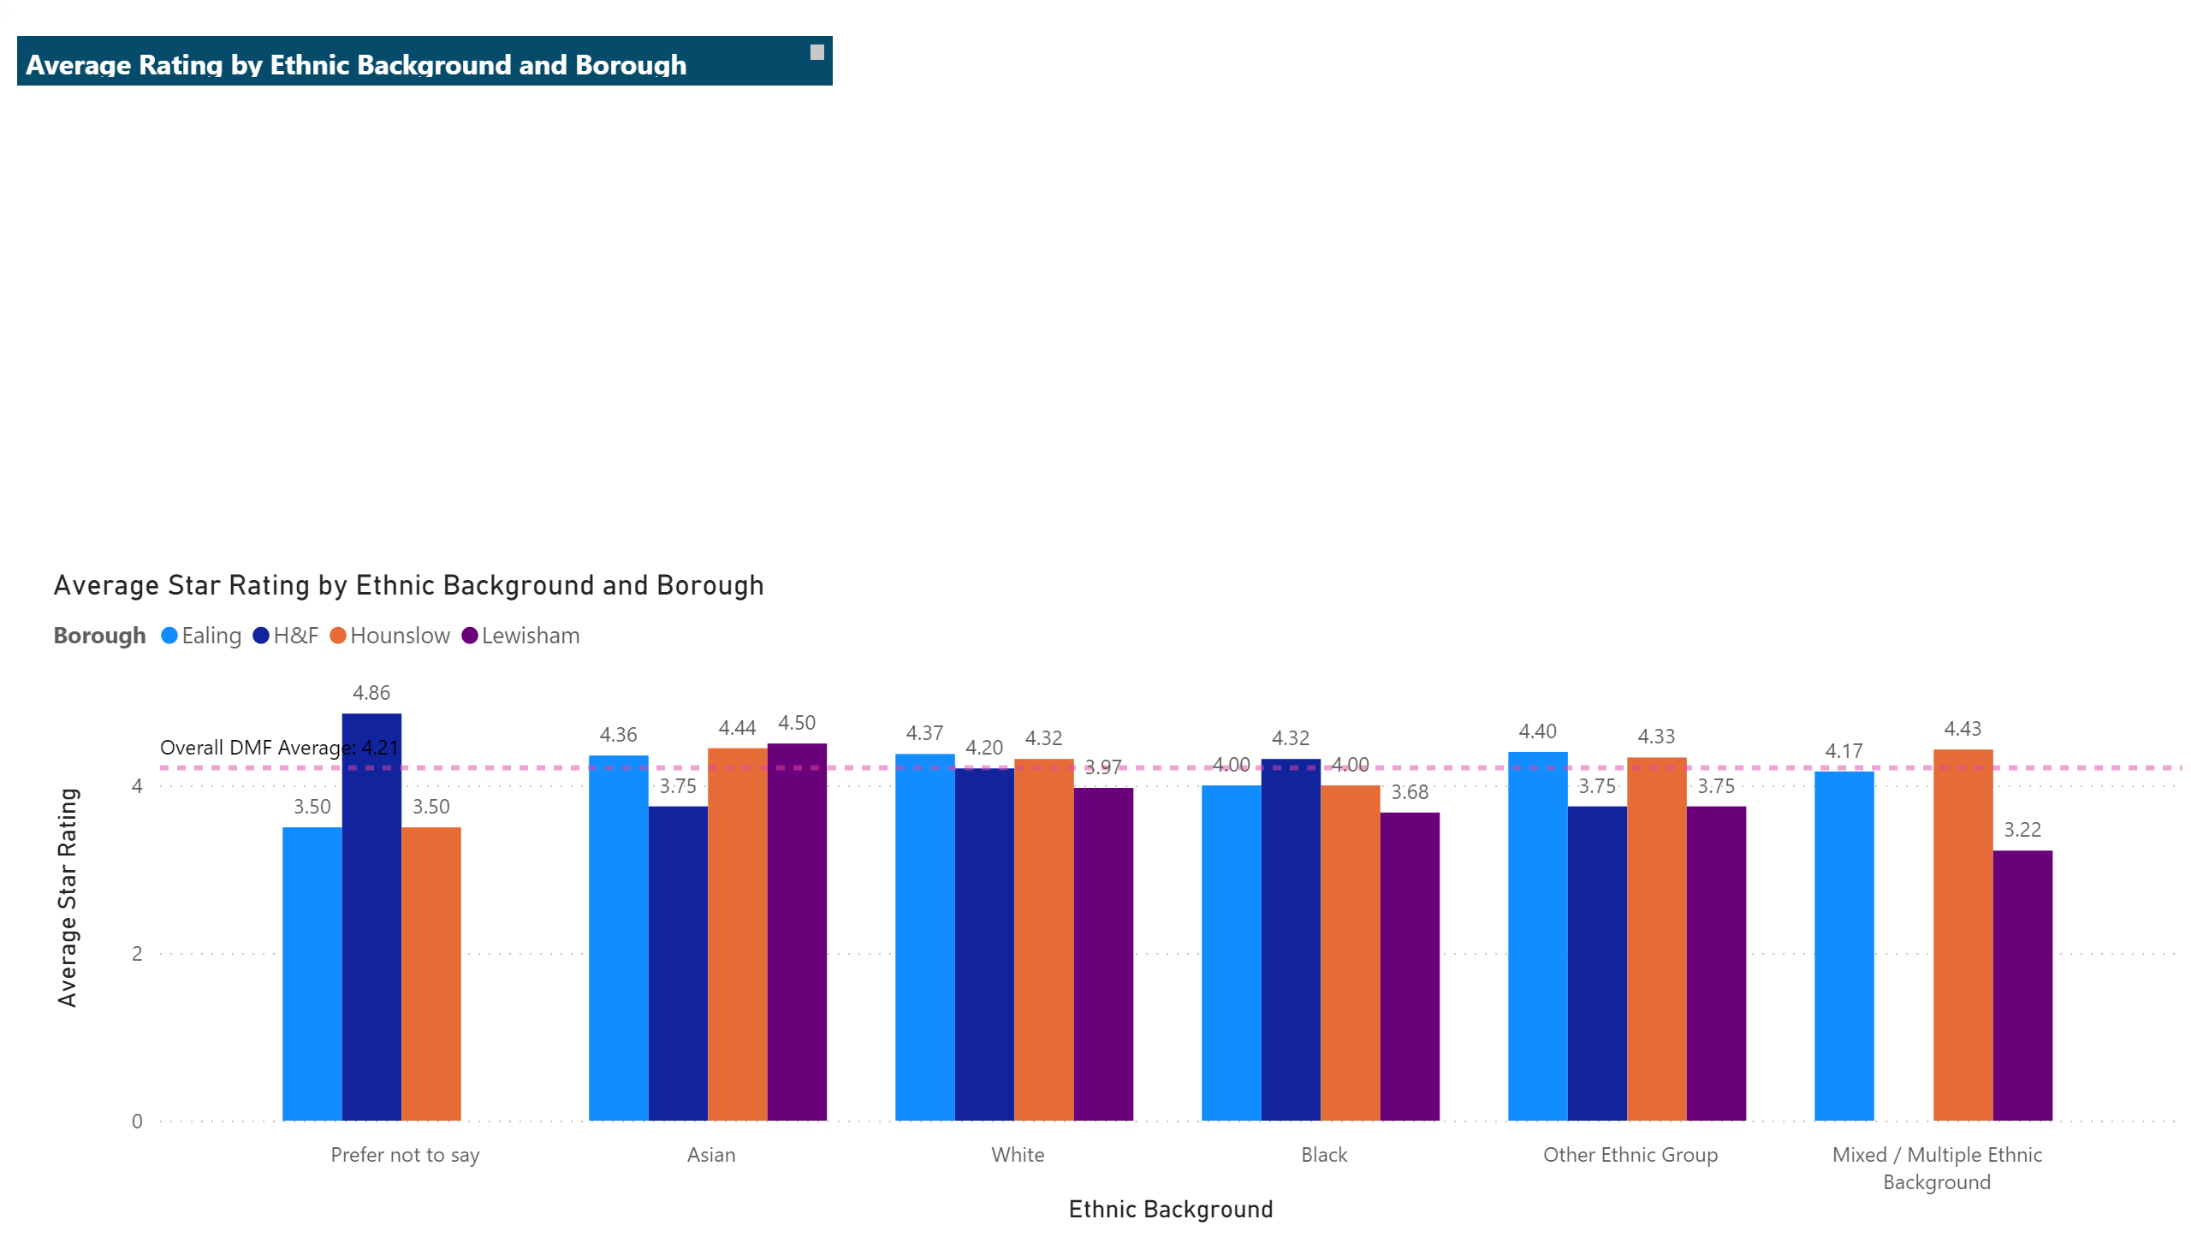
Ethnicity Rating by Ethnicity
This page looks further at those differences within the same ethnic groups across different boroughs.
Patients from different ethnic backgrounds appear to have had varying experiences according to the borough in which they were treated. Data from Bromley and Waltham Forest has been removed as numbers are below our threshold.
Whilst overall variation was small, the biggest differences are seen in the Asian ethnic group, rating highest in Lewisham at 4.5 stars and lowest in Hammersmith & Fulham at 3.75 stars, and the Mixed/Multiple Ethnic group, rating highest in Hounslow and lowest in Lewisham. With growing levels of data this picture can be monitored further for any trends that vary by ethnic group in different boroughs.
Notes:
clusteredColumnChart
No alt text provided.
textbox
No alt text provided.

Slide 16
Specific star ratings, Service Aspects

Slide 17
Service Rating
Specific star ratings – Service aspects
In addition to an ‘overall star rating’, patients are asked to rate different aspects of Hospital Services, such as ‘quality of care’ and ‘cleanliness’, from 1 – 5 (Very Bad to Very Good). This data captures feedback from Healthwatch Ealing, Hounslow, Hammersmith & Fulham and Lewisham.
For the White Ethnic group the lowest star rating was for ‘Ease of getting through on the phone’. For Asian, Black, Mixed and Other Ethnic Groups the lowest star rating was for ‘Waiting Times’. It is interesting to note that for people who preferred not leave their monitoring information – perhaps those most concerned about being identified? – ratings for ‘waiting time’ were just 1.33 out of 5. For all but one category this grouping of people also rated service aspects the lowest. Given this, the feedback from the ‘prefer not to say’ category may warrant further investigation.
In respect of the highest scoring areas there was a little more variation: White and Mixed = Cleanliness; Asian and Black = Staff Attitude; Other = Quality of Care.
‘Waiting times’ receives not only the lowest star ratings overall, but also the highest levels of variance in ratings by different groups. This is followed by ‘Quality of Care’ and ‘Getting through on the telephone’ with the second and third highest levels of variance respectively.
Service Aspect | Asian (n.37) | Black (n. 87) | White (n. 856) | Other Group (n. 8) | Mixed / Multiple (n.17) | Prefer not to say (n.12)
Cleanliness / Environment | 4.5 | 4.3 | 4.33 | 4 | 5 | 4
Convenience of appointment | 4 | 4.09 | 3.98 |  | 4
Ease of getting through on phone | 4 | 4 | 3.65 |  | 4.5 | 3.67
Quality of care | 4.43 | 4.65 | 4.29 | 4.75 | 4.5 | 3
Staff Attitude | 4.71 | 4.71 | 4.29 | 4 | 4.75 | 4
Waiting Time | 3.38 | 3.87 | 3.88 | 3.5 | 3.67 | 1.33
Notes:
textbox
No alt text provided.
clusteredColumnChart
No alt text provided.
textbox
No alt text provided.

Slide 18
Service Rating
Notes:
textbox
No alt text provided.
clusteredColumnChart
No alt text provided.
textbox
No alt text provided.

Slide 19
Themes from qualitative feedback

Slide 20
Service Rating
THEMES AND SENTIMENT
In addition to star ratings, patients leave freetext comments which are analysed for themes and sentiment. The following charts demonstrate the most common themes applied and look at the sentiment of these comments for the White Ethnic group and Black, Asian and Minority Ethnic groups combined.
Notes:
textbox
No alt text provided.
clusteredColumnChart
No alt text provided.
textbox
No alt text provided.

Slide 21
Service Rating
THEMES AND SENTIMENT
Notes:
textbox
No alt text provided.
clusteredColumnChart
No alt text provided.
textbox
No alt text provided.

Slide 22
Themes by Ethnicity
Themes’ Sentiment by Ethnic Background
* Below threshold
Theme | % positive WHITE | % positive BAME
STAFF | 73% | 72%
QUALITY OF CARE/TREATMENT | 80% | 67%
APPOINTMENTS | 45% | 22%
ADMINISTRATION | 63% | 67%
COMMUNICATIONS | 48% | 9%
WAITING TIMES | 52% | *
Notes:
Main Themes by Sentiment
No alt text provided.
textbox
No alt text provided.
textbox
No alt text provided.

Slide 23
04
CONCLUSION & NEXT STEPS

Slide 24
CONCLUSION
This intention of this report was to understand the experiences of patients from BAME backgrounds in hospitals. About a third of respondants provided their ethnic backgrounds in the Diversity Monitoring Form which showed 18% were from BAME ethnic backgrounds.
This report has highlighted a number of interesting areas for Healthwatch to monitor and build upon in future analysis, and for our commissioning and provider partners to explore further, triangulate with their own data sets and incorporate into their own work planning and strategy.
The online patient experience methods utilised during the COVID 19 pandemic severely impacted the ability of our local Healthwatch to capture equality monitoring data. Representation of BAME patients within the data was low. A return to face-to-face outreach, coupled with staff training on capturing equality monitoring data (already complete), and a heightened focus on those areas of the borough that may be most deprived, should yield increasing levels of equality monitoring data to analyse.
Overall average star ratings by ethnic group were high (rounded to 4 out of 5 stars for each ethnic group). The variation apparent from a more detailed look (from 3.91 stars to 4.36 stars) should be monitored in future data sets for any trends.
Whilst 82% of White respondents gave a 4 or 5 star (positive) rating, this drops to 74% for BAME respondents. This should be monitored in future reporting.

Slide 25
CONCLUSION
When analysing by borough, the Asian ethnic group scored 4.5 stars in Lewisham and 3.75 stars in Hammersmith & Fulham. The Mixed/Multiple Ethnic Group rated highest in Hounslow and lowest in Lewisham. With increasing data sets for each borough, interesting further analysis can be carried out in future reports.
When looking at star ratings against specific aspects of service we can see that ‘Waiting times’ receives not only the lowest star ratings overall (by all Ethnic groups), but also the highest levels of variance in ratings by different Ethnic Groups. For the White Ethnic group the lowest star rating was for ‘Ease of getting through on the phone’. For Asian, Black, Mixed and Other Ethnic Groups the lowest star rating was for ‘Waiting Times. In respect of the highest scoring areas there was a little more variation: White and Mixed = ‘Cleanliness’; Asian and Black = ‘Staff Attitude’; Other = Quality of Care. These findings offer an indication of areas that warrant further consideration by partners commissioning, delivering and designing services as well as how services communicate with patients around expectations. The findings reported here can be monitored in future report.
Analysis of freetext comments indicate notable variation in ‘Quality of Care’ (White 80% positive sentiment; BAME 67%); ‘Appointments’ (White 45% positive sentiment; BAME 22%); ‘Communications’ (White 48% positive sentiment; BAME 9%). Similar ratings are noted in ‘Staff’ (73% White and 72% BAME) and ‘Administration’ (63% White and 67% BAME. As above, this offers interesting food for thought to be tested/investigated further and this picture will be monitored in future reports.

Slide 26
NEXT STEPS
Present Findings
Improve reporting
Improve our Data Collection
Promote our Service to patients from BAME backgrounds
to relevant CCG, LA and provider partners to inform BAME Inequality work streams.
Further reporting should now commence to monitor themes and trend over time, integrate BAME analysis into standard reporting and look at GP data in a similar way.
This report has highlighted opportunities to improve our Equality monitoring data collection. Training has begun and a move back to our face-to-face model should increase data and our ability to understand and report prevalent themes and trends.
through a range of platforms and targeted outreach, to capture a range of feedback and experiences and encourage participation.

