Slide 1
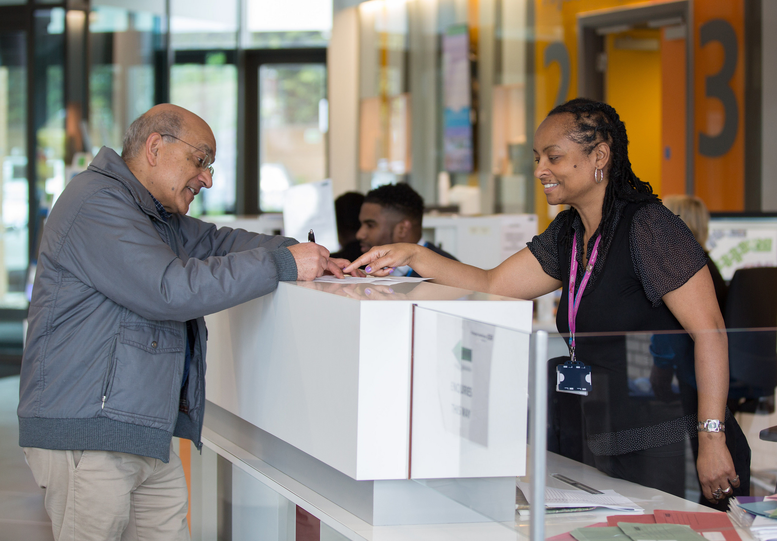
PATIENT EXPERIENCE: A TWO-YEAR COMPARATIVE ANALYSIS OF EALING, HOUNSLOW AND HAMMERSMITH & FULHAM GP SURGERIES
Oct 2019 –Aug 2021

Slide 2
Introduction
Our Patient Experience Programme collects data from patients about the local health and social care services.
Between October 2019 and August 2021, we collected
2485 reviews for Ealing GP surgeries
2917 reviews for Hounslow GP surgeries
2123 reviews for Hammersmith & Fulham (H&F) GP surgeries
This report compares the patient feedback for these three boroughs.

Slide 3
Sentiments
We apply Sentiments (Positive, Neutral or Negative) to each feedback we receive.
The overall sentiment for Ealing GPs was 60% positive, 25% negative and 15% neutral
The overall sentiment for Hounslow GPs was 61% positive, 22% negative and 17% neutral.
The overall sentiment for H&F GPs was 61% positive, 26% negative and 13% neutral.

Slide 4
Themes and Subthemes: Staff
We apply Themes and Subthemes to each feedback we receive. The main themes include Staff, Access to Services, and Administration.
In relation to the theme of Staff, H&F received significantly more positive feedback compared to Ealing and Hounslow. Ealing GPs received the most negative feedback around staffing among the three boroughs.

Slide 5
Themes and Subthemes: Staff - Capacity
We apply Themes and Subthemes to each feedback we receive. The Subthemes of Staff are Capacity, and Staff Attitudes.
Hounslow received the highest proportion of negative reviews (87%) for the sub-theme of Capacity while H&F received the highest proportion of positive reviews (94%).

Slide 6
Themes and Subthemes: Staff – Staff Attitudes
We apply Themes and Subthemes to each feedback we receive. The Subthemes of Staff are Capacity, and Staff Attitudes.
Ealing received the highest proportion of negative reviews (36%) for the sub-theme of Staff Attitudes (Customer Service) while H&F received the highest proportion of positive reviews (74%).

Slide 7
Themes and Subthemes: Access to Services
We apply Themes and Subthemes to each feedback we receive. The main themes include Staff, Access to Services, and Administration.
Ealing GPs received more positive feedback (56%) in comparison to the other two boroughs regarding the Access to Services theme. H&F GPs documented the most negative feedback regarding GP service access (60%) when compared to Ealing and Hounslow GPs.

Slide 8
Themes and Subthemes: Access to Services – Waiting Times
We apply Themes and Subthemes to each feedback we receive. The Subthemes of Access to Services are Waiting Times, and Patient Choice/Involvement.
H&F received the highest proportion of negative reviews (59%) for the Waiting Times sub-theme, with none of the boroughs receiving more than 40% positive feedback

Slide 9
Themes and Subthemes: Access to Services – Patient Choice/Involvement
We apply Themes and Subthemes to each feedback we receive. The Subthemes of Access to Services are Waiting Times, and Patient Choice/Involvement.
Whilst this was an area of predominantly negative feedback, Ealing received the highest proportion of positive reviews (30%) in relation to the sub-theme of Patient Choice.

Slide 10
Themes and Subthemes: Administration
We apply Themes and Subthemes to each feedback we receive. The main themes include Staff, Access to Services, and Administration.
Ealing GPs received slightly more positive responses (50%) around the Administration theme compared to Hounslow GP services (43%) and H&F GP services (48%). H&F received an equal number of positive and negative reviews pertaining to this theme.

Slide 11
Themes and Subthemes: Administration– Ease of Booking Appointments
We apply Themes and Subthemes to each feedback we receive. The Subthemes of Administration are Ease of Booking Appointment, Appointment Availability and Management of Services.
In relation to the ease of booking appointments, H&F receive the highest proportion of positive feedback (50%) whilst Ealing received the highest proportion of negative feedback (49%).

Slide 12
Themes and Subthemes: Administration– Appointment Availability
We apply Themes and Subthemes to each feedback we receive. The Subthemes of Administration are Ease of Booking Appointment, Appointment Availability and Management of Services.
Ealing and Hounslow both had an equal amount of negative feedback for appointment availability (49%) while H&F had the highest proportion of positive feedback (52%) for this sub-theme.

Slide 13
Themes and Subthemes: Administration– Management of Services
We apply Themes and Subthemes to each feedback we receive. The Subthemes of Administration are Ease of Booking Appointment, Appointment Availability and Management of Services.
Last, all three boroughs received a similar amount of positive feedback for the management of GP services (Ealing – 69%, Hounslow – 67%, H&F – 71%). Ealing received the highest proportion of negative reviews for this sub-theme (27%).

Slide 14
PATIENT EXPERIENCE: ACCESS TO EALING, HOUNSLOW, H&F GP SERVICES VIA PHONE (OCT 2019-AUG 2021)
Received an average rating of 3.5 or less
Received an average rating of 4 or more
No data available

Slide 15
EALING GP SERVICES
Acton Health Centre (Dr. Napolion Isaac) | Corfton Road Surgery
Acton Lane Medical Centre | Crown St Surgery
Acton Town Medical Centre (Dr.Wafiq Moustafa) | Cuckoo Lane Practice
Allendale Road Surgery | Dormers Wells Medical Centre
Barnabas Medical Centre | Ealing Park Health Centre
Belmont Medical Centre | Eastmead Avenue Surgery
Boileau Road Surgery | Elm Trees Surgery
Broadmead Surgery | Elmbank Surgery
Chepstow Gardens Medical Centre | Elthorne Park Surgery/ /Dr A Arfeen, Dr. R Shah, Dr. P Reynolds, Dr M Waters Practice
Chiswick Family Practice (Dr Bhatt) | Featherstone Road Health Centre
Chiswick Family Practice (Dr Webber) [Dr O'Connel&Dr Bennett] | Florence Road Surgery
Churchfield Surgery | Goodcare Practice
Cloister Road Surgery | Gordon House Surgery
46% (n.33 out of 72) of the GP surgeries within the Ealing borough received a 3.5 rating or less for ‘Ease of Access Via Phone’. Out of the remaining, 22 received an average rating of higher than 3.5. Unfortunately, 17 of the GP surgeries did not receive enough feedback during this time to be able to report on their average telephone access.

Slide 16
EALING GP SERVICES
Greenford Avenue Family Health Practice | Lynwood Surgery
Greenford Road Medical Centre | Mandeville Medical Centre (Dr Surakshan Claude Seimon)
Grosvenor House Surgery | Mansell Road Practice
Guru Nanak Medical Centre/Dr G Singh and Partners | Mattock Lane Health (Dr H Nay Lin Centre)
Hammond Road Surgery | Meadow View Surgery
Hanwell Health Centre | Medical Centre (Beaconsfield Road)
Hillcrest surgery (Drs Dhatt & Tailor) | Mill Hill Surgery
Hillview Surgery/Dr Shergill & Partners | Northfields Surgery
Horn Lane Surgery (Dr Muhammed Akbar Khan) | Oldfield Family Practice
Islip Manor Medical Centre | Perivale Medical Clinic
Jubilee Gardens Medical Centre | Pitshanger family practice
KS Medical Centre Limited | Queens Walk Practice
Lady Margaret Road Medical Centre | Saluja Clinic

Slide 17
EALING GP SERVICES
Somerset Family Health Practice/ Healthcare 360 limited | The Welcome Practice (Norwood Road Surgery)/ Dr Naz Asghar
Somerset Medical Centre | Waterside Medical Centre
St George's Medical | West End Surgery
St Marks/Brunswick Road Medical Centre (Dr. Nader Lewis) | Western Avenue Surgery
Sunrise Medical Centre | Westseven (Dr S Foo & Dr M Prevost)
The Argyle Surgery | Woodbridge Medical Centre
The Avenue Surgery (Dr Suganthamala Radhakrishnan | Yeading Medical Centre
The Avenue Surgery (Jacqueline Bayer and Dr Jane Livingston)
The Bedford Park Surgery
The Grove Medical
The Medical Centre (Dr.G.Balachandran)
The MWH Practice Centre
The Vale Surgery

Slide 18
HOUNSLOW GP SERVICES
Argyle Health Group Practice- Isleworth Practice | Dr Soods Practice
Bedfont (Caretaker Dr N Kumar-Hounslow Medical | First care Practice
Blue Wing Family Doctor Unit | Gill Medical Practice
Brentford Family Practice | Glebe Street Surgery
Brentford Group Practice | Grove Park Surgery
Carlton Surgery | Grove Park Terrace Surgery
Chestnut Practice | Grove Village Medical Centre
Chiswick Family Doctors Practice | Hatton Medical Practice
Chiswick Health Practice | Heston Practice
Clifford House Surgery | Holly Road Medical Centre
Clifford Road Surgery | Hounslow Family Practice
Cranford Medical | Hounslow Medical Centre & Bath Road Surgery
Crosslands Surgery | Jersey Practice
76% (34 out of 45) of the GP surgeries in Hounslow received a 3.5 rating or less for ‘Ease of Access Via Phone’. Two surgeries had inconclusive data and 9 surgeries had an average of more than a 3.5 rating for telephone access during this time.

Slide 19
HOUNSLOW GP SERVICES
Kingfisher Practice | The Practice Feltham
Little Park Surgery | Thornbury Road Centre for Health
Mount Medical Centre | Twickenham Park Medical Centre
Pentelow Practice | Wellesley Road Practice
Queens Park Medical Practice | WEST 4GPS
Redwood Practice | Willow Practice
Skyways Medical Centre
Spring Grove Medical Practice
St David’s Practice
St Margarets Medical Practice
The Albany Practice
The Great West Surgery
The Practice (Hounslow)

Slide 20
H&F GP SERVICES
Ashville Surgery | North Fulham Surgery
Babylon GP at hand, Dr. Jefferies and Partners | Park Medical Centre
Babylon GP at Hand, The Medical Centre | Parkview Medical Centre- Dr Kukar
Brook Green Medical Centre | Parkview Practice
Brook Green Surgery | Richford Gate Medical Practice
Canberra Old Oak Surgery | Sands End Health Clinic
Cassidy Medical Centre | Shepherds’ Bush Medical Centre
Dr Uppal & Partners, Parkview Centre for Health and Wellbeing | Sterndale Surgery
Fulham Cross Medical Centre | The Ashchurch Medical Centre
Fulham Medical Centre | The Bush Doctors
Hammersmith & Fulham Centre for Health (Charing Cross Hospital) | The Medical Centre (Dr Kukar)
Hammersmith & Fulham Centre for Health (Hammersmith Hospital) | The New Surgery, Dr Dassanayake & Partners
Hammersmith Surgery | The Palace Surgery, Dr. Mangwana and Partners
Lilyville Surgery | The Salisbury Surgery, Dr. Ravindrasena Muthiah
North End Medical centre | Westway Surgery
70% (21 out of 30) of the GP surgeries in the H&F borough received a 3.5 rating or less for ‘Ease of Access Via Phone’. The remaining 9 received higher than 3.5 during this time.

