Slide 1
GP Patient Experience Annual Report – Hammersmith & Fulham
April 2020 to March 2021

Slide 2
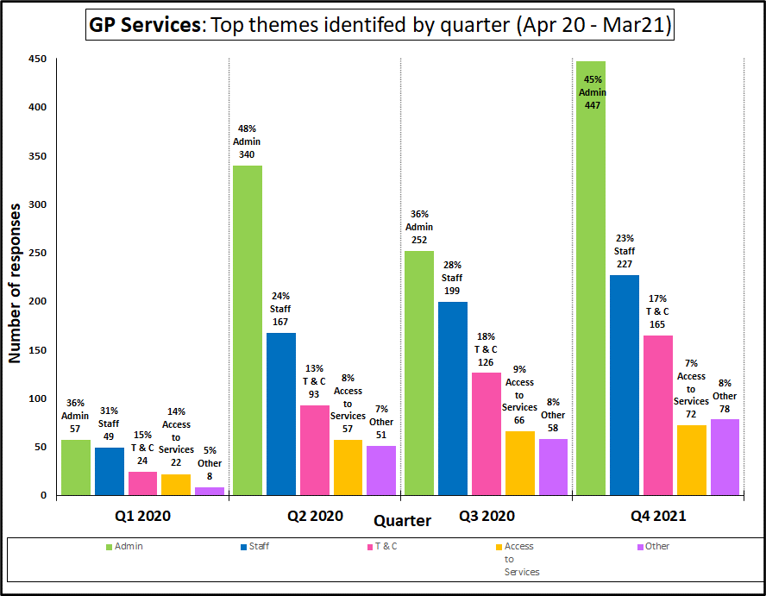
GP ALL SERVICES – MAIN THEMES BY QUARTER
Between April 20 and March 21, 1161 reviews were received regarding GP Services, and was applied on 2,561 counts. The top four themes identified were Administration 43% (n.1,096), Staff 25% (n.646), Treatment and Care 16% (n.407) and Access to Services 8% (n.217).

Slide 3
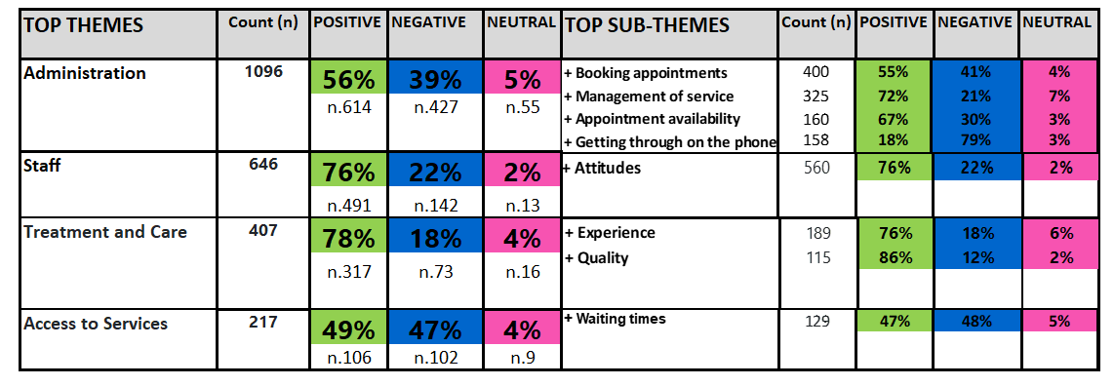
GP ALL SERVICES – MAIN THEMES AND SUB-THEMES 2020/21

Slide 4
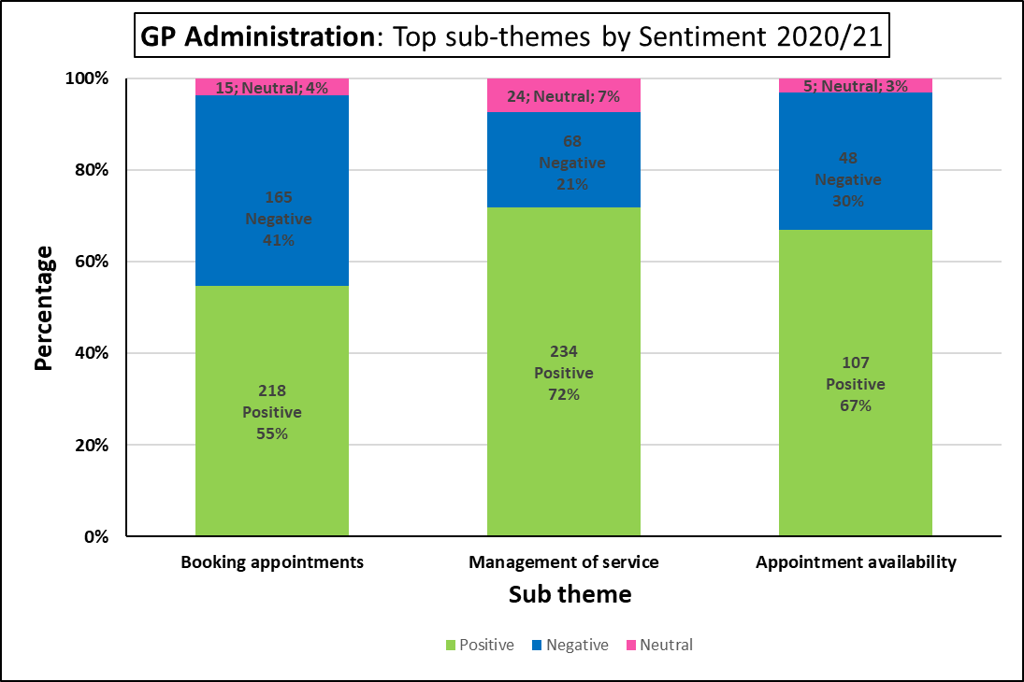
GP ADMINISTRATION – MAIN SUB THEMES
Between April 20 to March 21, the theme Administration was applied 1,096 times; 56% (n.614), positive, 39% (n.427) negative and 5% (n.55) neutral.
The three most prominent sub themes were Booking an Appointment (n.398), Management of Service (n.326) and Appointment availability (n.160).

Slide 5
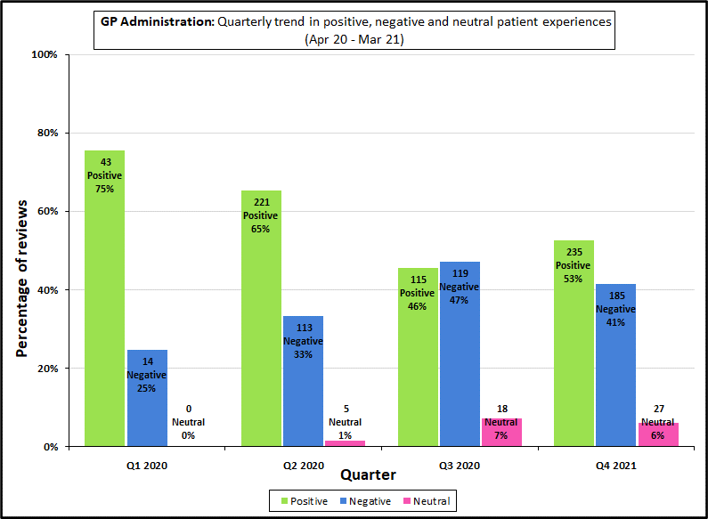
THEME: GP ADMINISTRATION
During Q1, 75% of the reviews received regarding the theme of Administration expressed a positive sentiment, whilst 25% attributed a negative sentiment. The proportion of negative reviews continued to increase over the subsequent quarters, to a peak of 47% by Q3, which exceeded positive reviews received at 46%.

Slide 6
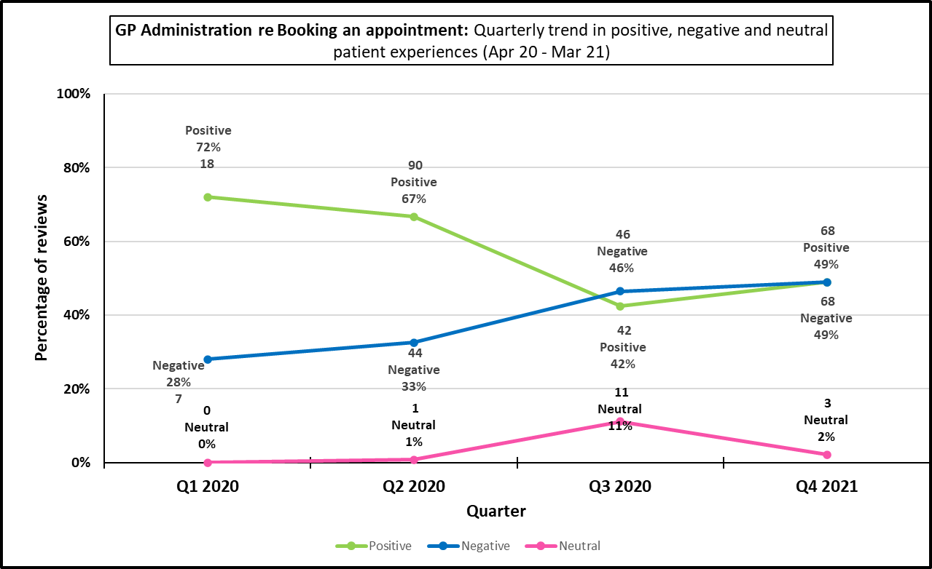
GP ADMINISTRATION – BOOKING AN APPOINTMENT
Positive sentiment regarding booking an appointment started off at 72% (n.18) in Q1 but reduced over the year to 49% (n.68) by Q4. Correspondingly, the proportion of negative reviews increased over this period from 28% (n.7) in Q1, to the same level as positive reviews at 49% (n.68) by Q4.
During Q3 and Q4, the proportion of negative and neutral patient sentiment reviews outweighed those expressing a positive sentiment.

Slide 7
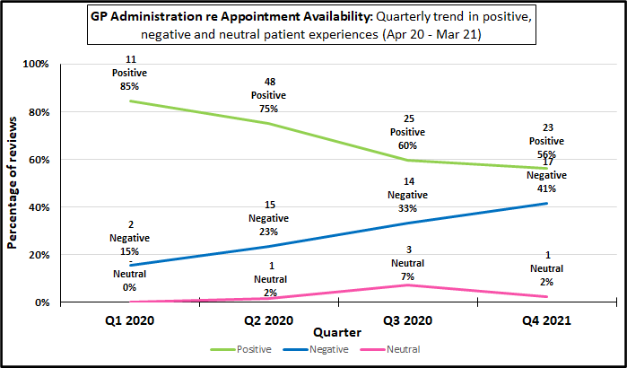
GP ADMINISTRATION – APPOINTMENT AVAILABILITY
Positive sentiment regarding appointment availability decreased from 85% in Q1 (n.11) to 56% (n.23) by Q4. Meanwhile, negative sentiment increased from 15% (n.2) to 41% (n.17) over the same period.

Slide 8
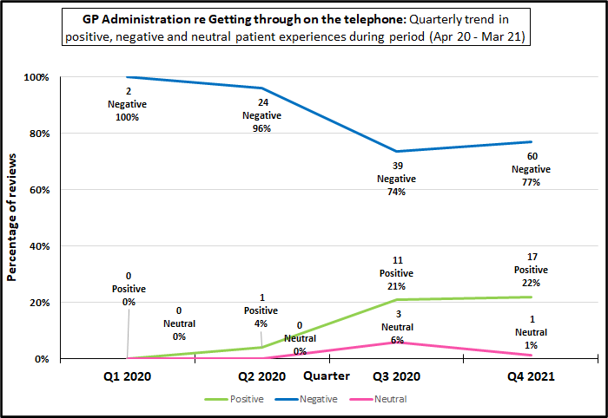
GP ADMINISTRATION – GETTING THROUGH ON THE PHONE
In Q1, the two reviews received regarding this sub theme were negative, equating to 100% of the small sample size. Negative sentiment remained high during Q2 at 96% (n.24) but reduced to 74% and 77% respectively during Q3 and Q4. Positive sentiment increased from 0% in Q1 to 22% by Q4, accounting for roughly a fifth of reviews.

Slide 9
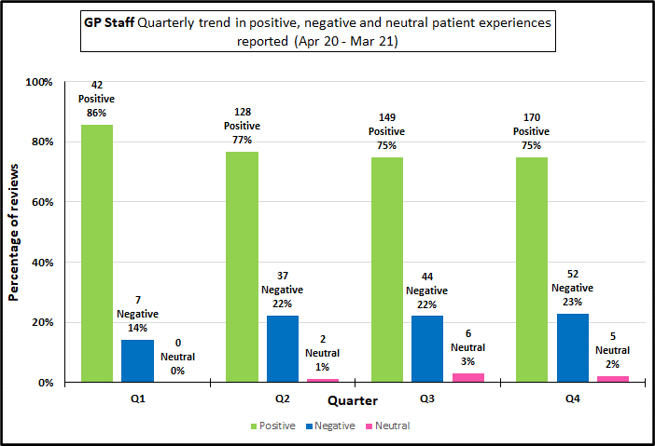
THEME: GP STAFF
During Q1, 86% of reviews regarding GP staff were of a positive sentiment. This level reduced over Q2-Q4, ranging between 75-77%. Meanwhile, negative sentiment increased from 14% in Q1, to 22-23% between Q2-Q4.

Slide 10
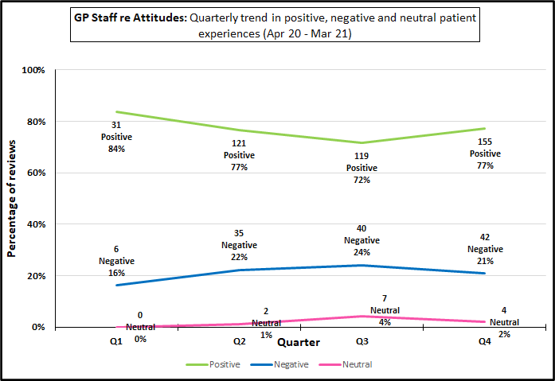
THEME: GP STAFF – ATTITUDES
During Q1, 84% of reviews regarding the attitudes of GP Staff were of a positive sentiment. This reduced over the period Q2-Q4, remaining between 72%-77%. Meanwhile, negative sentiment increased from 16% in Q1, to 21-24% between Q2-Q4.

Slide 11
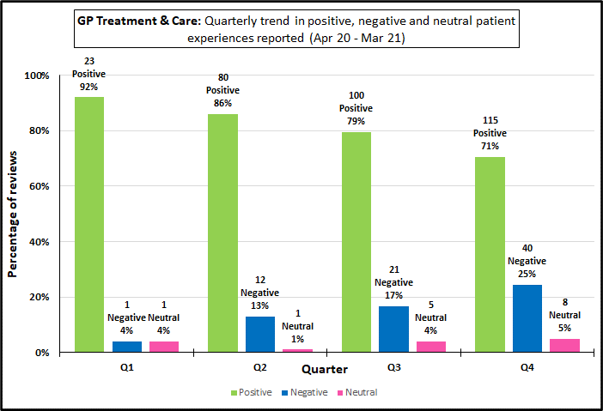
THEME: GP TREATMENT & CARE
Patient Experience regarding Treatment and Care started with 92% of reviews expressing a positive sentiment in Q1 (n.23). This decreased between Q2 and Q4, with the proportion of positive reviews accounting for 71% of responses by Q4 (n.115). Meanwhile, the proportion of reviews expressing a negative sentiment increased from 4% in Q1 (n.1) to 25% by Q4.

Slide 12
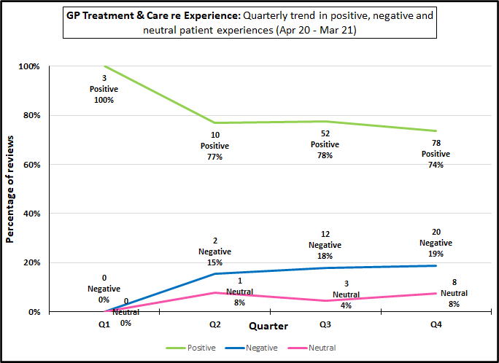
GP TREATMENT & CARE: EXPERIENCE
In Q1, all three reviews received regarding treatment and care were positive, equating to 100% of the sample size. The level of positive sentiment reduced over Q2-Q4, remaining between 74-78%. Meanwhile, negative sentiment varied between 15-19%. .

Slide 13
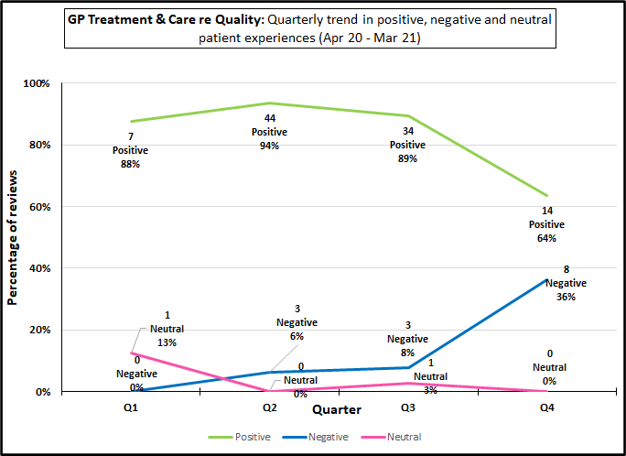
GP TREATMENT & CARE: QUALITY
The majority of patient reviews received regarding the quality of treatment and care expressed a very high level of positive sentiment between Q1 and Q3, ranging between 88%-94%. Correspondingly, negative sentiment remained low during this period, remaining between 6%-13% over the same period.
In Q4, there was a reduction in positive sentiment compared to Q3, with 64%, or roughly 2 in 3 patient reviews, reporting a positive experience

Slide 14
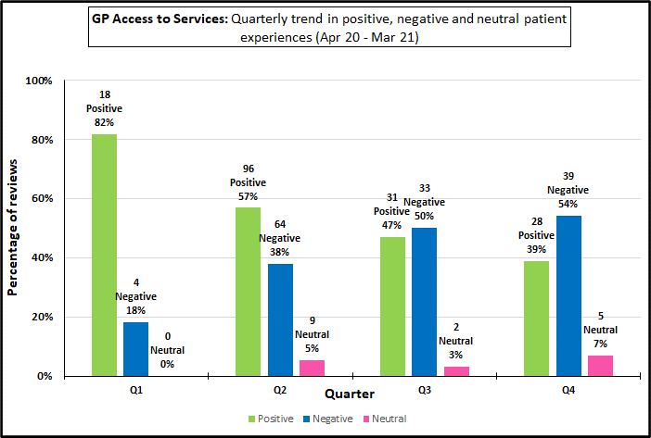
THEME: ACCESS TO SERVICES
Patient experience regarding Access to Services started with over four fifths of reviews expressing a positive sentiment in Q1 (82%, n.18). This reduced by a quarter to 57% by Q2 (n.96).
The relative proportion of positive reviews decreased during Q3 and Q4 to 39% (n=28), with negative reviews accounting for half or more of the reviews at 50% and 54% respectively.

Slide 15
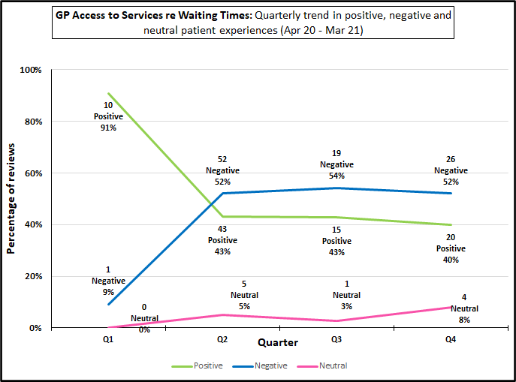
GP ACCESS TO SERVICES – WAITING TIMES
Majority of patients in Q1 (91%, n.10) expressed a positive sentiment regarding waiting times. This reduced during Q2-Q4, with negative reviews accounting for just over half of the proportion of reviews received regarding this sub theme.

Slide 16
CONCLUSIONS - Administration
56% of patient reviews reported a positive experience regarding Administration during the period, and 39% (almost 2 in 5) indicated a negative experience.
55% of patient reviews reported a positive experience regarding Booking an appointment.
30% of patient reviews reported a negative experience regarding Appointment availability.
4 out of 5 patient reviews (79%) reported a negative experience regarding Getting through on the Phone.

Slide 17
CONCLUSIONS – Access to Services
49% of patient reviews reported a positive experience regarding Access to Services during the period, and 47% (almost 2 in 5) indicated a negative experience. In terms of patient experience, this was the lowest performing theme out of the top 4 main themes analysed.
Almost half of patient reviews (47%) indicated issues regarding Waiting times.

Slide 18
CONCLUSIONS – Staff
Most of our feedback results show that patients greatly appreciated the staff at GP services for their care, compassion and kindness.
76% of patient reviews reported a positive experience regarding the Staff function as a whole.
Staff/ Staff Attitudes was the most numerously (560) applied theme indicating its central importance in contributing to a patient’s overall experience of GP healthcare services
76% of patient reviews reported a positive experience regarding Staff Attitudes.
Roughly 1 in five patients reviews (22%) had a negative experience.

Slide 19
CONCLUSIONS – Treatment and Care
78% of patient reviews reported a positive experience regarding Treatment and Care, which was the highest out of the 4 main themes analysed.
Roughly 3 in 4 (76%) patient reviews reported a positive experience regarding Treatment and Care. Almost 1 in 5 (18%) experienced it negatively.
A large majority of 86% of patient reviews, indicated a positive experience regarding the quality of Treatment of Care.

Slide 20
RECOMMENDATIONS
To minimize the number of patients experiencing problems with online or app-based appointment booking, GP surgeries could further publicise and increase information regarding digital platforms to encourage and broaden their uptake amongst patients. GP practices could also work with patients to identify issues and how these may be solved or improved.
GP services or PCN’s could work with administration staff to review the main activities, workflow and pressure points in their function and identify collaboratively where improvements can be made and how best to implement them.
To reduce pressure on GP telephone lines and more fundamentally on appointment availability, a possible solution could be to increase information awareness amongst patients regarding alternative sources of medical assistance where appropriate.

Slide 21
PATIENT EXPERIENCE FULL REPORT APRIL 2020 – MARCH 2021
To request the full report with in-depth analysis of the patient experience feedback collected between April 2020 and March 2021, please email: info@healthwatchhf.co.uk or call our office on 0203 886 0386.

